Slide 1
Unlocking Influence: Understanding the NCBFAA PAC
Jenette Prince
NCBFAA PAC Committee Chair; Vice President, Trade Control - Import & Export, Kuehne + Nagel Inc.

Slide 2
Unlocking Influence: Dive Into the World of the NCBFAA Political Action Committee (PAC)
Shaping the future of the Trade Industry while Advocating for customs and freight forwarding industries

Slide 3
Agenda for Today
Introduction to NCBFAA PAC
Governance of NCBFAA PAC
Operations of NCBFAA PAC
Contributor Guidelines
Notes:
The NCBFAA Political Action Committee (PAC) plays a vital role in advocating for the interests of the customs broker and freight forwarder industries. This presentation will provide insights into the PAC's importance, governance, operations, and contributor guidelines.
In this presentation, we will cover the key aspects of the NCBFAA PAC, including its role and significance, governance structure, operational focus on key issues, and guidelines for contributors. Each section aims to provide a comprehensive understanding of how the PAC functions and its impact on the industry.

Slide 4
Introduction to NCBFAA PAC

Slide 5
Role and Importance
Shaping Industry Regulations
The NCBFAA PAC plays a crucial role in influencing rules and regulations that impact our industry landscape.
Bipartisan Support
As a bipartisan committee, the PAC supports candidates from both parties who prioritize key issues affecting our industry.
Collective Contributions
The PAC pools individual contributions to support key candidates for Congress and the Senate under federal election regulations.
Notes:
The NCBFAA Political Action Committee (PAC) plays an important role in shaping the rules and regulations that govern our industry. We are a bipartisan committee and support those that support key issues impacting our industry. We operate under federal election regulations, which pools together individual contributions and collectively contributes them to key candidates for Congress and the Senate.

Slide 6
Strength in Numbers
Unified Political Force
The NCBFAA PAC allows for a collective political influence, making it stronger and more effective than individual efforts.
Broader Geographic Impact
This PAC enables contributions to a wider range of candidates across various regions, amplifying the voice of members.
Greater Contribution Impact
Contributions made through the PAC have a more significant impact on a national scale compared to individual donations.
Notes:
The NCBFAA PAC provides the Association with the ability to be a stronger, more unified force in the political arena, to contribute in larger amounts to a greater number of candidates on a broader geographic scale than most of us would or could individually. Because there is strength in numbers, the NCBFAA PAC is more effective than individual contributions. This gives greater impact on a national scale to each dollar contributed by an NCBFAA member.

Slide 7
Governance of NCBFAA PAC

Slide 8
Board of Governors
NCBFAA PAC Leadership
The NCBFAA PAC Board of Governors consists of leaders from the customs broker and forwarder industry, steering the PAC's direction.
Coordination of PAC Activities
The Board of Governors manages PAC activities, ensuring effective coordination and execution of initiatives.
Candidate Selection Process
The Board selects candidates for contributions based on strategic input and guidance from the Legislative Representative.
Notes:
Who directs the activities of the NCBFAA PAC?
The NCBFAA PAC Board of Governors, a committee composed of NCBFAA leaders representing the customs broker and forwarder industry, handles the PAC activities, coordinates fundraising for the PAC and selects candidates for contributions, with input from our Legislative Representative.

Slide 9
Operations of NCBFAA PAC

Slide 10
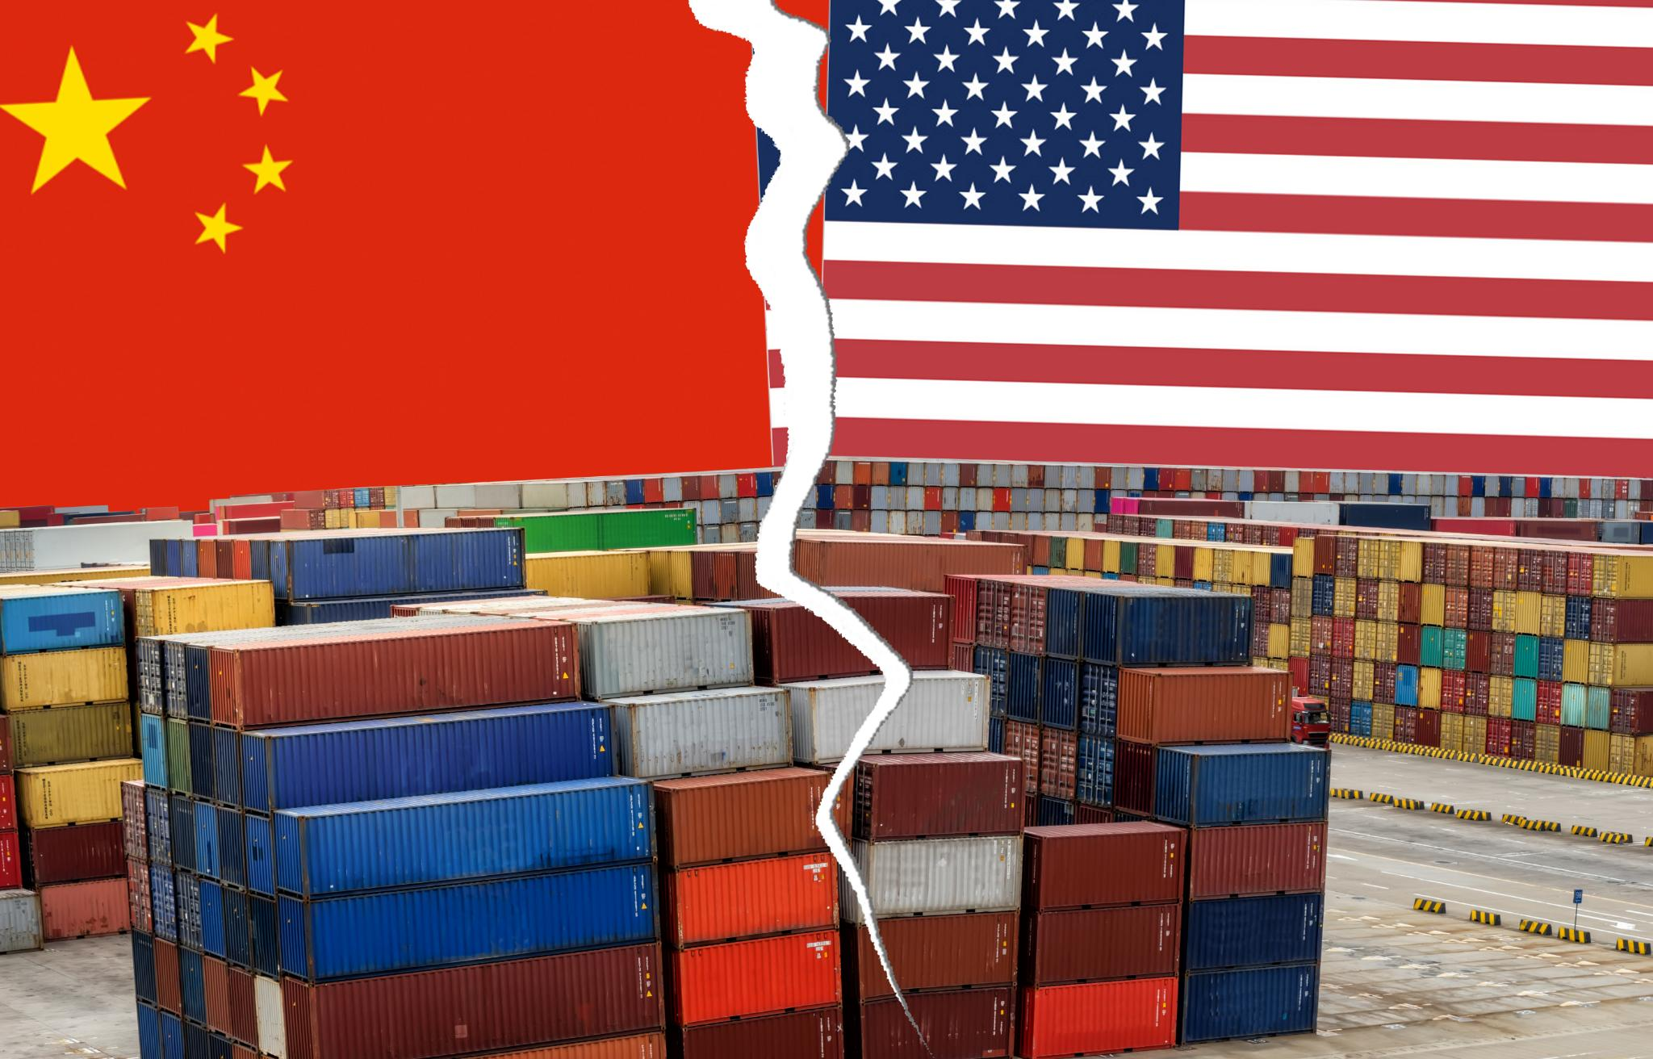
Focus on Key Issues
Role of NCBFAA PAC
The NCBFAA PAC plays a crucial role in addressing key issues for customs brokers and freight forwarders.
Targeting Candidates
The PAC focuses on candidates who have the potential to impact customs and freight forwarding positively.
Industry Advocacy
The NCBFAA PAC advocates for the interests of the customs brokerage and freight forwarding industry in Congress.
Notes:
How does the NCBFAA PAC work?
The NCBFAA PAC concentrates on those issues that have become vitally important to customs brokers and freight forwarders and targets those candidates who make a difference in these areas. The NCBFAA PAC Committee selects only candidates who meet our standards in voicing the interest of the industry in Congress and who serve the nation well in high public office.

Slide 11
Contributor Guidelines

Slide 12
Suggesting Candidates
Encouraging Suggestions
Contributors are encouraged to suggest candidates for support by the NCBFAA PAC at any time.
Who Can Recommend?
Any member or contributor can recommend candidates to the NCBFAA PAC Committee and Board of Directors.
Contribution Restrictions
Federal law prohibits corporations from contributing to political action committees like NCBFAA PAC.
Notes:
Can contributors suggest candidates they feel the NCBFAA PAC should support?
Any contributor is encouraged to make recommendations at any time to any member of the NCBFAA PAC Committee, the NCBFAA officers and Board of Directors, or staff
Can my company contribute?
No! Federal law prohibits contributions from incorporated entities.

Slide 13
Recommended Contributions
Personal Donations
Contributions are personal, and each individual can decide the amount they are comfortable donating.
Flexible Amounts
Donors are encouraged to give any amount that feels appropriate for them, fostering a personal connection.
Annual Contribution Limit
The maximum annual contribution each individual can make is capped at $5,000.
Notes:
What's the recommended contribution?
Whatever you feel appropriate. As a reminder this is a personal donation, so whatever amount you feel comfortable donating personally. The maximum contribution annually from each individual is $5,000.

Slide 14
Timing of Contributions
Any Time Contributions
Contributions to the NCBFAA PAC can be made at any time throughout the year, not just during election cycles.
Election Cycle Considerations
While contributions can be made anytime, aligning with election cycles can enhance visibility and impact.
Notes:
When is the best time to give to the NCBFAA PAC?
The NCBFAA PAC accepts contributions at any time, even when elections are not immediately pending.

Slide 15
Conclusion
Advocacy Role
The NCBFAA PAC serves as a vital tool for advocating industry interests in political matters affecting customs and freight.
Governance Structure
Understanding the governance of the NCBFAA PAC is crucial for members to navigate its operations and make impactful contributions.
Member Engagement
Members are encouraged to actively participate in shaping their political landscape through informed contributions and involvement.
Notes:
In conclusion, the NCBFAA PAC is a powerful tool for advocacy within the customs brokerage and freight forwarding industries. By understanding its function, governance, operations, and contribution guidelines, members can actively participate in shaping their political environment for the better.

Slide 16
For More Information
Please reach out to Jenette Prince for ways to get involved or to contribute.
Jenette.prince@kuehne-nagel.com

