Slide 1




Mexico/Canada/United States –
Regional trade uncertainty and the role of the Brokerage Community
Panelists:
Moderator:
Kim Campbell
Director, Canadian International Freight Forwarders Association, Inc. (CIFFA)
Federico "Kiko" Zuniga
NCBFAA NACBA Representative; Business Development Director, NCBFAA Educational Institute
Rene Vidal Rodriguez
Confederación de Asociaciones de Agentes Aduanales
de la República Mexicana (CAAAREEM)
Adrienne Braumiller
CEO, Braumiller Consulting Group, LLC

Slide 2

USMCA - Regional Trade Uncertainty and the Role of the Brokerage Community:
Latest Developments & Future Implications
NCBFAA 2025
Braumiller Law Group, PLLC
Adrienne Braumiller
April 4, 2025
Notes:
Adrienne – update date

Slide 3
Introduction
Overview of Regional Uncertainty
  Trade disputes and tariff escalations affecting North America
  Impact of new tariffs on supply chains
  Upcoming USMCA review in 2026 and potential renegotiations
• Role of Licensed Customs Brokers:
  Ensuring trade compliance amid shifting regulations.
  Minimizing risks for importers/exporters in a volatile trade environment.
  Providing strategic guidance on duty exemptions and tariff classifications.

Slide 4
Key Factors Contributing to Regional Uncertainty
Trade Retaliation & Tariff Adjustments
  IEEPA and Reciprocal tariffs imposed by the U.S.
  Canadian & Mexican responses to U.S. trade policies
Section 232 Auto Tariffs
Section 232 on Steel and Aluminum and Derivatives
  No FTA exemption available
Upcoming 2026 USMCA Review
  Potential renegotiations based on trade developments
  Economic impact on North American industries

Slide 5
Latest Status of USMCA
USMCA-compliant goods currently exempt from IEEPA 25% tariffs
Non-USMCA goods may be subject to 12% IEEPA tariffs upon suspension of border tariffs
25% Sec. 232 tariff on automobiles and auto parts
  April 3, 2025 – Tariffs on passenger vehicles and light trucks
  May 3, 2025 – Tariffs on automobile parts
USMCA-compliant vehicles may qualify for partial tariff exemptions (US content)
USMCA auto parts remain tariff-free until a process is established

Slide 6
Role of Licensed Customs Brokers in Trade Compliance
Navigating USMCA Rules of Origin
  Ensuring products qualify for preferential duty treatment.
  Verifying supplier records to prevent misclassification penalties.
Adapting to Section 232 & Reciprocal Tariffs
  Helping businesses understand how new tariffs impact pricing and duty calculations
  Processing exemptions for qualifying products
Streamlining Cross-Border Trade
  Preventing delays at customs by ensuring accurate documentation
  Reducing compliance risks amid policy changes

Slide 7
Impact of Tariffs on Supply Chains
Disruptions in Raw Material Sourcing
  Increased costs for non-USMCA imports
Shifting Manufacturing Strategies
  Companies adjusting operations to avoid tariffs
• Customs Brokers Helping Businesses Adapt
  Providing alternative sourcing strategies
  Ensuring businesses meet USMCA eligibility to avoid duties

Slide 8
2026 USMCA Review & Customs Broker Preparation
Expected changes in trade agreements based on reciprocal tariffs
Customs brokers assisting businesses in preparing for policy shifts
Compliance strategies to mitigate risks ahead of renegotiations

Slide 9
Potential U.S. Retaliatory Tariffs
Highest tariffs on China (34%), Vietnam (46%), Cambodia (49%)
Countries considering retaliation:
  Canada: 25% tariffs on U.S. vehicles
  Brazil: Reviewing new import restrictions
  European Union: Evaluating 20% reciprocal tariffs
  China: Expected countermeasures on U.S. exports
U.S. response:
  Doubling existing tariff rates for retaliating nations
  Sector-specific tariffs targeting autos, steel, and technology
  Trade agreement suspensions for non-compliant nations

Slide 10
Implications for Businesses & Trade
Short-term effects: Increased costs for non-USMCA imports
Long-term effects: Possible renegotiation of USMCA terms
Recommendations for businesses:
  Ensure USMCA compliance to avoid tariffs
  Monitor policy changes ahead of the 2026 meeting
  Adjust supply chains to mitigate tariff impacts

Slide 11
Future Outlook & Recommendations
Strategic Role of Customs Brokers in Shaping Trade Policies
  Advising policymakers: Brokers provide industry feedback on regulations & enforcement
  Educating businesses: Helping firms understand compliance changes in USMCA renegotiations
  Streamlining imports/exports: Customs brokers ensure smooth trade despite policy shifts
Key Takeaways & Next Steps for Compliance Planning
  Monitor reciprocal tariff updates: Businesses must watch for retaliatory measures from trade partners
  Prepare for the 2026 USMCA review: Brokers assist in anticipating rule changes & ensuring compliance
  Adopt technology-driven customs solutions: AI and automation can improve classification accuracy & reduce processing times

Slide 12

Adrienne Braumiller,
Partner
Adrienne@braumillerlaw.com

Slide 13


"Mexico Facing the Challenges of the United States’ 'Liberation Day'"

Slide 14

83% of Mexican exports were destined for the United States.
Since 2023, Mexico has been the United States' top trading partner.
These figures demonstrate the strong economic interdependence between the two countries.

Slide 15

"Effects of 'Liberation Day'"
The recent imposition of tariffs by U.S. President Donald Trump on more than one hundred countries has sparked a wave of uncertainty in international trade, directly and indirectly affecting Mexico.
Although both Mexico and Canada were spared from additional tariffs under the USMCA, “Liberation Day” has led global companies to reassess their production and supply chain strategies.
Goods that do not meet the USMCA rules of origin will continue to face the previously established Trump tariffs (25% on products outside the agreement and 10% on certain strategic sectors such as energy), in addition to a 25% surcharge on automobiles.

Slide 16

The Mexican industry, especially the maquiladora sector, heavily depends on imported inputs from various countries to assemble products destined for the U.S. market.
This means that industries using components imported from countries outside the USMCA may face additional tariffs if those products do not meet the agreement’s rules of origin.
For example, if a maquiladora imports parts from China or Europe that do not comply with the rules of origin, the final products could be subject to these tariffs upon entering the United States.
This also puts at risk the policy based on nearshoring — investments by companies seeking to be close to the U.S. market to benefit from the USMCA, as well as Mexico’s geographic location and labor advantages.

Slide 17
The cost of tariffs is typically absorbed initially by importing companies in the United States, which will pass it on to end consumers in the form of higher prices. This means that, ultimately, it is American consumers who will bear the cost of these tariffs.
At the same time, exporters—although they will not pay the tariffs directly—are likely to lose market share, as the barrier may prompt U.S. importers to seek alternative suppliers.

Slide 18

The uncertainty generated by these tariff policies has put some investments on hold and led companies to reassess their supply chains.
If we manage to preserve the conditions of the USMCA in this new era of global trade that began on April 2, Mexico will have an opportunity to attract investment and strengthen its local industry.

Slide 19

"Three Recommendations for Companies"
It is extremely important for companies to review their supply chain, that is, to analyze the origin of their inputs and evaluate whether they comply with the USMCA rules of origin in order to avoid additional tariffs.

Slide 20

It is necessary for them to seek suppliers within the USMCA region as a strategy to minimize the impact of tariffs and ensure compliance with the rules of origin.

Slide 21

They should seek specialized advice by consulting their Customs Broker or CAAAREM, as it is advisable for companies to consult with international trade experts—such as Customs Brokers like us— to understand the specific implications and adapt their operations accordingly.

Slide 22
The imposition of tariffs by the United States has created a series of challenges for Mexico and its export industry.
While the USMCA offers certain protections and advantages, it is essential for Mexico and its companies to adapt their strategies to remain competitive in this new environment.
The key will be to diversify markets, strengthen local industry, and seek political solutions to minimize the impact of imposed tariff barriers.

Slide 23




I AM CANADIAN

Slide 24

Goods Friends Tell Each
Other the Truth
Stage 1 : Ha Ha
Stage 2 : That is very nice of you to think about us but no we are…good.
Stage 3 : Elbows…Up !

Slide 25
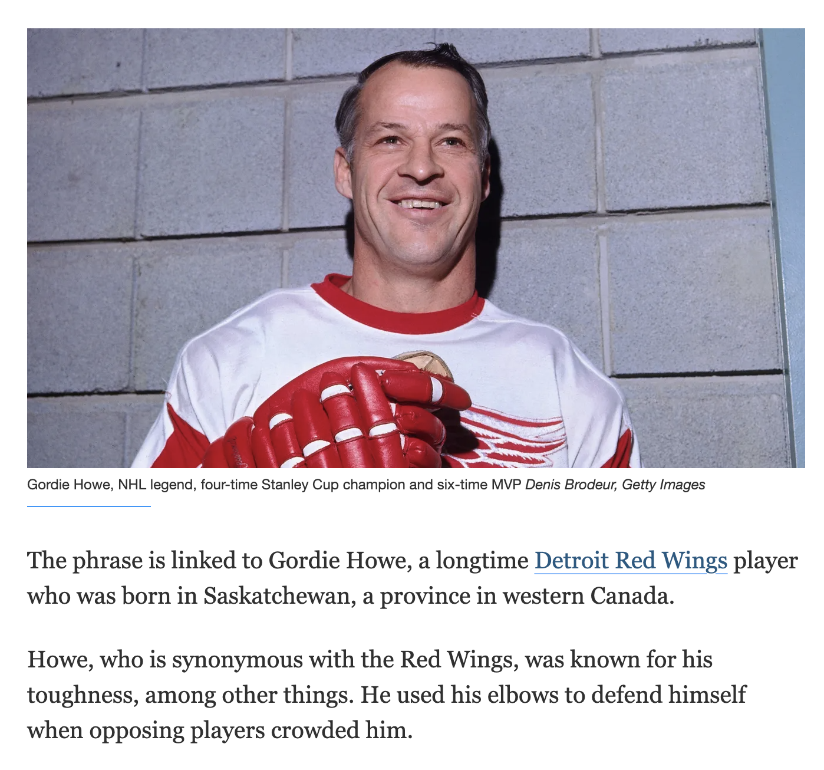
ELBOWS UP 🍁 What it means to be Canadian
According to a Reuters report, Canadian Tire has ramped up efforts to reduce reliance on US suppliers, bracing for possible long-term tariff impacts. Similarly, other retailers are strategizing ways to mitigate disruptions in supply chains.
Buying Canadian is a matter of pride for shoppers. For major grocery chains, it's an opportunity
New ads from businesses are walking the fine line between Canadian pride and snubbing the U.S.
New survey says national pride has skyrocketed

Slide 26
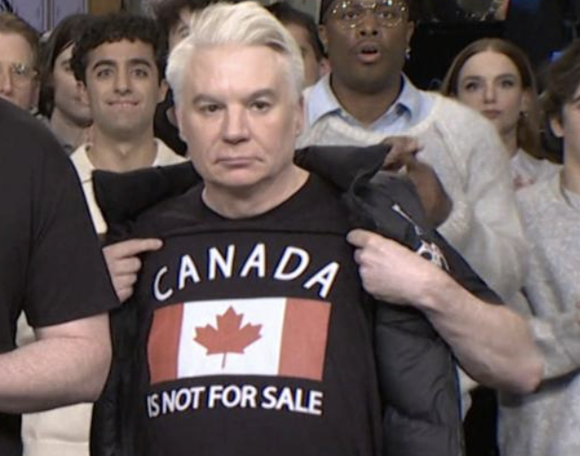

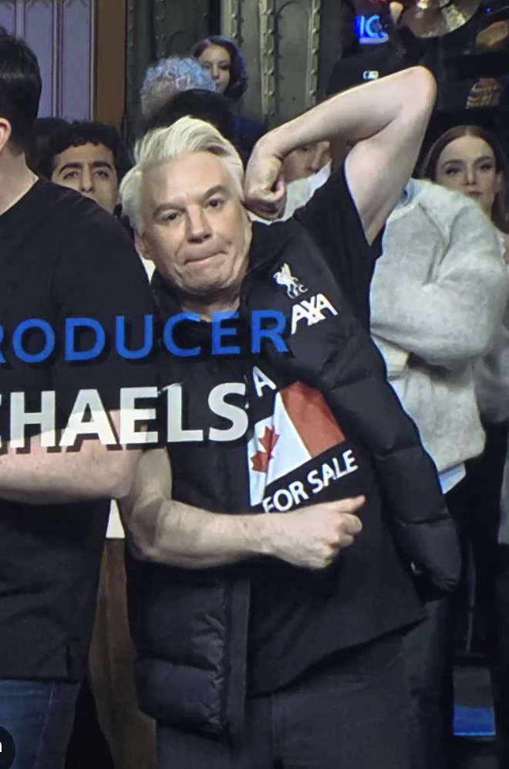
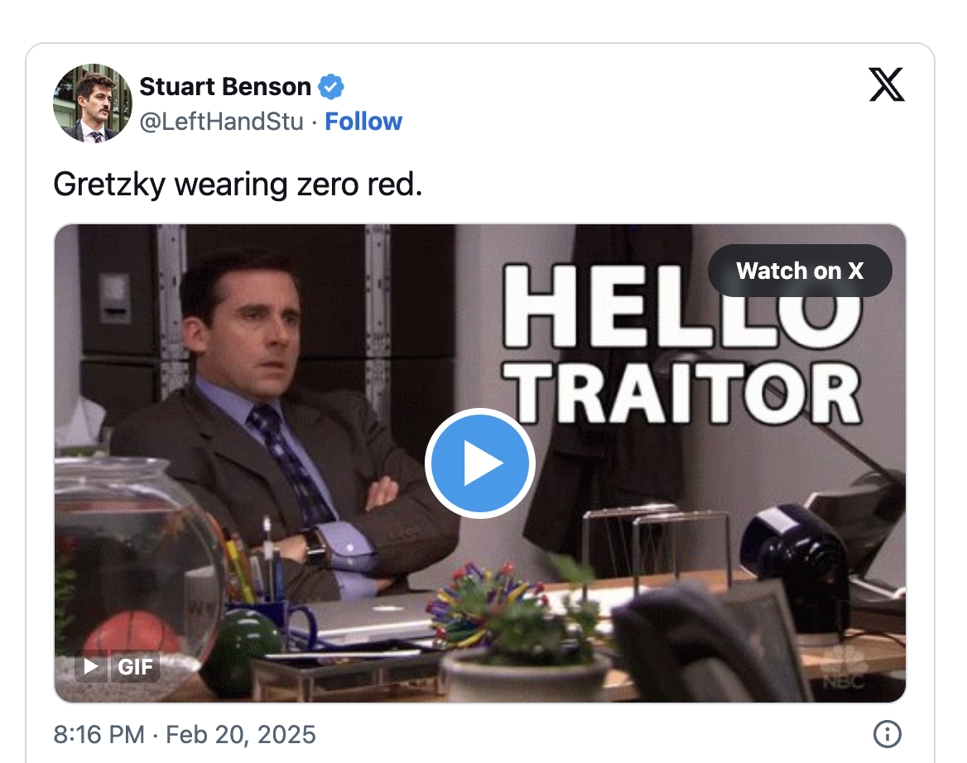



Canada’s # 1 Wayne

Slide 27
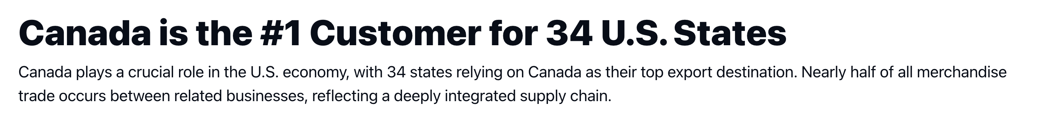
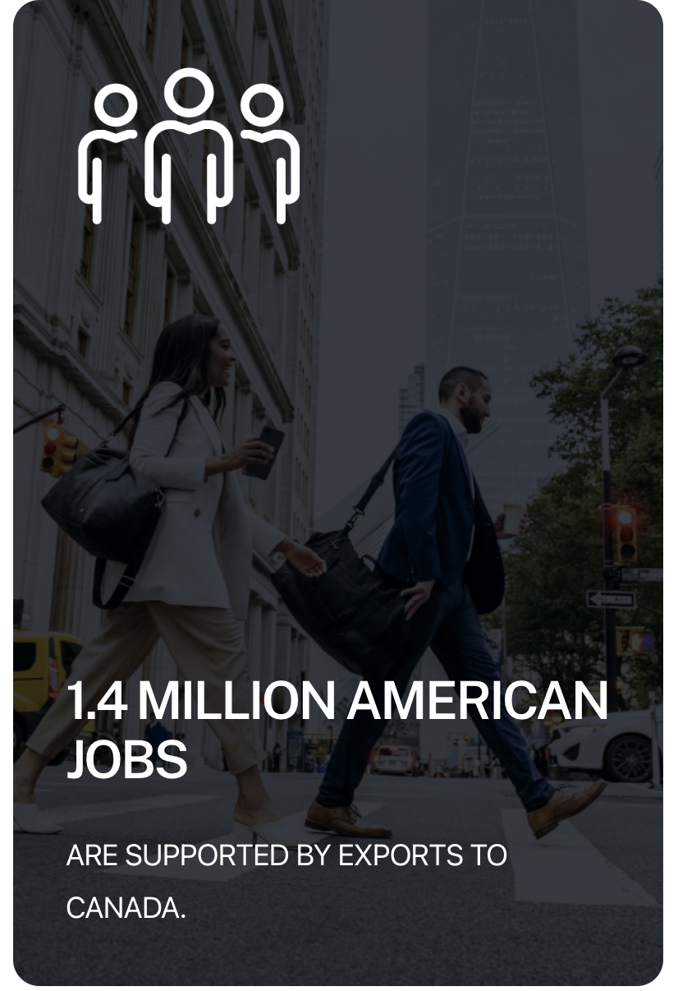
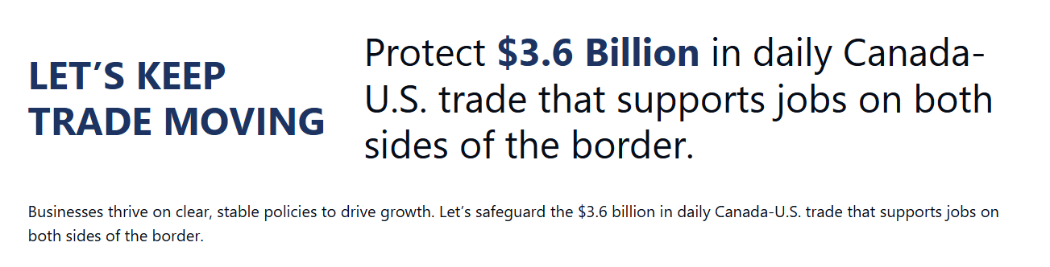
When You Attack Your Largest Customer – Stuff Happens…
https://businessdatalab.ca/canada-u-s-trade-tracker/

Slide 28
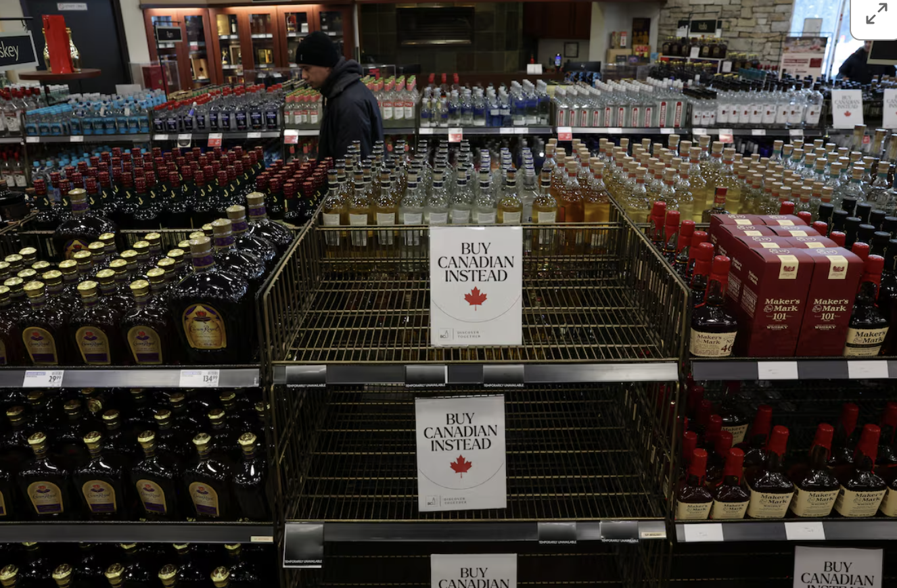

Not Just an Empty Shelf
Kentucky Distillers' Association President Eric Gregory noted that bourbon distilling is a $9 billion industry in the state and supports more than 23,000 jobs across the distilleries, tourism, hospitality, and other industries in the commonwealth, which is home to 95% of the world's bourbon. This latest action by Canada in response to the U.S. stands to impact these jobs, with Gregory stating it's the "corn farmers, truckers, distillery workers, barrel makers, bartenders, servers, and the communities and businesses" that will face loss.
Major bourbon distillers in Kentucky such as Brown-Forman, which, as one of the leading exporters of U.S. spirits globally, has 55% of its net sales coming from outside the U.S., stand to feel a substantial impact from the tariffs.

Slide 29
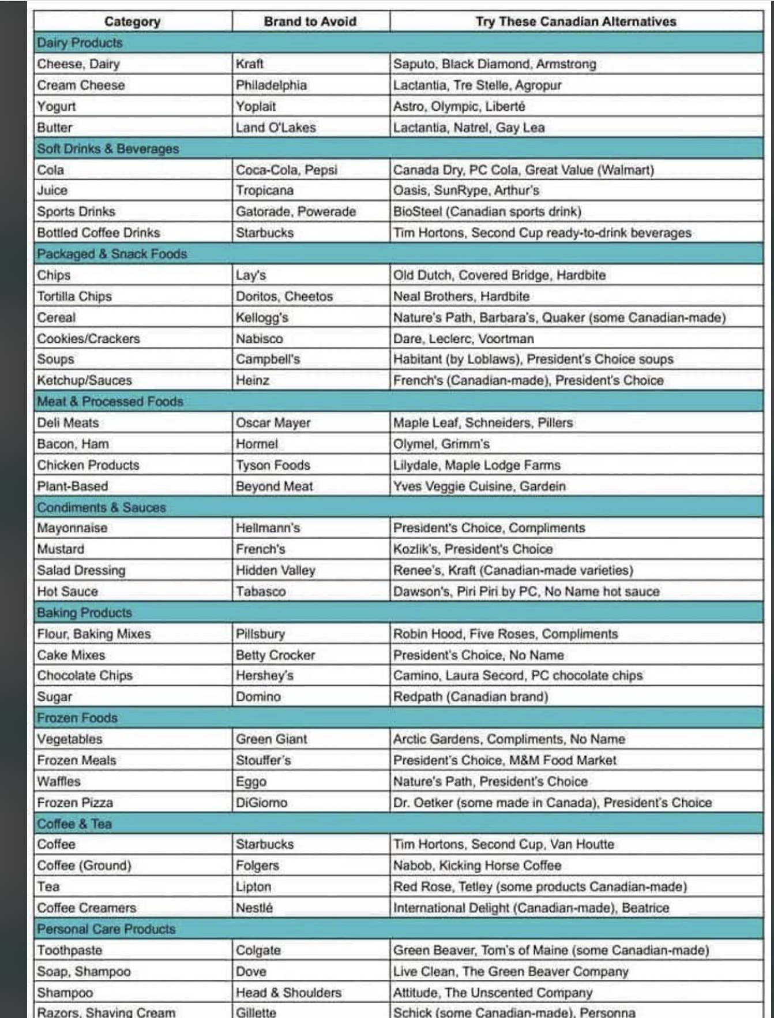
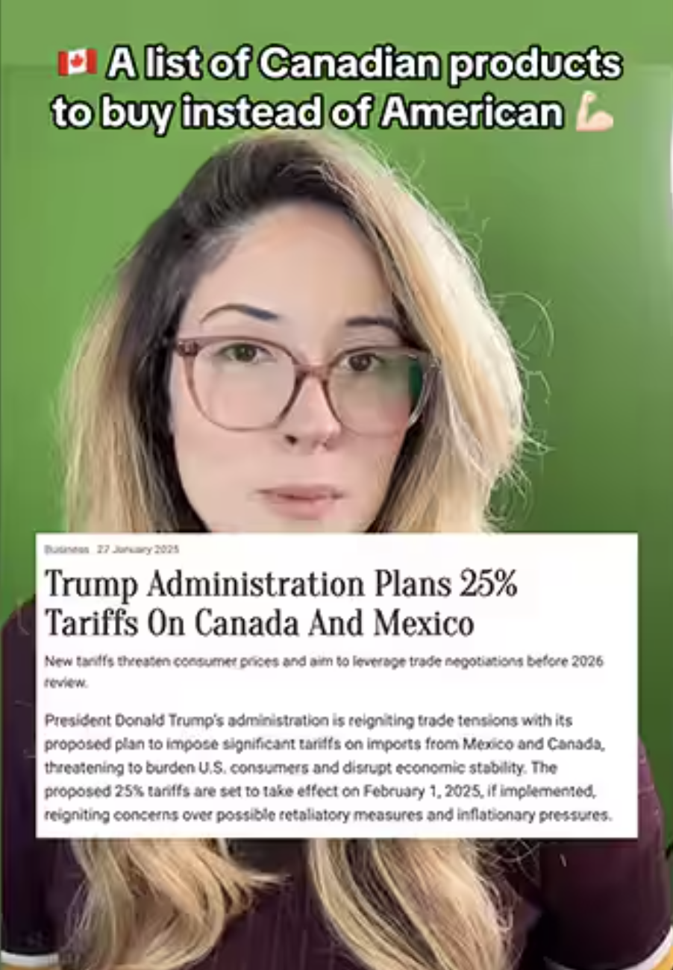


Buy Canadian movement starts to take a sizable bite out of U.S. business

Slide 30

Tourism
Cross-border trips to the U.S. reach COVID lows with nearly 500,000 fewer travellers in February
More Canadians avoid setting foot in the U.S., 'without even a connection or layover'
Boycotts over Trump’s trade war have dented cross-border traffic and pushed tourism boards to retool ad campaigns as Canadian travelers shift their vacation plans to Mexico and elsewhere.
Canadian Road Trippers Boycotting U.S. Could Mean A $4 Billion Economic Loss The U.S. Travel Association (USTA) warned last month that even a 10% reduction in
Canadian inbound travel could translate to $2.1 billion in lost spending and 140,000 jobs jeopardized in the hospitality and related sectors.
Canadian Snowbirds Are Canceling Their Florida Trips and Offloading Properties Amid Tariff War

Slide 31

Fake News/Help President Trump as We Know He is Super Busy Making America Great Again
U.S. border officials have caught more people with eggs than fentanyl this year
Trump complains about Canada — but new data shows spike in U.S. drugs and guns coming north
Quantity of drugs seized by Canadian officials at U.S. border has doubled in 2 years

Slide 32


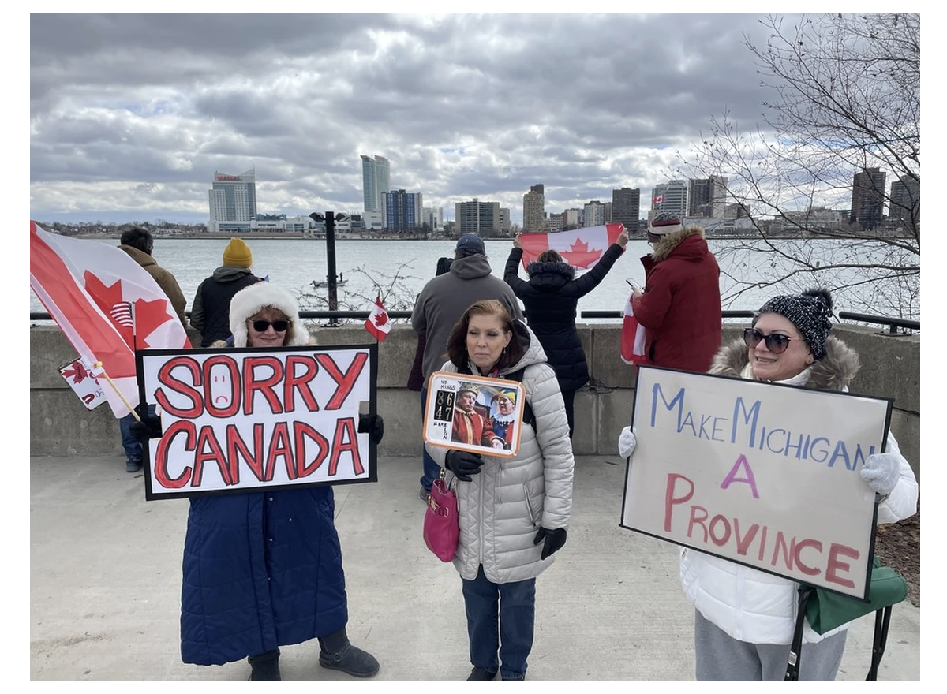
We Appreciate You!!!
The Americans who are buying Canadian to oppose Trump’s trade war
Majority of Americans are strongly opposed to Canada joining the U.S., new poll says

Slide 33

Next Stop…Italy 2026

Slide 34
Thank You!

