Slide 1




U.S. Fish & Wildlife Service
Panelists:
Moderator:
Jeff Moore
Senior Wildlife Inspector, U.S. Fish & Wildlife Service
Mike Lahar
NCBFAA Regulatory Agencies Committee (RAC) Chair; Manager Regulatory Affairs, A.N. Deringer, Inc.
René Galindo
Supervisory Wildlife Inspector, U.S. Fish & Wildlife Service

Slide 2

U.S. Fish & Wildlife Updates
2025 NCBFAA
Annual Conference
FWS Supervisory Wildlife Inspector Rene Galindo
FWS Senior Wildlife Inspector Jeffery Moore

Slide 3

FWS ACE Mandatory filing date
Currently in an Extended Pilot Phase
  CERT and PROD environments are Open to all ACE Filers at all FWS authorized ports
  FWS HTS Flags enforced with a “warning” severity
Mandatory date is dependent on rulemaking (50 CFR 14)
Tentative Mandatory Date: end of 2025
  Filers using ACE must enter FWS data (or disclaim)
  Filers will always have the option to file via eDecs

Slide 4
Status of FWS ACE Filings
Over 112,000 ACE import entries processed
30% filings via ACE
Filing breakdown
  50% EDS
  50% LDS

Slide 7
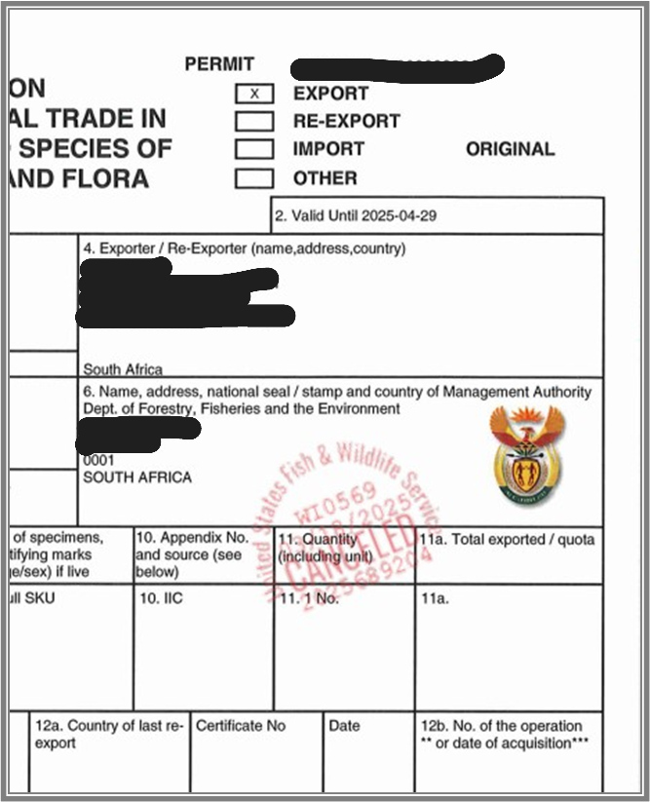
Electronically Cancelled CITES permits
In eDecs, filers have the option to separately upload validated CITES permits.
A CITES permit with a ‘cancelled’ stamp will be avialable via the eDec in the filer’s account.
A request has been submitted to CBP to make this option available to ACE filers.
Public bulletin found at: https://www.fws.gov/library/collections/ole-public-bulletins

Slide 8
Login.gov
DOI security mandate to transition to Login.gov for eDecs and eLicense
Login.gov and the current login method for eDecs will both be available until June 1, 2025
After June 1st, all filers must use Login.gov to sign in to eDecs
eLicense Login.gov implementation will follow
Public bulletin with specific guidance will be found at: https://www.fws.gov/library/collections/ole-public-bulletins

Slide 9
What’s coming...
Electronic applications for Designated Port Exception Permits (DPEPs)
Updates to Declaration Form 3-177
  DPEP number
  Container number
  Other U.S. permit number
  Tag numbers for certain hunted species
Feature to save a 'draft' eDec without submitting

Slide 10
FWS Resources
FWS ACE Help Desk fwsole_ace_support@fws.gov
FWS web site https://fws.gov/service/importing-and-exporting
FWS Office of Law Enforcement https://www.fws.gov/program/office-of-law-enforcement/information-importers-exporters
Electronic Declarations (edecs) where you can submit Declarations online: https://edecs.fws.gov/
Electronic Import/Export License (eLicense) used to request a new commercial import/export license or renew/amend an existing license: https://www.fws.gov/elicense/
Electronic Permits (epermits) used to apply for protected species permits such as CITES, Migratory Bird or Endangerd Species Permits: https://fwsepermits.servicenowservices.com/fws/
Filing Tips: ACE Tips for Trade when Filing U.S. Fish and Wildlife Service Data | U.S. Customs and Border Protection (cbp.gov)

