Slide 1
“Under Pressure” - Trade Remedy Tariffs and Bond Sufficiency
Panelists:
Moderator:
Colleen Clarke
Senior Vice President, Surety & Trade Relations, Roanoke Insurance Group Inc.
Patrice Lafayette
Regional Vice President, Roanoke Insurance Group Inc.
Sandy Langford-Coty
NCBFAA Customs Committee Chair; Director of Operational Development, A.N. Deringer, Inc.

Slide 2
“Under Pressure” Trade Remedy Tariffs & Bond Sufficiency
April 9, 2025
11:30am-12:00pm

Slide 3
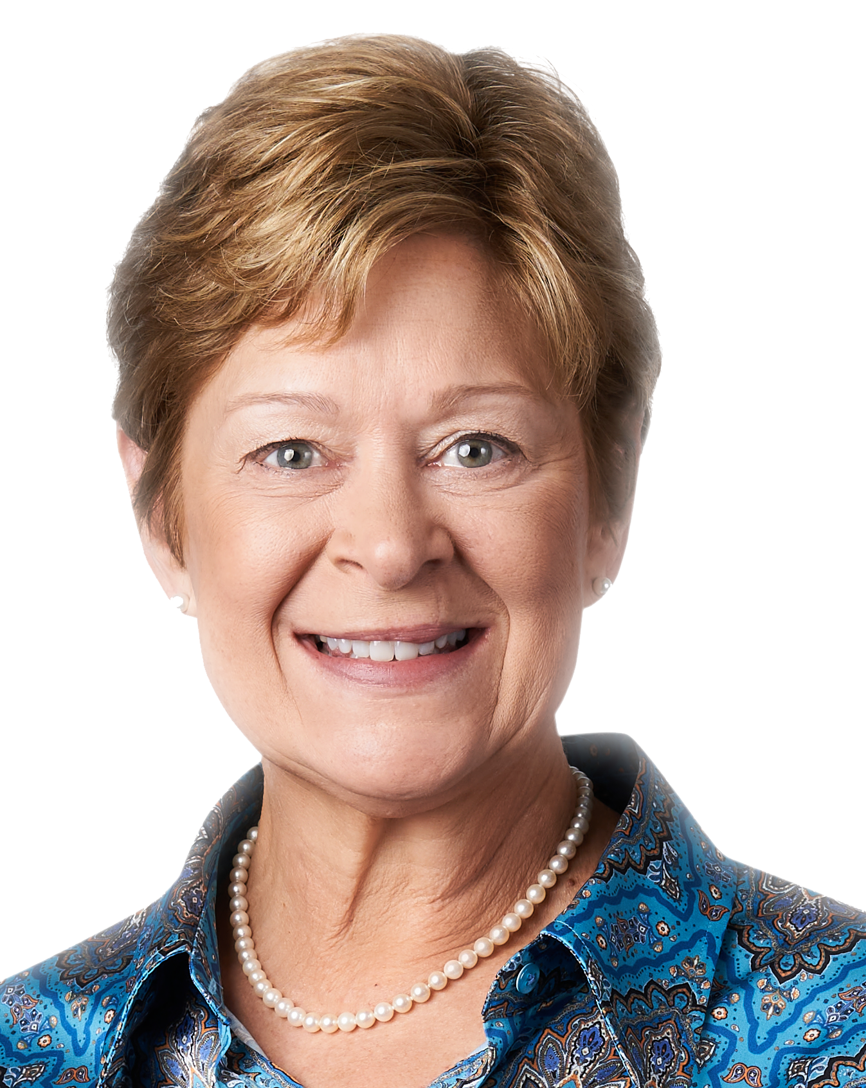
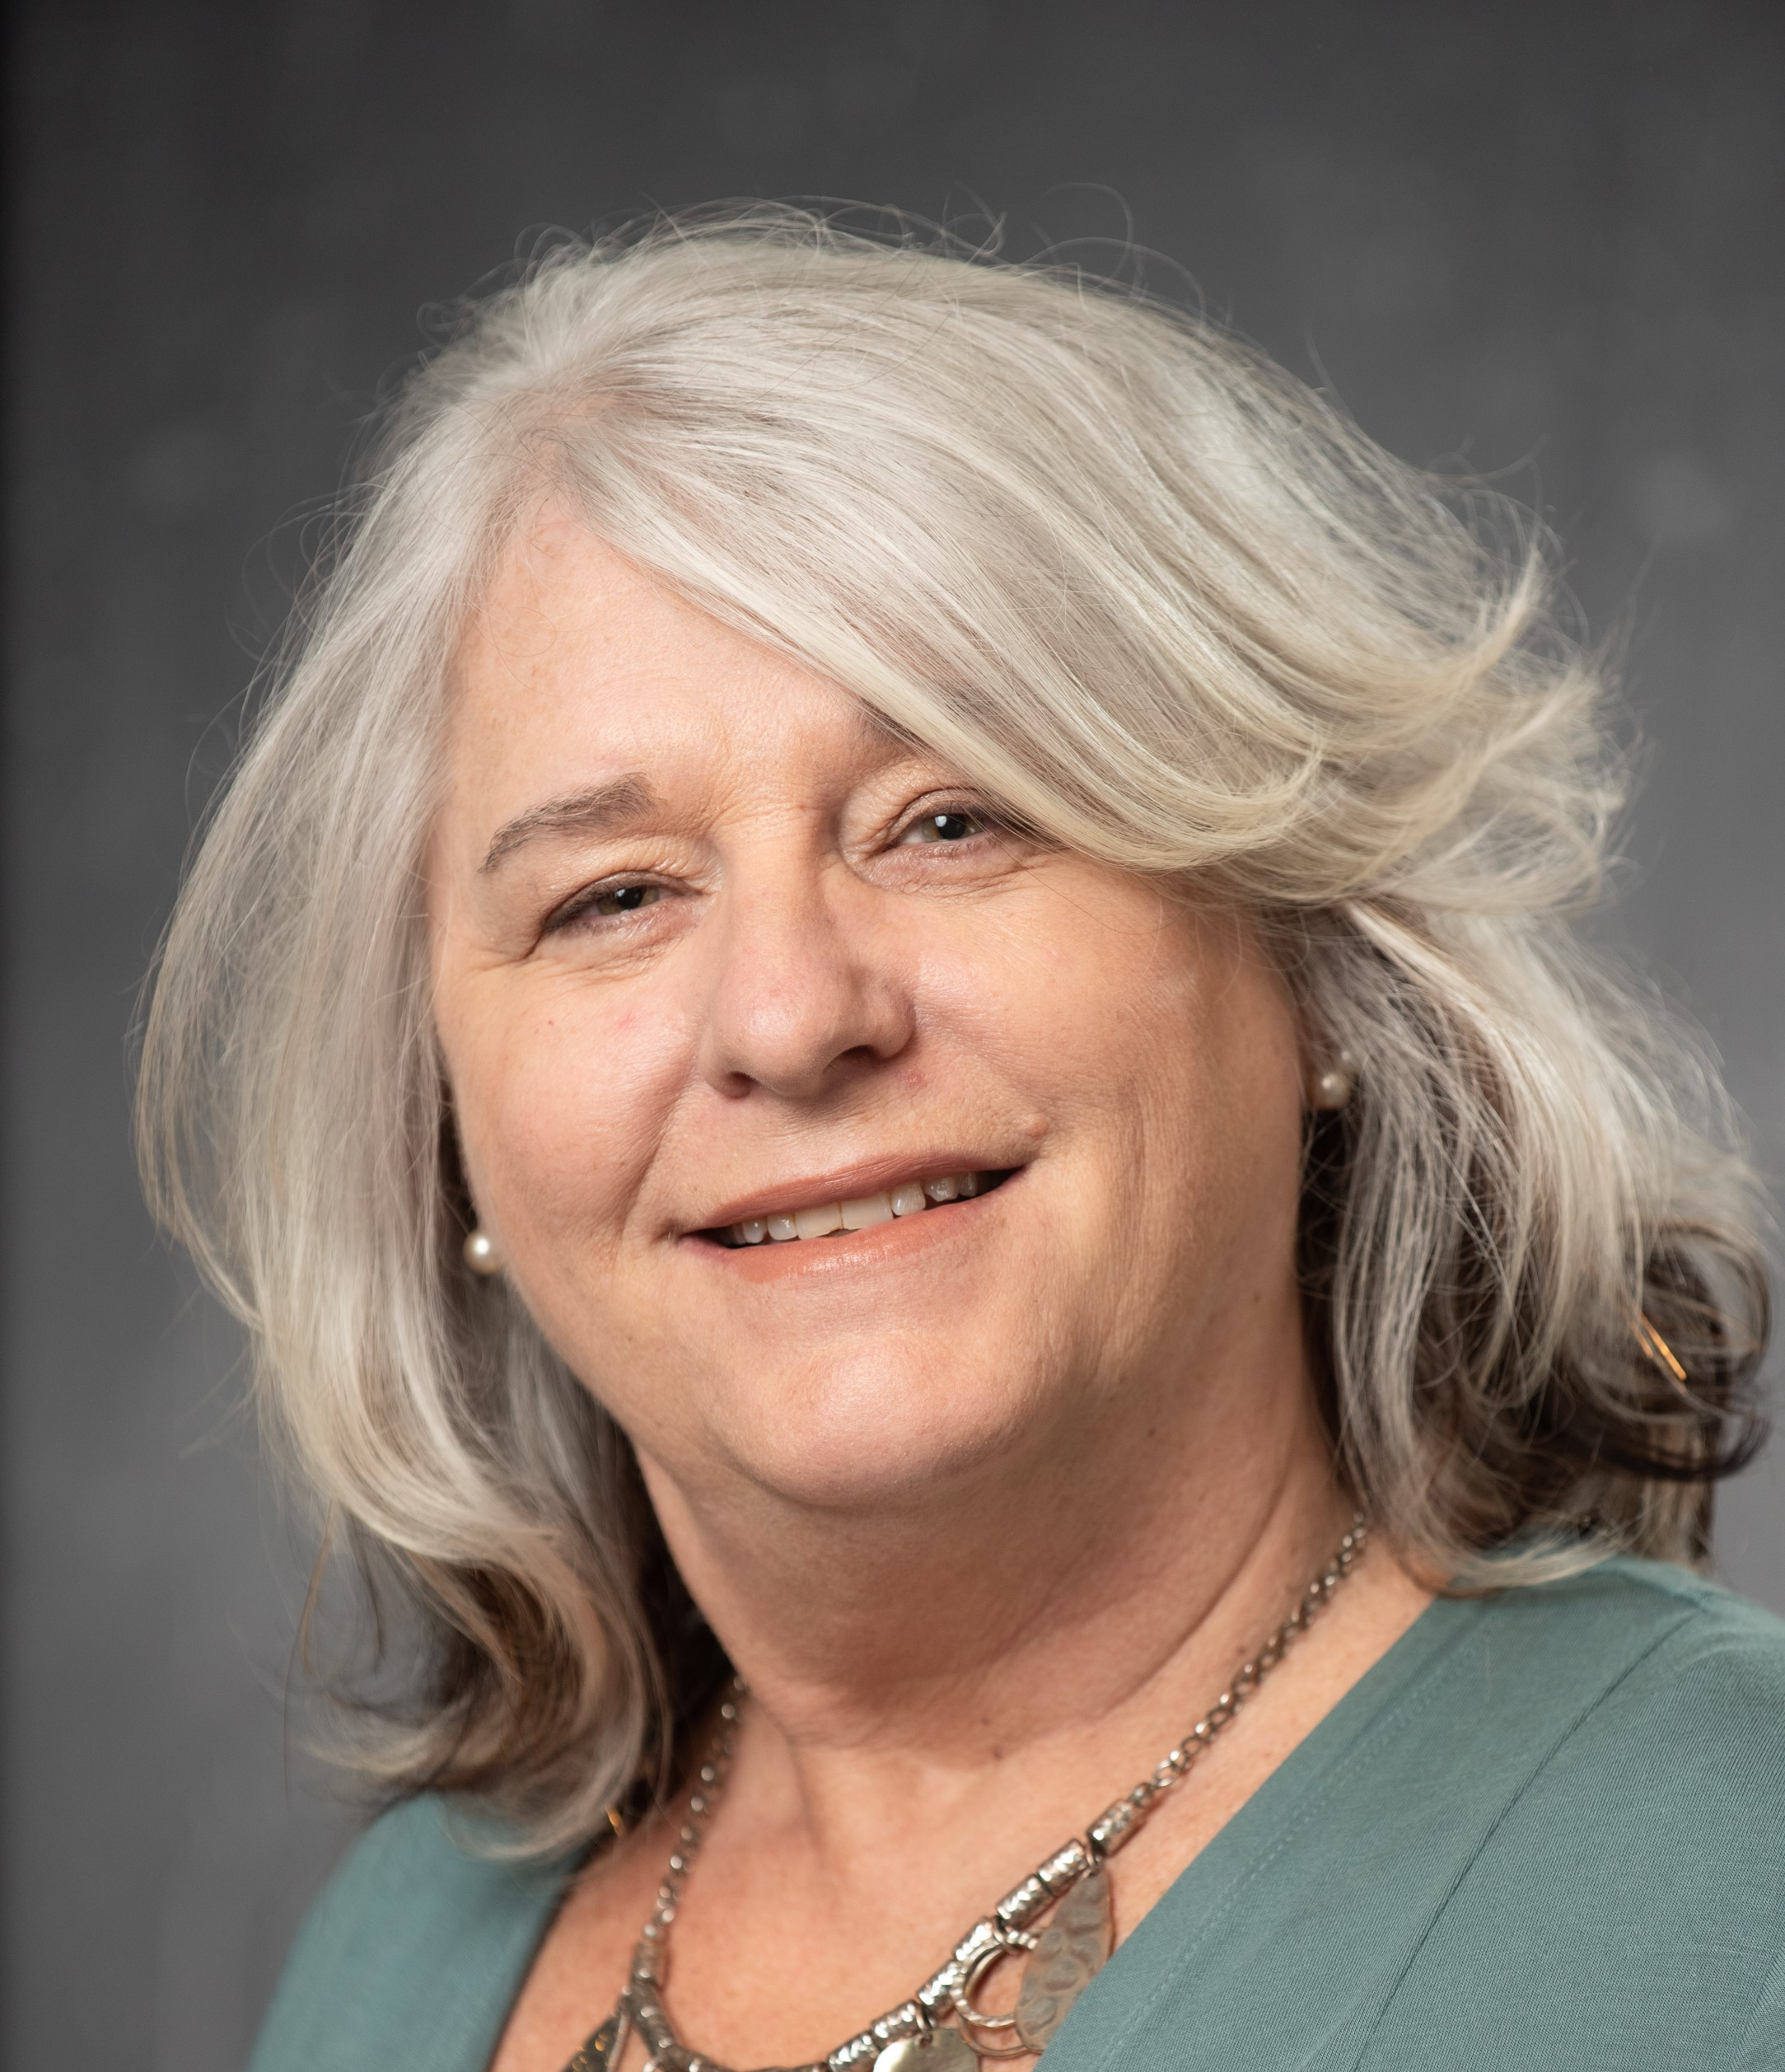
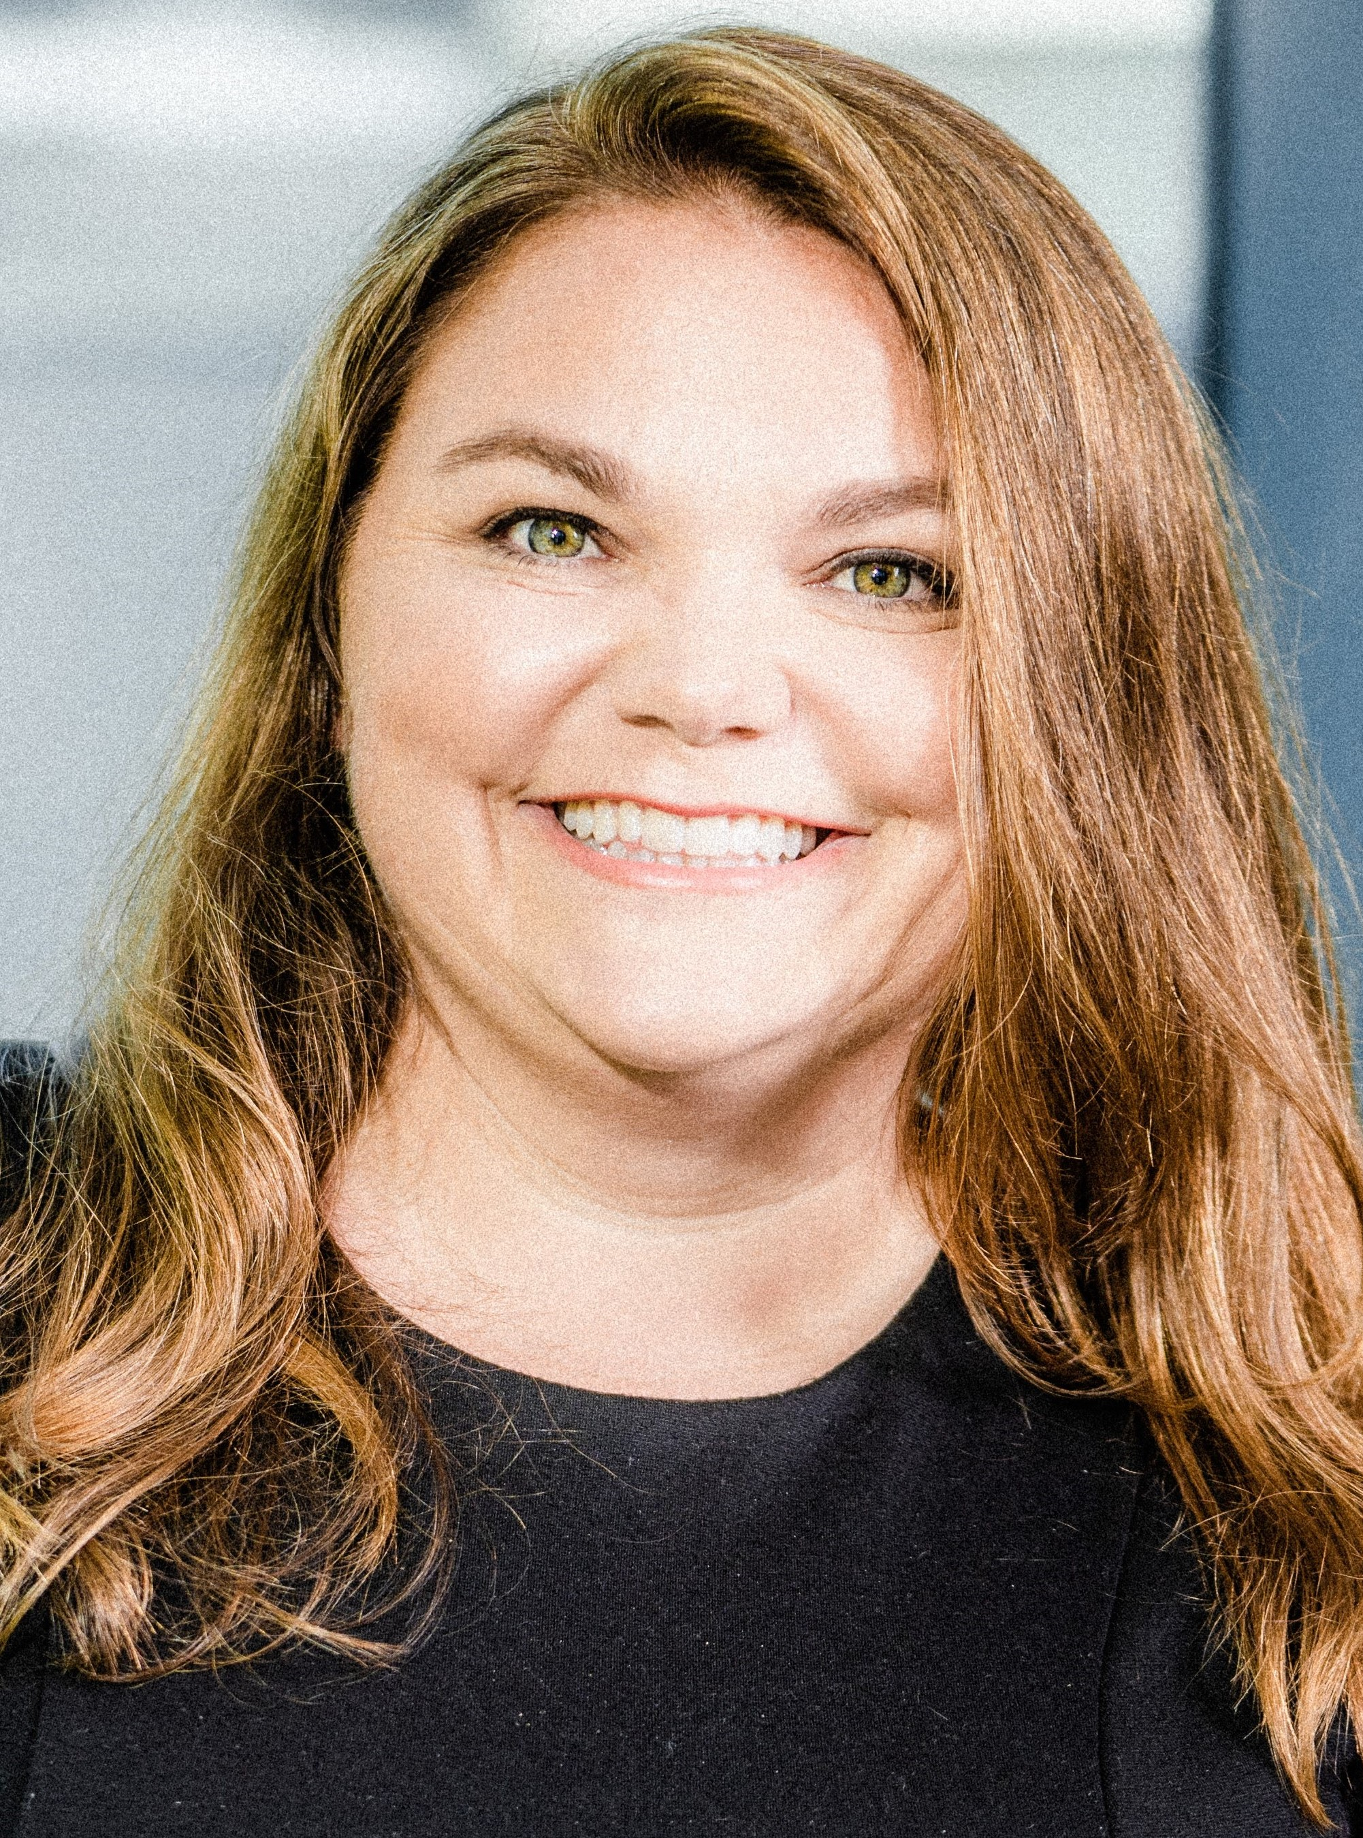
Presenters
Colleen Clarke
Senior Vice President
Roanoke Insurance Group, Inc.
Sandy Coty
Director
A.N Deringer, Inc.
Patrice Lafayette
Regional Vice President
Roanoke Insurance Group Inc.
Notes:
Patrice

Slide 4
Today’s Topics
CBP Bond Statistics
& Potential Bond Amounts
CBP Bond Insufficiency Process
Best Practices
Underwriting
Notes:
Patrice

Slide 5
CBP Bond Statistics

Slide 6
Continuous Import Bond Count – December 31, 2024
BOND AMOUNT RANGE | LIABILITY AMOUNT | BOND COUNT | % OF TOTAL
LE - 50,000 | $11,288,850,000 | 225,777 | 88.51%
50,001 TO 99,999 | $485,250,000 | 6,598 | 2.59%
100,000 TO 199,999 | $629,300,000 | 6,293 | 2.47%
200,000 TO 299,999 | $1,321,800,000 | 6,609 | 2.59%
300,000 TO 399,999 | $879,900,000 | 2,933 | 1.15%
400,000 TO 499,999 | $561,600,000 | 1,404 | 0.55%
500,000 TO 599,999 | $609,000,000 | 1,218 | 0.48%
600,000 TO 699,999 | $380,400,000 | 634 | 0.25%
700,000 TO 799,999 | $300,300,000 | 429 | 0.17%
800,000 TO 899,999 | $331,200,000 | 414 | 0.16%
900,000 TO 999,999 | $189,000,000 | 210 | 0.08%
1,000,000 TO 9,999,999 | $5,658,300,000 | 2,371 | 0.93%
10,000,000 TO 19,999,999 | $1,379,700,000 | 107 | 0.04%
20,000,000 TO 29,999,999 | $957,600,000 | 42 | 0.02%
GE 30,000,000 | $2,226,700,000 | 41 | 0.02%
TOTAL | $27,198,900,000 | 255,080 | 100.00%
Historically 95% at $50,000
Expect rise in these ranges
Source: CBP
Notes:
Colleen

Slide 7
Import Bond Sufficiency Best Practices

Slide 8
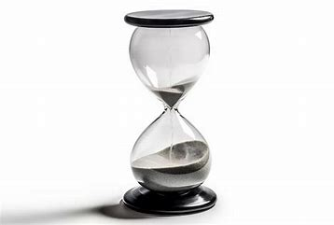
Best Practices
Review Current Bond Activity
Discuss and project the plans for the next 12 months
Review with your importers if they are currently filing de minimis entries
Are there any entries subject to ADD/CVD
Are there are other customs brokers involved
Review your issuing authority with your surety
Get ahead of underwriting on large bonds. Discuss the possibility of collateral and inform your importer on those requirements of your surety.
Consider the renewal date of the bond and potential stacking liability
Customs requires a minimum 15- day termination notice
Review Bond sufficiency and proper bond calculation
Don’t Wait! Use your resources
Notes:
Patrice

Slide 9
More Best Practices
More Best Practices
Run CBP Bond Query
If not BOR or only filer
To review effective date/termination date/sufficiency indicator
Stay Informed and Communicate Early
Knowledge is power! Open communication between the importer, customs broker, and surety is key
Actively monitor updates and use your resources
Discuss your importers supply chain plans
Discuss ACH accounts for duty payments for your importers
In the first round, increase in Debit Voucher claims
If extending credit, review if you want to continue doing so
Discuss with your importer how they will handle the increase in expenses
Notes:
Sandy & Patrice

Slide 10
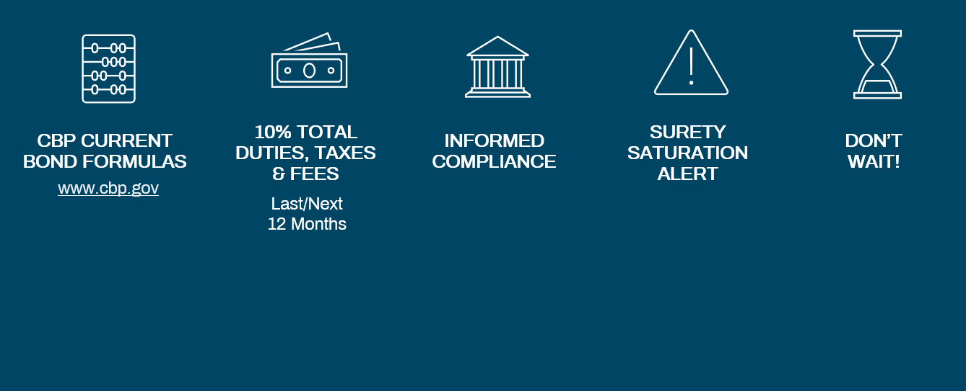
Managing Bond Sufficiency
Managing Bond Sufficiency
CBP Current Bond formulas
10% total duties, taxes & fees
Informed compliance
Surety Saturation alert
Don’t wait!
www.cbp.gov
Last/Next 12 Months
Notes:
Patrice

Slide 11
More Best Practices
Bond Amount Calculation - Analytical
More Best Practices
a
10% of total duties + taxes + fees paid in previous 12 months
+
b
10% of unpaid/not protested bills less than 210 days OR protested
+
c
$ for $ of delinquent & not paid bills greater than 210 days OR denied protest
+
d
$ for $ unpaid debit vouchers
Notes:
Sandy & Patrice

Slide 12
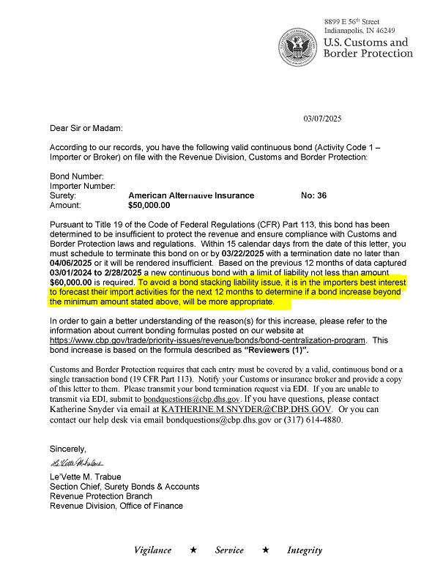
CBP Monthly Review
Total Duties, Taxes & Fees (DTF) paid or payable for last 12 months is compared to each bond amount.
If found to be insufficient, a letter is issued indicating the bond amount required.
CBP suggests forecasting the future 12 months of DTF payable
Importer must terminate within 15 days and replace the bond effective 30 days after the date of the letter.
If a bond is grossly insufficient, they can render it insufficient immediately.
Notes:
Colleen

Slide 13
Tips on Calculating Bond Amounts
Rule of Thumb
Project next 12 months of duties, taxes & fees
Do the Math
Account for special tariffs, timing of tariff changes, import volume, classification review, etc.
Over-Estimate
Consider higher bond amount; Risk of overestimating is less than underestimating
U.S. Customs Continuous Import Bond Calculator - Roanoke
Notes:
Sandy

Slide 14
Risk of Failing to Increase
No entries allowed
STBs required
Bond grossly insufficient? Immediate shut-off
Stacking / Aggregate Liability
Underwriting scrutiny
Demurrage
Storage
Additional Collateral? Additional Premium?
Notes:
Colleen

Slide 15
Concerns

Slide 16
Additional Considerations
The Bond is a Financial Guarantee
If importer defaults, surety is obligated to pay
Market Capacity
Surety Appetite for risk
Liquidation time frame and statute of limitations cause aggregate/stacking liability
Importers failing to pay duty
Impacts the broker’s loss ratio
Importers using multiple brokers
Impacts the BOR loss ratio if other brokers entries have losses
Run FastBond report of bonds where you are filing less than 100% of the entries
High Loss Ratios
Result in higher premium for the broker
Lose the ability to file bonds for that surety
Notes:
Colleen & Patrice

Slide 17
Bond Loss Trends
Notes:
Colleen

Slide 18
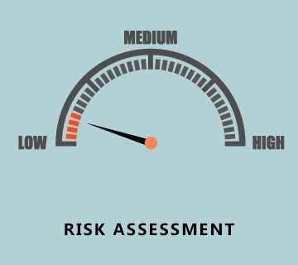
Underwriting Concerns
Bond Amount / Aggregate Liability
Credit Rating (S&P, D&B)
Commodity/Entry Type
Duty Rate
Liquidation History
Claims History
Red Flags
CBP Extensions
Late payments
Notes:
Patrice

Slide 19
Common Sense Approach
Sureties are in the business to write bonds, not decline!
Importer History is key
Bond Amount / Importer Informed Compliance
Duty rate
Claims activity
Number of years writing bond
Broker History is a factor
Loss ratio of the broker account
Subjective Review
Low risk vs financial condition
Notes:
Colleen

Slide 20
Questions?

