Slide 1
LCB Continuing Education
Cynthia Whittenburg
Executive Vice President, NCBFAA Educational Institute (NEI)

Slide 2
Continuing Education Priorities
Partner Accreditor for CBP’s Customs Brokers
Continuing Education Program
Licensed Customs Brokers
rad i
Cynthia F. Whittenburg NCBFAA Annual Conference
April 2025
www.ncbfaa.org/education

Slide 3
Continuing Education Priorities
Discussion Topics:
Why Now?
Who is Impacted?
Licensed Customs Broker Requirements
CBP Partner Accreditor Responsibilities
Educational Provider Responsibilities
CBP’s Responsibilities
Recordkeeping

Slide 4
Why Now?
CBP Licensed Customs Broker
Regulation more than 10 years in the making
Championed by LCBs themselves
Another step toward being recognized as a vital profession
Continued education has nexus to compliance

Slide 5
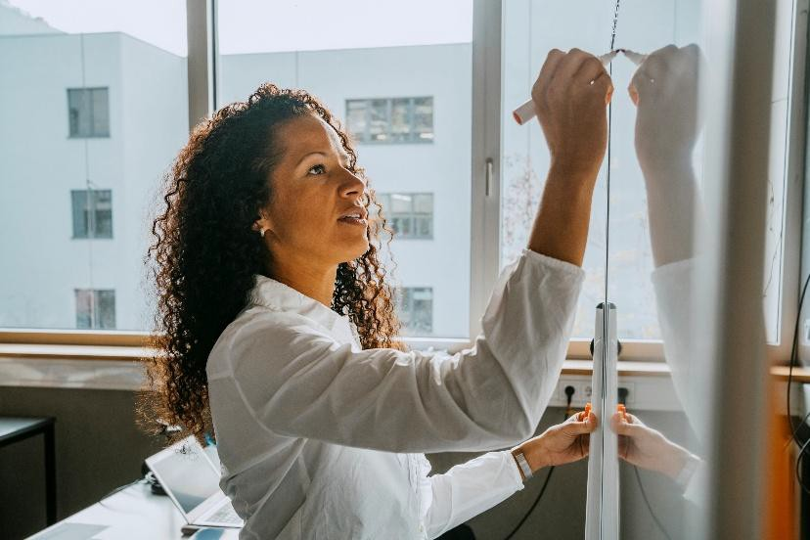
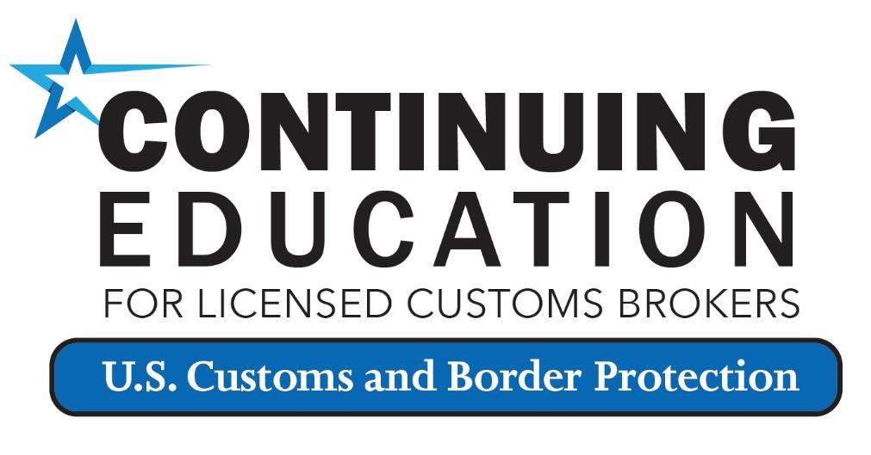
Who is Impacted?
Not just licensed customs brokers…
All International Trade Professionals
Trade Educational
Providers
Accreditors
of content

Slide 6
Licensed Customs Broker Requirements
…in order to maintain sufficient knowledge of customs and related laws, regulations, and procedures…and all other appropriate matters necessary to render valuable service to importers and drawback claimants.
LCBs must complete at least 36* CE credits of qualifying continuing broker education.
*The 2027 Triennial Status Report (TSR) will require only 20 CE
credits effective January 1, 2025
through January 31, 2027.
Exception:
LCB voluntarily suspends license; OR
LCB has not held license
for an entire triennial period.
…Must report and certify compliance with LCB continuing education (CE) requirement upon submitting the Triennial Status Report (TSR)
***Important to keep your email address up to date when submitting TSR.***

Slide 7
Licensed Customs Broker Requirements
Industry or trade-related conferences, seminars, webinars, and workshops (including recordings) led by an instructor, discussion leader, or speaker
Conferences, symposiums, or conventions
Online, self-administered courses (also known as asynchronous)
Company trainings (internally developed or offered by an outside vendor)
Port tours
Trade days sponsored by local associations

Slide 8
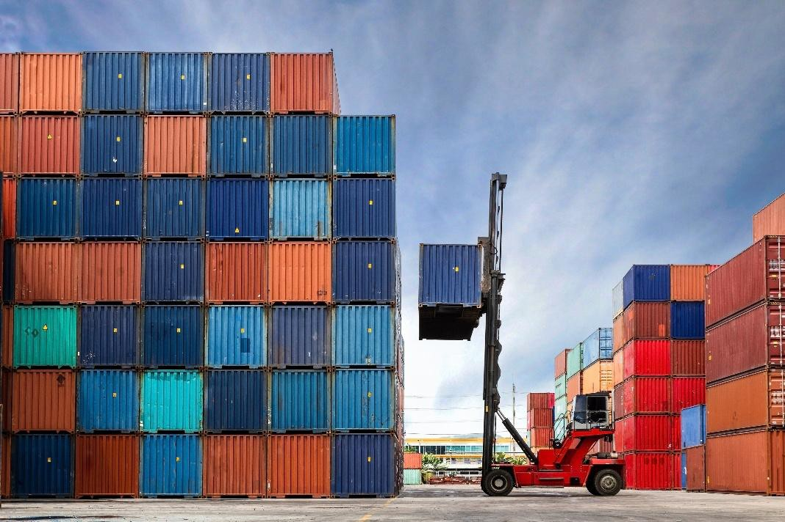
Licensed Customs Broker Requirements
Diversify your sources of continuing education!

Slide 9
Licensed Customs Broker Requirements
Government-led meetings (i.e., FACA Committees, CCOAC, ITAC, TSN, regularly scheduled Trade Meetings)
Reading or authoring trade subject matter such as trade publications
Individual professional development activities and events
Social events (sports outings, networking receptions, etc.)
Courses administered by an established academic institution and offered as part of their curriculum
Sales or marketing content, activities, or events
LCB Prep courses are not eligible for LCB CE credit.

Slide 10
Licensed Customs Broker Requirements
NOTE: Special Allowance
An individual broker may claim 0.5 credits for each full 30 minutes spent:
Presenting subject matter as an instructor, discussion leader, or speaker
Regardless of the duration of a single presentation, a maximum of one continuing education credit may be claimed preparing subject matter for that presentation.
A maximum of 12 CE credits per TSR can be earned this way.

Slide 11
Licensed Customs Broker Requirements
Failure to report and certify compliance with the continuing broker education requirement as part of the submission of the TSR?
CBP will notify the LCB of failure to report and certify. The notification will be sent to the LCB’s address in CBP’s records. The LCB must, on or before 30 calendar days either:
Submit a corrected status report that reflects the individual broker’s compliance with the continuing broker education requirement, if the LCB completed the required number of CE credits but failed to report and certify compliance properly; OR
Complete the required number of CE credits of qualifying continuing broker education and submit a corrected TSR if the individual broker had not completed the required number of CE credits at the time the TSR was due.

Slide 12
Licensed Customs Broker Requirements
Failure to take corrective action within 30 calendar days from notification issuance date will result in:
Step 1 –
Suspension of license
Failure to take corrective action within 120 calendar days from date of suspension issuance will result in:
Step 2 –
Revocation without prejudice to the filing of an application for a new license if requirement is not met within 120 days of suspension order date.

Slide 13
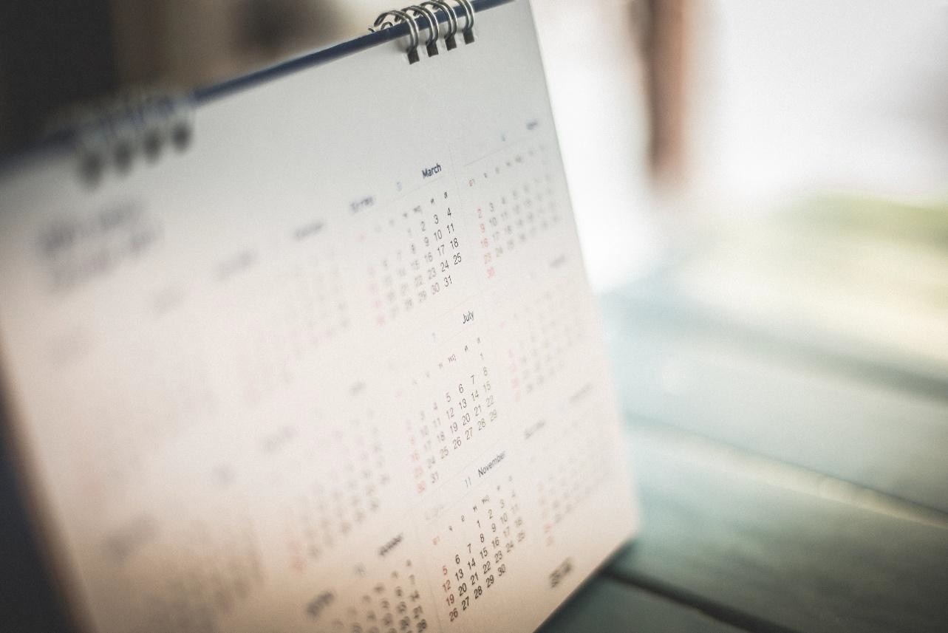
Licensed Customs Broker Requirements
Following a period of voluntary suspension (§111.52):
The number of continuing education credits that a LCB must complete by the end of the triennial period during which the reinstatement of the license occurred will be calculated on a prorated basis of one CE credit for each complete remaining month until the end of the triennial period.

Slide 14
Accreditor Responsibilities
Accreditors have the primary responsibility for accepting, reviewing, and making a determination on the worthiness of activities offered by the private sector submitted for potential CE credit.
Treated as government contractors; however, without compensation offered by CBP for the service.
3-year contract; CBP will reopen request for proposals
CBP Selected Partner Accreditors
Partner Accreditor for CBP’s Customs Brokers
Continuing Education Program

Slide 15
Accreditor Responsibilities
Each activity must align to at least one of the eligibility criteria for LCB CE accreditation:
The activity promotes an understanding of the laws and regulations governing CBP or enforced by CBP, including relevant laws and regulations of CBP’s partner government agencies.
The activity contributes directly to CBP’s trade priorities, programs, policies, and/or
business practices.
The activity provides understanding of U.S. imports and exports.
The activity conveys information intended to increase and improve U.S. trade compliance and enhance risk management.
Accreditors may not accredit their own content for LCB CE credit.

Slide 16
Accreditor Responsibilities

Slide 17
Accreditor Responsibilities
Calculating Credits
Accredited activities will be assigned based on the activity’s length, in increments of no less than
0.5 hours.
For seminars, conferences, etc. with an agenda, accreditor will add up all eligible items in the agenda, in minutes, then divide by 60, and round to the nearest 0.5-hour increment within 10 minutes.
For online, self-administered courses, accreditors will use the Continuing Education Unit standard calculation, where 10 hours equals 1 credit hour.
This methodology was created by the International Accreditors for Continuing Education and Training in 1970, and it has become the industry standard for calculating self-administered continuing education hours.
Example:
Total 825 minutes ÷ 60 = 13.75 hrs
13.5 CE credits will be awarded
Total 835 minutes ÷ 60 = 13.92 hrs 14 CE credits will be awarded

Slide 18
Educational Provider Responsibilities
The accreditation is effective for 1 calendar year from the date of approval. Educational providers must:
Follow all instructions on using the “unique identifier” code correctly.
Keep accreditation messages received from the accreditor.
Issue a “certificate of completion” that includes the unique identifier code and date of
completion (can be electronic), per CBP recommendation.
Generally, responsible for advertising your activities. (Not a responsibility of the accreditor)
Inform accreditor of content and structure changes of content.

Slide 19
CBP’s Responsibilities
CBP is overseeing the LCB Continuing Education Program.
CBP will assign education credits similarly to the accreditors for its own eligible continuing education activities.
CBP’s Continuing Education Team will coordinate internal Field Office hosted eligible
activities.
CBP’s Continuing Education Team will coordinate with Partner Government Agencies to
assign continuing education credits.
CBP will promote Federal government activities on the Continuing Education page of CBP.gov.

Slide 20
Recordkeeping
Under §111.102 (2) (d), the individual licensed customs broker “must retain the following information and documentation pertaining to the qualifying education completed during a triennial period for a period of three years following the submission of the status report…”:
Licensed Customs Broker
The title of the qualifying continuing broker education attended;
The name of the provider or host of the qualifying continuing broker education;
The date(s) attended;
The number of continuing education credits accrued;
The location of the qualifying continuing broker education; and,
Any documentation received from the provider or host of the qualifying continuing broker education that evidences the individual broker's registration for, attendance at, completion of, or other activity bearing upon the individual broker's participation in and completion of the qualifying continuing broker education.
NOTE: Upon CBP’s request, the individual broker must make available to CBP the above information and documentation on or before 30 calendar days from the date of receipt of CBP’s request.

Slide 21
How to Enter UIC/Verification Code
https://logistics-ei.ncbfaa.org/completion-code
How to Check Your Transcript
https://logistics-ei.ncbfaa.org/transcript-check
Please note: Use of LogisticsEI to track LCB continuing education credits is a benefit afforded to NEI CCS/MCS and CES/MES designees ONLY.

Slide 22
Recordkeeping
Accreditor
The title of the qualifying continuing broker education accredited;
The name of the provider or host of the qualifying continuing broker education;
The date(s), if applicable;
The number of continuing education credits awarded;
The location of the qualifying continuing broker education; and
Additional pdf documents submitted by the educational provider.
Submission records received by accreditor must be retained for a period of 6 years.

Slide 23
Recordkeeping
Educational Provider
Maintain their submission documentation return messages from the accreditors for 6 years.
Maintain records of registration information and/or take attendance when activity occurs and keep this information for 6 years.

Slide 24
Questions?
Are you a NEI Certified Customs Specialist, Master Customs Specialist, Certified Export Specialist, or Master Export Specialist designee?
The NEI as aligned its CE criteria with the LCB criteria because it just makes sense!
The renewal period for all designees is also aligned to a February 1 renewal date.

Slide 25
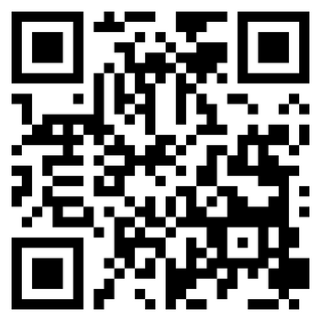
THANK YOU!
Visit our website
Partner Accreditor for CBP’s Customs Brokers
Continuing Education Program
www.ncbfaa.org/education

