Slide 1
Scope and Mirrors: Mastering AD/CVD and Certification, don't get lost in the orders.
Panelists:
Moderators:
William Jansen
NCBFAA Customs Committee Member; Director of Customs Brokerage Services, Seko Customs Brokerage, Inc.
Christine Sliwinski
NCBFAA Customs Committee Member; CHB Compliance Manager, Maersk Customs Services USA, Inc.
Kim Roebke
NCBFAA Customs Committee Member; Director, Regulatory and Compliance, LCB, CCS, RIM logistics, Ltd.
Patrick Caulfield
Partner, Grunfeld, Desiderio, Lebowitz, Silverman & Klestadt LLP

Slide 2
Scope and Mirrors: Mastering AD/CVD and Certification, Don’t Get Lost in the Orders
Panelist:
Patrick Caulfield, Partner, Grunfeld, Desiderio, Lebowitz, Silverman & Klestadt LLP
William Jansen, Director of Customs and Trade Compliance, LCB, CCS, Seko Customs Brokerage, Inc.
Moderators:
Christine Sliwinski, CHB Responsible Supervision & Control Manager, LCB, CCS, Maersk Customs Services USA, Inc.
Kim Roebke, Director, Regulatory and Compliance, LCB, CCS, Rim logistics, ltd.

Slide 3
For customs brokers, mastering the distinctions between an AD/CVD non-reimbursement certificate and an AD/CVD certification is essential. Identifying which entries require AD/CVD certification and understanding the specific certification requirements are key aspects of compliance. This session will provide an overview of the AD/CVD certification process, detailing the necessary steps and criteria to ensure compliance, helping brokers navigate the complexities of AD/CVD orders without getting lost.

Slide 4
AD/CVD: Basics
Antidumping duties (“ADD”) - additional duties placed on certain types of merchandise based upon a finding that foreign manufacturers from a particular country (or countries) “dump” or sell goods in the United States at prices less than fair market value thereby injuring the domestic industry.
Countervailing duties (“CVD”) - additional duties placed on certain types of merchandise based upon a finding that a foreign government provides subsidies (e.g., tax breaks) to manufacturers that export goods to the United States thereby injuring the domestic industry.
Products can be subject to ADD, CVD or in some cases both.
Notes:
Patrick

Slide 5
AD/CVD: The Process
AD/CVD investigations generally initiated by domestic industries.
Petition filed with the International Trade Commission (“ITC”) and Department of Commerce (“DOC”) alleging material injury (or threat thereof) to domestic industry (ITC decision) and presence of dumping and/or subsidization (DOC decision).
DOC decides whether to initiate an investigation.
If yes, ITC makes preliminary determination regarding material injury (or threat thereof).
If affirmative, DOC makes preliminary determination regarding dumping/ subsidies.
Cash deposits due upon publication of DOC’s preliminary determination.
AD/CVD order published after DOC/ITC final determinations (assuming determinations are affirmative).
Notes:
Patrick
Prompt over to William

Slide 6
Basic Types of AD/CVD Certification
19 CFR 351.402- Reimbursement Certificates
19 CFR 351.228 – Importer/Exporter Certification
Filed by the importer of record.
Can use a blanket certificate or be filed per transaction.
May be filed via ACE Portal or per entry in DIS.
Must be filed prior to liquidation.
Generally filed for imports in scope of order.
May be required by importer, exporter, and/or other interested parties.
Generally, does not allow blanket certificates, unless covering entries made prior to requirement.
Generally filed via DIS.
Generally implemented in response to a circumvention inquiry.
Often required for products not covered, or not yet known if in scope.
Notes:
William -
CS Question: 19 CFR 351.228 – Is there any new reporting functionality in ACE that allows an Importer to enter an additional declaration code at the time of entry, identifying whether the merchandise entering the Customs Territory of the US is subject to an AD CVD certification requirement. I believe the DOC in coordination with CBP announced a new feature allowing the IOR to identify entries that are subject to an AD CVD certification.

Slide 7
AD/CVD: Reimbursement Certification
19 CFR 351.402(f)(2) requires importers to certify whether or not they have entered into an agreement for the payment or reimbursement of AD/CVD duties by the exporter or producer.
Certification must be filed prior to liquidation of entries, or via a protest.
If no certification is filed, CBP is instructed to double to the duty at time of liquidation.
Notes:
William
Insert Slide for NRS
The current Department of Commerce (Commerce) regulations require that, prior to liquidation and the assessment of antidumping (AD) duties, the importer is required to file a certificate advising whether it has entered into an agreement or otherwise has received reimbursement of AD duties. If an importer fails to provide a statement of reimbursement prior to liquidation, CBP should presume reimbursement and double the duties.

Slide 8
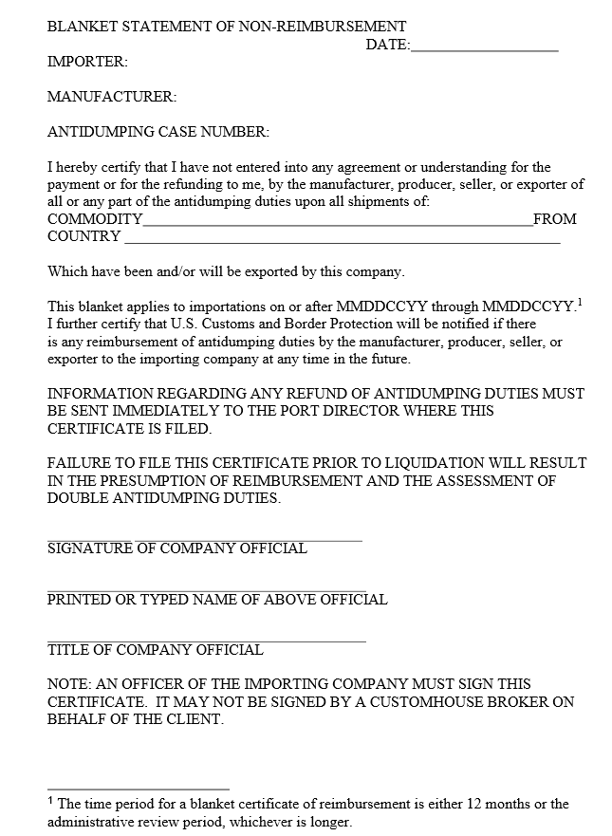
AD/CVD: Reimbursement Certification
Guidance for Reimbursement Certificates | U.S. Customs and Border Protection
Notes:
William

Slide 9
AD/CVD: Certifications
In some cases, after an AD/CVD order is issued, either the Petitioner or DOC itself initiates an investigation that expands or clarifies the scope or coverage of the order. The primary methods to do so are:
Large-scale scope investigations (e.g., Wooden Cabinets and Vanities from Vietnam and Malaysia); or
Circumvention inquiries (e.g., Aluminum Foil from South Korea or Thailand)
Notes:
Patrick

Slide 10
Example 1: Wooden Cabinets and Vanities from Vietnam and Malaysia
Large-scale scope investigation based upon underlying AD/CVD Orders on Wooden Cabinets and Vanities from China (A-570-106 and C-570-107).
Initiated at the request of Petitioners seeking to determine whether wooden cabinets and vanities manufactured in Malaysia and Vietnam were within the scope of the Chinese orders given the manufacture of these products in Malaysia and Vietnam using Chinese components.
DOC determined that wooden cabinets and vanities from these countries manufactured in certain scenarios were, in fact, within the scope of the Chinese AD/CVD order. If, however, the cabinets were manufactured in a manner different from these scenarios, importers can avoid the AD/CVD by filing a certification to that effect.
Notes:
William
Subject merchandise also includes wooden cabinets and vanities and in-scope components that have been further processed in a third country, including but not limited to one or more of the following: Trimming, cutting, notching, punching, drilling, painting, staining, finishing, assembly, or any other processing that would not otherwise remove the merchandise from the scope of the investigation if performed in the country of manufacture of the in-scope product.
ADD SLIDE FOR 3 Scenarios https://statics.teams.cdn.office.net/evergreen-assets/safelinks/1/atp-safelinks.html

Slide 11
Example 1: Wooden Cabinets and Vanities from Vietnam and Malaysia
These scope and circumvention inquiries cover wooden cabinets exported to the United States that were completed in Malaysia or Vietnam under the following scenarios:
Scenario 1: A Malaysian or Vietnamese company imports finished wooden cabinet doors, drawer fronts, and frames that are produced in China. The Malaysian or Vietnamese company produces wooden cabinet boxes and drawer boxes in Malaysia or Vietnam and combines the wooden cabinet subassemblies from China and Malaysia or Vietnam, resulting in merchandise that still meets the description of the scope of the Orders
Scenario 2: A Malaysian or Vietnamese company imports semifinished wooden cabinet doors, drawer fronts, and frames that are produced in China and performs further processing of these components from China in Malaysia or Vietnam such as trimming, cutting, notching, punching, drilling, painting, staining, or other finishing processes. The Malaysian or Vietnamese company produced wooden cabinet boxes and drawer boxes in Malaysia or Vietnam and combines the wooden cabinet doors, drawer fronts, and frames that are produced in China with the wooden cabinet boxes and drawer boxes produced in Malaysia or Vietnam, resulting in merchandise that still meets the description of the scope of the Orders.
Scenario 3: A Malaysian or Vietnamese company imports semifinished wooden component parts of wooden cabinet doors, drawer fronts, and frames that are produced in China. The wooden component parts of the wooden cabinet doors, drawer fronts, and frames include rails, stiles, and panels. The Malaysian or Vietnamese company performs further processing of these parts from China in Malaysia or Vietnam such as trimming, cutting, notching, punching, drilling, painting, staining, or other finishing processes, including the assembly of the wooden component parts into completed subassembly doors, drawer fronts, and frames. The Malaysian or Vietnamese company produces wooden cabinet boxes and drawer boxes in Malaysia or Vietnam. Finally, the Malaysian or Vietnamese company combines the wooden cabinet doors, drawer fronts, and frames that are produced in China with the wooden cabinet boxes and drawer boxes produced in Malaysia or Vietnam, resulting in merchandise that still meets the description of the scope of the Orders
Notes:
William
Add additional verbiage : Subject merchandise also includes wooden cabinets and vanities and in-scope components that have been further processed in a third country, including but not limited to one or more of the following: Trimming, cutting, notching, punching, drilling, painting, staining, finishing, assembly, or any other processing that would not otherwise remove the merchandise from the scope of the investigation if performed in the country of manufacture of the in-scope product.
ADD SLIDE FOR 3 Scenarios https://statics.teams.cdn.office.net/evergreen-assets/safelinks/1/atp-safelinks.html

Slide 12
Example 1: Wooden Cabinets and Vanities from Vietnam and Malaysia
These scope and circumvention inquiries cover wooden cabinets exported to the United States that were completed in Malaysia or Vietnam under the following scenarios:
Scenario 4: A Malaysian or Vietnamese company imports a finished wooden cabinet wooden component part, toe kick, that is produced in China. The Malaysian or Vietnamese company produces all other wooden cabinet component parts necessary to assemble a complete wooden cabinet in Malaysia or Vietnam. The Malaysian or Vietnamese company combines the wooden component part, cabinet box toe kick, produced in China with the other wooden cabinet component parts of the cabinet box, as well as the frame, doors, and drawer subassemblies made in Malaysia or Vietnam, resulting in merchandise that does not meet the description of the scope of the Orders.^{[7]}
Notes:
William
Add additional verbiage : Subject merchandise also includes wooden cabinets and vanities and in-scope components that have been further processed in a third country, including but not limited to one or more of the following: Trimming, cutting, notching, punching, drilling, painting, staining, finishing, assembly, or any other processing that would not otherwise remove the merchandise from the scope of the investigation if performed in the country of manufacture of the in-scope product.
ADD SLIDE FOR 3 Scenarios https://statics.teams.cdn.office.net/evergreen-assets/safelinks/1/atp-safelinks.html

Slide 13
Example 2: Aluminum Foil from South Korea and Thailand
Inquiry initiated by the Department of Commerce to determine whether aluminum foil manufactured in South Korea and Thailand was “circumventing” AD/CVD orders on Chinese aluminum foil (A-570-053 and C-570-054).
DOC investigated whether manufacturers in these countries were using significant Chinese inputs and investments to such an extent that they should be covered by the Chinese AD/CVD order.
DOC determined this was the case, but only where South Korean and Thai producers relied on Chinese-cast aluminum to manufacture the foil. Thus, importers can enter foil from these countries without AD/CVD provided they can certify the foil is made from aluminum cast outside of China.
Notes:
Patrick

Slide 14
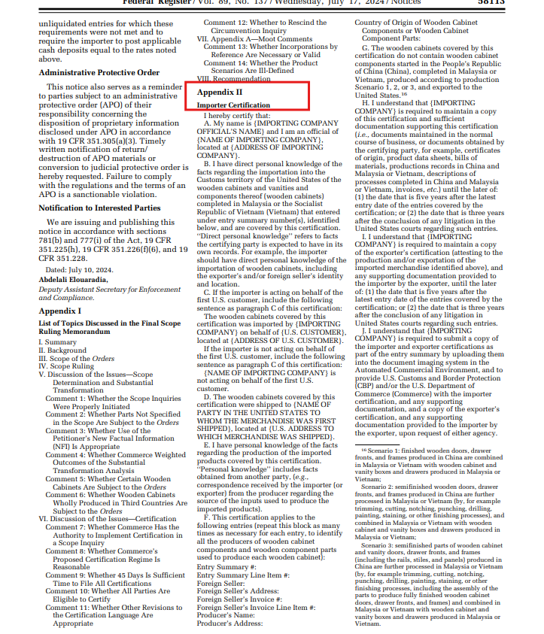
AD/CVD: Certifications
Importer Certification for Wooden Cabinets and Vanities from Vietnam and Malaysia
Notes:
Patrick

Slide 15
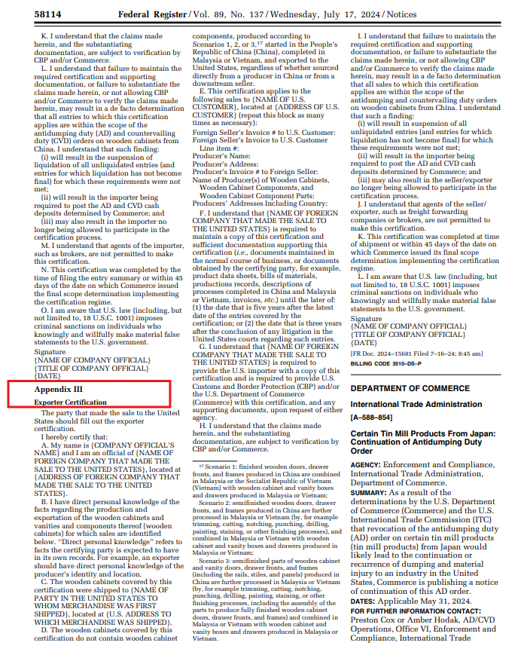
AD/CVD: Certifications
Exporter Certification for Wooden Cabinets and Vanities from Vietnam and Malaysia
Notes:
Patrick

Slide 16
General Certification Requirements
Generally, both an importer and exporter certification are required.
Certifications must be signed and dated within specific timelines (CAVEAT: recent litigation suggests that CBP has flexibility on timing).
Uploaded into Document Imaging System.
One per shipment (except for retroactively required certificates)
Notes:
Patrick
Possibly collaborative
Retroactive certifications

Slide 17
Certification Issues
Retroactive liability
Subject to verification
Recordkeeping Requirements
Can deny the ability to certify based upon a single failure.
BROKER SPECIFIC: How can brokers know which cases require certifications?
Notes:
Patrick & William Collaborate
Moderator Question: What do you do for a new client to avoid these types of issues?
What happens if Certification requirements are not met?
Broker Liability
eCFR :: 19 CFR 351.228 -- Certification by importer or other interested party.
§ 351.228 Certification by importer or other interested party.
(a) Certification requirements.
(1) The Secretary may determine in the context of an antidumping or countervailing duty proceeding that an importer or other interested party shall:
(i) Maintain a certification for entries of merchandise into the customs territory of the United States;
(ii) Provide a certification by electronic means at the time of entry or entry summary; or
(iii) Otherwise demonstrate compliance with a certification requirement as determined by the Secretary, in consultation with U.S. Customs and Border Protection.
(2) Where the certification is required to be maintained by the importer or other interested party under paragraph (a)(1) of this section, the Secretary and/or U.S. Customs and Border Protection may require the importer or other interested party to provide such a certification to the requesting agency upon request.
(b) Consequences for no provision of a certificate; provision of a false certificate.
(1) The Secretary may instruct U.S. Customs and Border Protection to suspend liquidation of entries of the importer or entries associated with the other interested party and require a cash deposit of estimated duties at the applicable rate if:
(i) The importer or other interested party has not provided to the Secretary or U.S. Customs and Border Protection, as appropriate, the certification described under paragraph (a) of this section either as required or upon request for such entries; or
(ii) The importer or other interested party provided a certification in accordance with paragraph (a) of this section for such entries, but the certification contained materially false, fictitious or fraudulent statements or representations, or contained material omissions.
(2) Under paragraph (b)(1)(i) or (ii) of this section, the Secretary may also instruct U.S. Customs and Border Protection to assess antidumping or countervailing duties, as the case may be, at the applicable rate.

Slide 18
Notable Cases with Certification Requirements
Aluminum Sheet from China – minor alteration
Various Pipe Products from China, Korea, India, Taiwan - completed in Vietnam from hot-rolled steel from China, Korea India or Taiwan
Aluminum Foil from China- completed in Korea and Thailand
Solar Panels from China – completed in Malaysia, Thailand, Vietnam and Cambodia
Wooden Cabinets from China – completed in Vietnam and Malaysia
Vertical Shaft Engines from China- minor alteration
Quartz Surface Products from China – completed in Malaysia
Notes:
Patrick

Slide 19
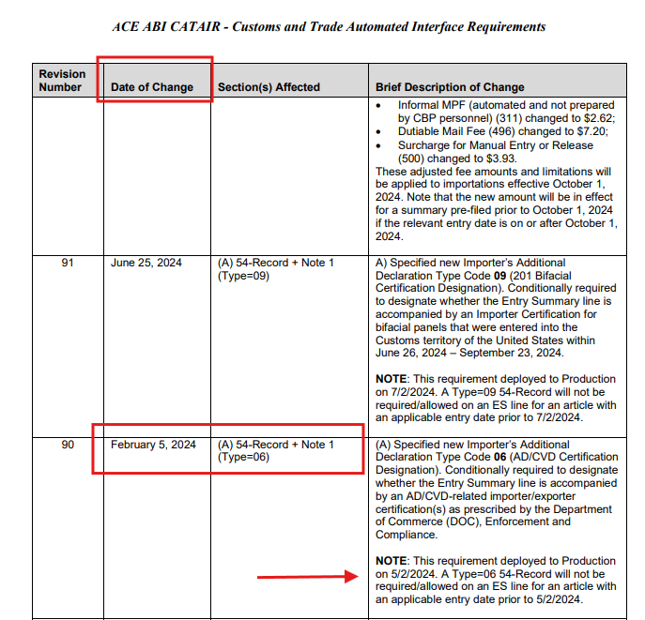
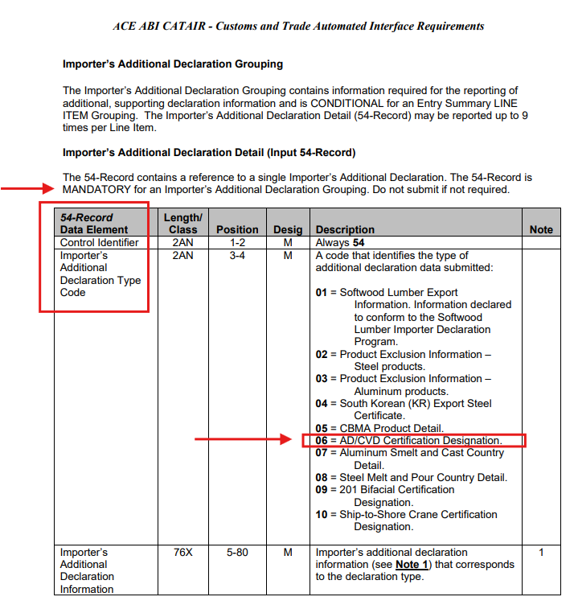
ACE ABI Requirements
Importer Additional Declaration – AD/CVD Certification Declaration – Code: 06
The AD/CVD certification code is a new functionality in the ACE environment for importers entering merchandise that is the subject of an antidumping and/or countervailing duty (AD/CVD) certification. Specifically, the capability will exist for importers to identify in the ACE entries that are the subject of an AD/CVD certification.
Notes:
William
This declaration code represents a claim that, for example, the entered merchandise is entitled to a specific company AD and/or CVD rate or, alternatively, a claim that the entered merchandise is not subject to AD and/or CVD order.

Slide 20
ACE ABI Requirements
Example of Importer Additional Declaration – AD/CVD Certification Declaration – Code: 06 on Entry Summary (CF7501)
Per 89 FR 7372 – Commerce Dept. announce an Importer's Additional Declaration in the Automated Commercial Environment Specific to Antidumping/Countervailing Duty Certifications.
Federal Register :: Announcing an Importer's Additional Declaration in the Automated Commercial Environment Specific to Antidumping/Countervailing Duty Certifications
Notes:
William
This declaration code represents a claim that, for example, the entered merchandise is entitled to a specific company AD and/or CVD rate or, alternatively, a claim that the entered merchandise is not subject to AD and/or CVD order.

Slide 21
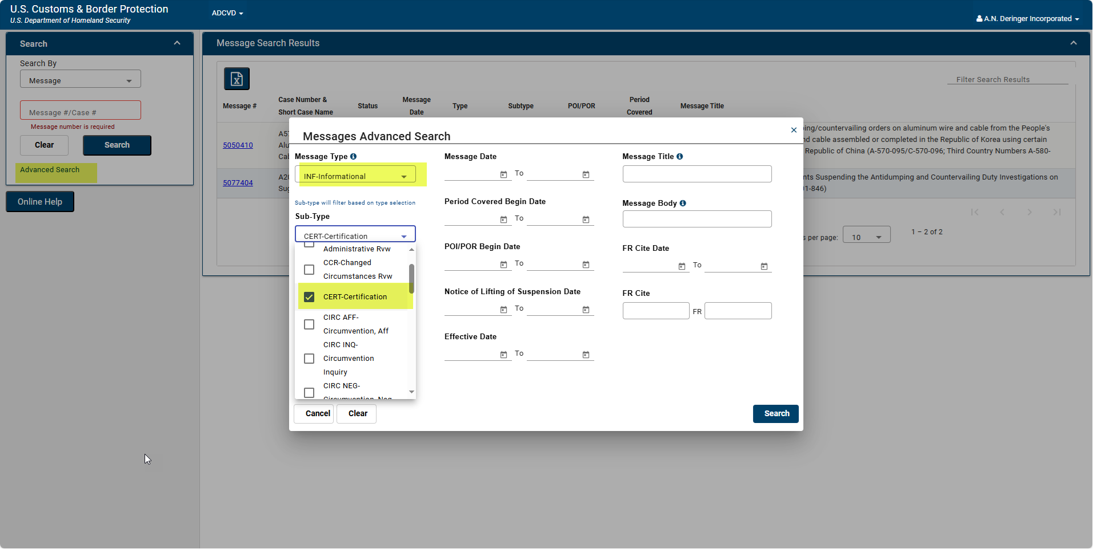
AD CVD Scopes with Certification Messages
The Dept of Commerce (DOC) has recently created a new message type to capture the Certification Messages..
From the ACE Portal: Login
Log in
Go to “References”, then click on “AD/CVD”
Go to the “Advanced Search” option
Then, the “Messages Advanced Search” box will populate on your screen.
Select your Message Type from the Dropdown select INF – Informational
Select your Sub-Type from the Dropdown select CERT – Certification
Notes:
William
Stat’s from CBP (Per Sandy)
63 AD/CVD certifications
732 Orders
111 Investigations
Commerce has created a new Message Type to capture the Certification Messages. The goal is to go back to the original 68 but for now, it is a going-forward flagging

Slide 22
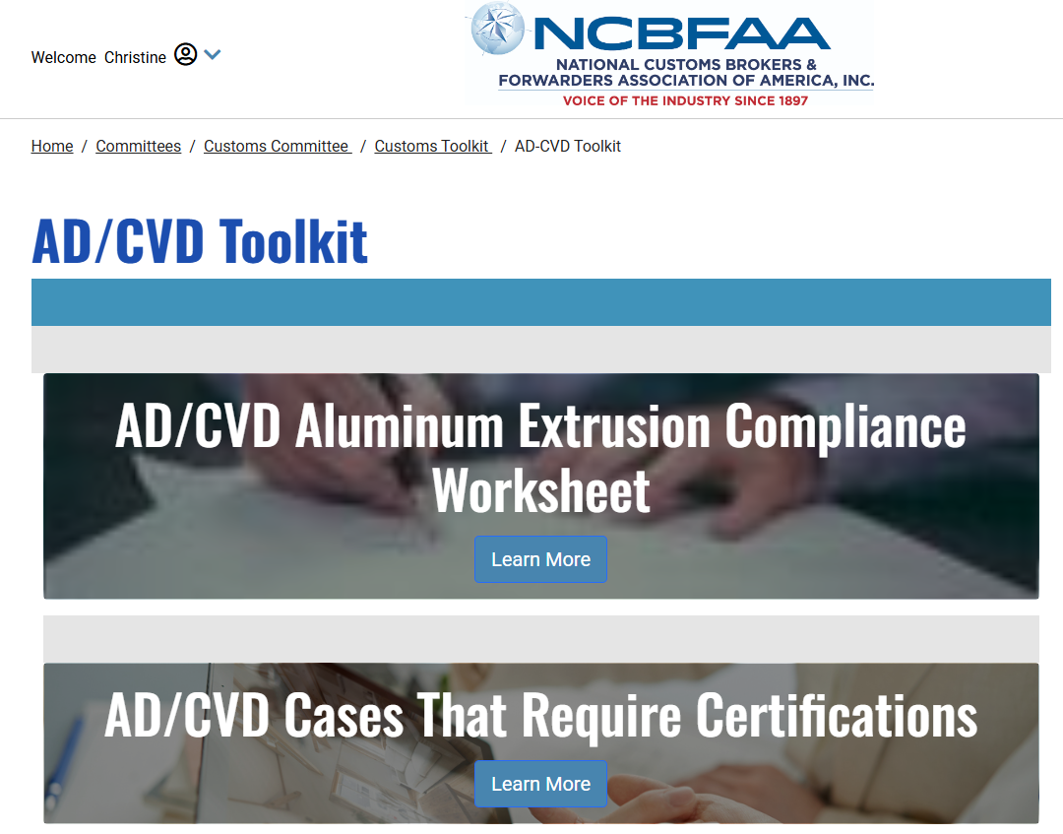
Key Resources
Notes:
William

Slide 23
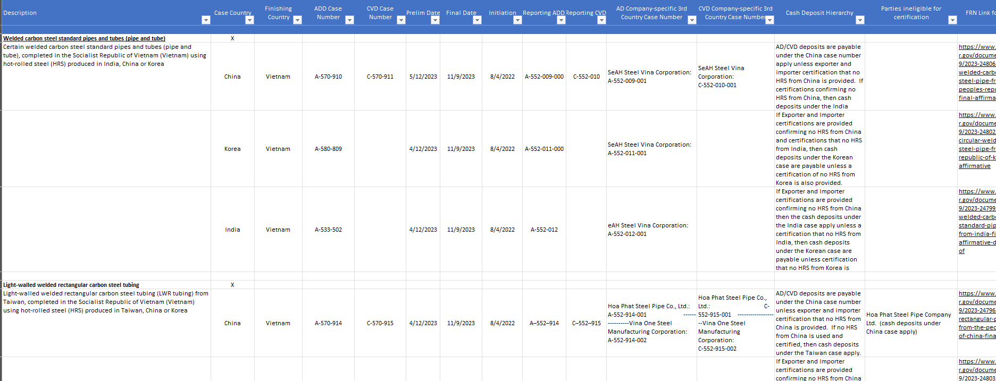
Key Resources
Notes:
William

Slide 24
Key Resources
CSMS Messages
Department of Commerce Messages
ADD CVD & Trade Remedies link: Home
ACCESS - International Trade Administration
Antidumping and Countervailing Duties (AD/CVD) Frequently …
AD/CVD Handbook | United States International Trade Commission
A Glossary of Terms and Phrases used in AD/CVD Cases
NCBFAA Certification Tool
Notes:
William

Slide 25
Additional Resource – Locating AD CVD Scopes

Slide 26
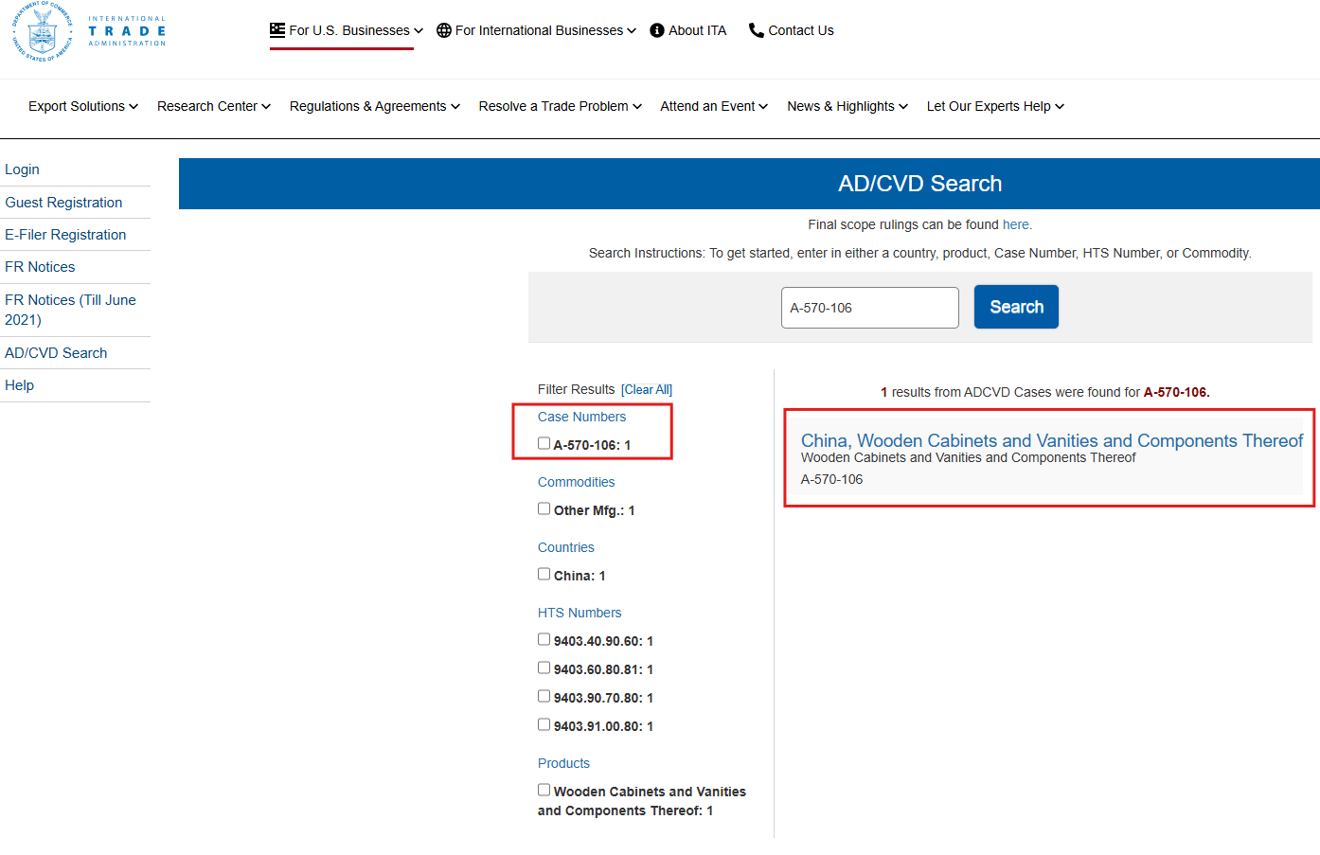
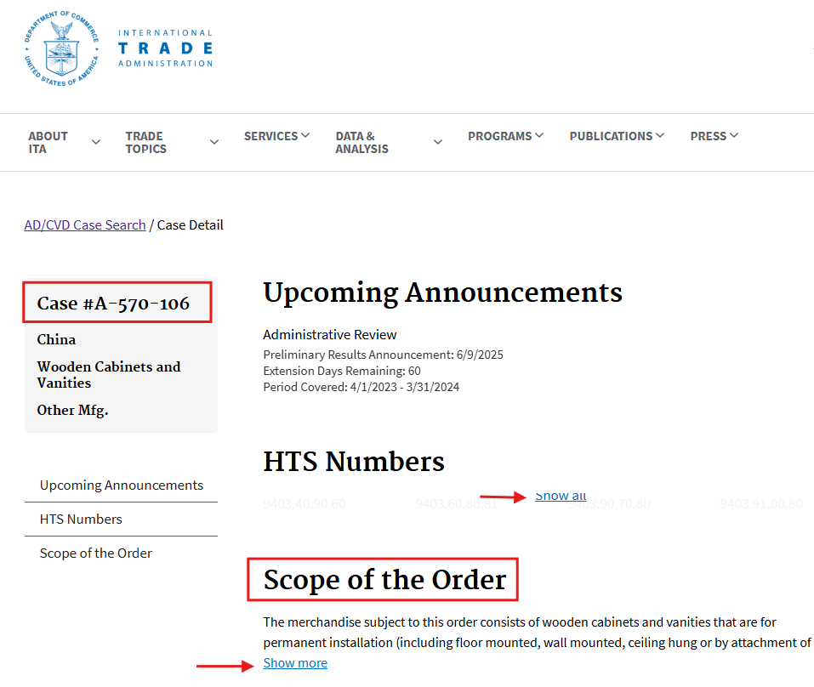
Locating AD CVD Case Scopes
Scenario 1
From ACCESS link: ACCESS
To get started, enter either a country, product, case number, HTS number, or commodity.
Example: A-570-106
Select the case, and it will then open the next screen. The full scope can be read by clicking on the “Show more” under the “Scope of the Order” --------------------------→

Slide 27
Locating AD CVD Case Scopes
Scenario 1 Continued
If the AD CVD Order has not gone to order the Int’l Trade Administration (ITA) will not have the scope on its website.
The website will only show the case details and its upcoming milestone dates, but no scope will be listed.
Instead under HTS Numbers and Scope of the Order, the website will state: No data is available to display.
When this happens you now need to go to CBP’s AD CVD Application. This is where CBP posts the notices they receive from the ITA by case.

Slide 28
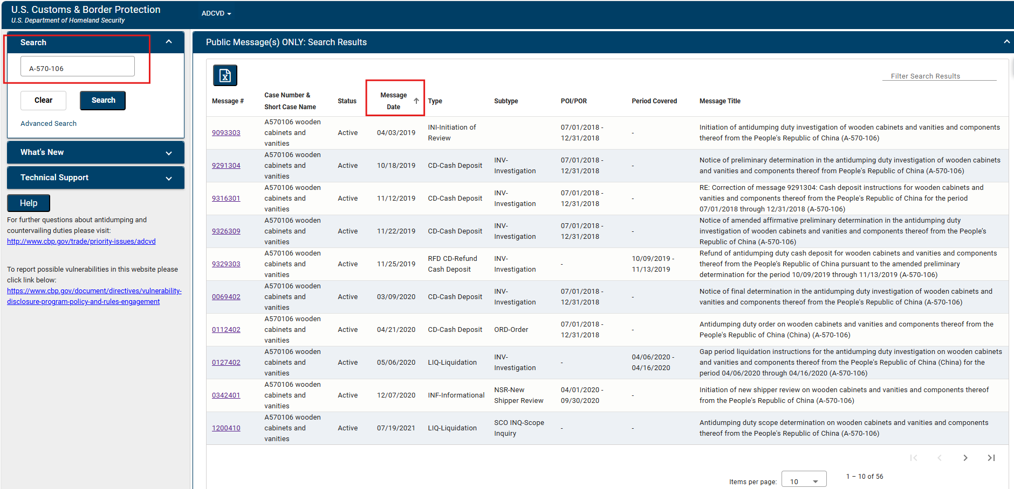
Locating AD CVD Case Scopes
Scenario 2
From ACE | AD-CVD application
To get started, enter the case number in the search bar. Example: A-570-106
Then sort by the “Message Date” so the newest messages are on top.
Look for the newest CD-Cash Deposit under the type, then click on the Message # hyperlink

Slide 29
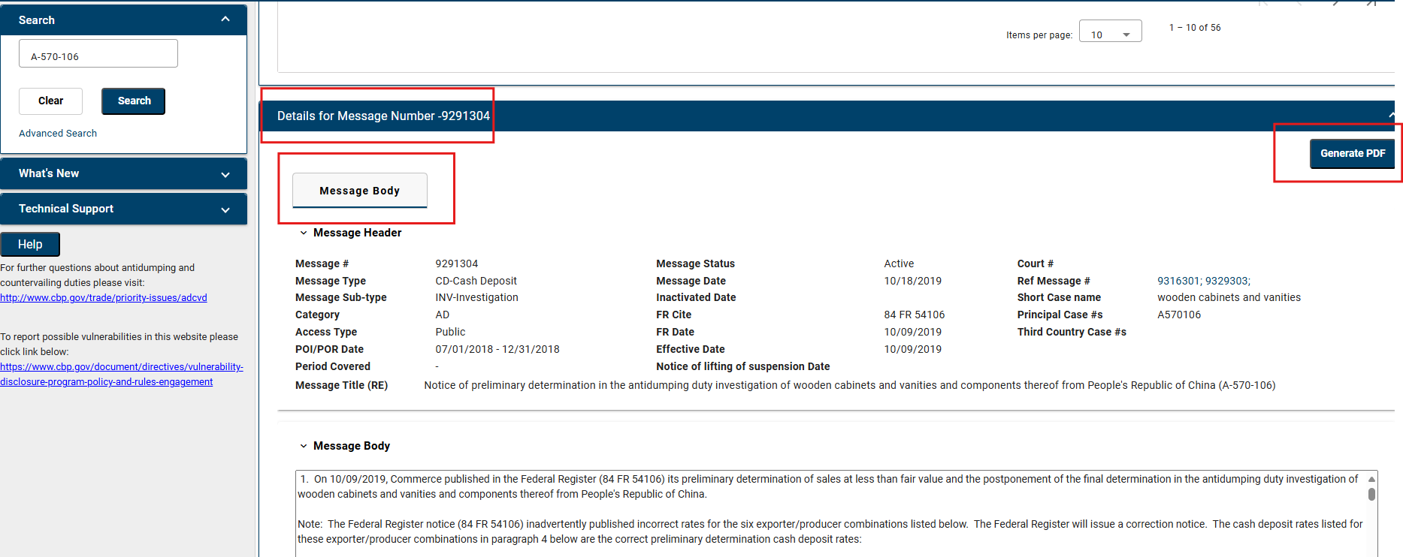
Locating AD CVD Case Scopes
Scenario 2 Continued
Scroll down to the “Message Body” and read the scope. You also have the option of viewing the scope in a PDF document.

Slide 30
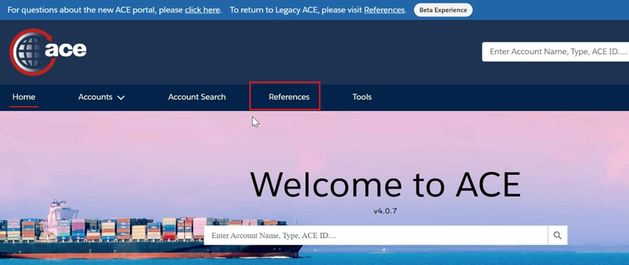
Locating AD CVD Case Scopes
Scenario 3
If the case scope is still not identifiable under ACCESS or the CBP’s AD/CVD Application, then you are most likely dealing with a Third Country Case and will need to track down the parent principal case as that is the scope that will apply.
From the ACE Portal: Login
Log in
Go to “References”, then click on “AD/CVD”

Slide 31
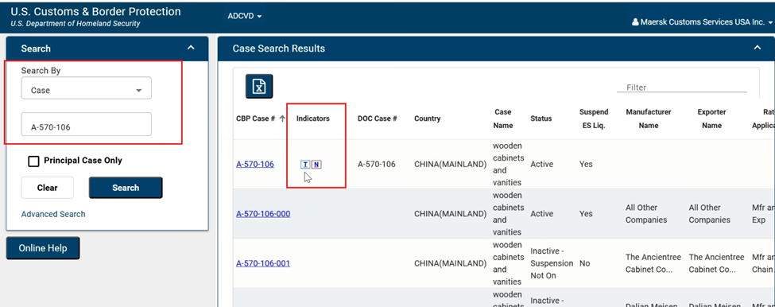
Locating AD CVD Case Scopes
Scenario 3
In the search bar, enter the AD/CVD Case
In the Case Search Results you can see that it is a Third Country Case by symbol “T” under “Indicators”

Slide 32
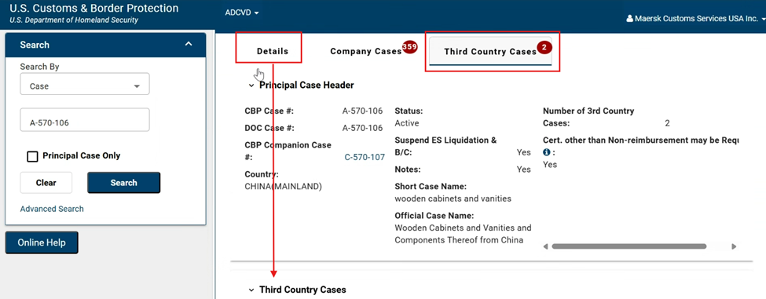
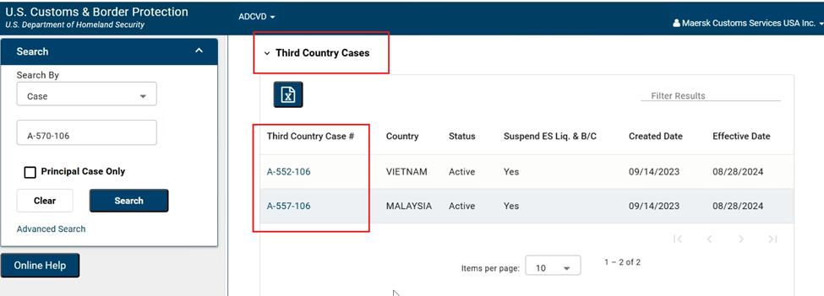
Locating AD CVD Case Scopes
Scenario 3
By clicking on the top case, you can see the “Parent Principal Case” under the “Details” tab.
This is the AD CVD scope that would apply to your product and now you can look up the scope by following the steps under Scenario 1.

Slide 33
AD CVD Scopes with Certification Messages
The Dept of Commerce (DOC) has recently created a new message type to capture the Certification Messages..
From the ACE Portal: Login
Log in
Go to “References”, then click on “AD/CVD”
Go to the “Advanced Search” option
Then, the “Messages Advanced Search” box will populate on your screen.
Select your Message Type from the Dropdown select INF – Informational
Select your Sub-Type from the Dropdown select CERT – Certification
Notes:
William
Stat’s from CBP (Per Sandy)
63 AD/CVD certifications
732 Orders
111 Investigations
Commerce has created a new Message Type to capture the Certification Messages. The goal is to go back to the original 68 but for now, it is a going-forward flagging

Slide 34
Q&A

