Slide 1




Everything, Everywhere, All at Once. Managing Change as a Broker
Panelists:
Moderator:
Joanne (Bartlett) Slapinski
Vice President, Retail Insurance Broker Servicing, International Bond & Marine Brokerage, Ltd.
Dan Meylor
NCBFAA Customs Committee Member; Director,
Customs Administration & Compliance, Carmichael International Service
Ryan Raynak
NCBFAA Customs Committee Member; Licensed US Customs Broker, CCS, HG Enterprises, LLC
Karen Damon
NCBFAA Treasurer; Vice President, Regulatory Compliance, Mohawk Global Logistics

Slide 2

Everything, Everywhere, All at Once Managing Change as a Broker
Panelists:
Dan Meylor, Director, Customs Administration & Compliance, Carmichael International Service
Karen Damon, Vice President, Regulatory Compliance, Mohawk Global Logistics
Ryan Raynak, Licensed US Customs Broker, HG Enterprises LLC
Joanne Slapinski, Vice President, Retail Insurance Broker Servicing

Slide 3

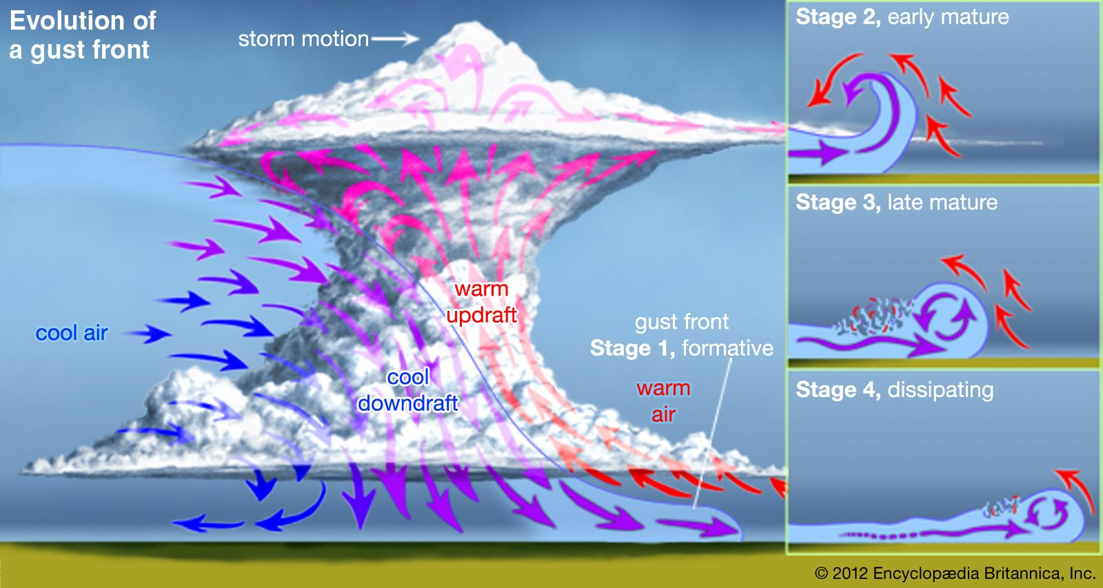
FRN & CSMS
CLIENT OUTREACH
SOFTWARE
DEVELOPMENT
TWEET
Ryan – NCBFAA resources
NEWS
DUTY
COLLECTION

Slide 4

Keep Calm – Read the Facts
America First Trade Policy
Presidential Actions
  Memoranda
  Proclamations
  Executive Orders
Federal Register Notices
CBP CSMS
Notes:
Keep calm and weather the storm!
The effective dates and timing of receipt of detail has been one of the biggest challenges of this Administration’s tariffs.
Tariffs were a clear campaign strategy and the first 100 days of office of any new administration is newsworthy
The news publications have been fast and furious with various reports of when and to what effect these tariffs will be implemented.
This poses a challenge when our clients are trying to understand the impact and plan accordingly.
It is so important we try to stay calm and educate our clients on the facts.
The best crystal ball into this administration's actions is to read the America First Trade Policy.
-External Revenue Service
-unfair trade practices
USMCA
Currency
FTA and reciprocity
De minimis
So when clients ask for the crystal ball – the America 1St Trade Policy is our best bet

Slide 5

Member Resources
IEEPA Webpage:
Single source for Brokers & Forwarders
  Sorted by Action (i.e. Auto Tariffs, Steel & Aluminum…etc)
  Links to all pertinent documents (Proclamations/EO, FR Notices & CSMS)
  Applicable Trade Presentation Slides
  Up-to-Date Information
  Expert Commentary
MMeB (Monday Morning e-Briefing)
Weekly headlines for all Industry News and updates on Committee activities.
Event Calendar
Notes:
Thank you to the NCBFAA Staff, Committees and Contributors…especially NCBFAA Legislative Advisor Nicole Bivens Collinson of ST&R for her timely analysis.

Slide 6

Responsible Supervision and Control
CBP expects full compliance from the trade community for accurate reporting and payment of the additional duties. CBP will take enforcement action for non-compliance.
Ensuring proper application of CH99
Understand limited ACE edits
  CBP only validates up to two tariff lines
Reviewing pre-filed entries
Preview the CBP Form 7501
Notes:
All licensed customs brokers understand our requirement to exercise Responsible Supervision and Control but we are experiencing strains in the ability to be compliant with managing multiple executive orders, proclamations, FRN and various CSMS.
What is concerning but important to recognize is CBP’s compliance language that we have seen creeping into various CSMS messages. CBP expects full compliance from the trade community for accurate reporting and payment of the additional duties. CBP will take enforcement action for non-compliance.
How can your operations ensure this level of compliance -

Slide 7

Training and Engagement
Classification
Ensuring staff has clear direction on CH99 application
Validating software calculations
Documentation and Reporting
Origin
Addressing documentation deficiencies
Valuation
Understanding content duty application
Entered value
Recordkeeping
USMCA / FTA certifications
Mill certs / Certificate of analysis
Content values
Support Staff
Accounting
Finance
Sales
Notes:
Brokerage Staff Training & Engagement:
As important as it is that each of us know where to find accurate and up-to-date information, we need to ensure that we disseminate this within our organizations or teams. Whether you are part of the Entry team or a Support Function, the new challenges have far reaching effects.
ENTRY…Even with all of the uncertainty and chatter, we can rely on the basics…Classification/Origin/Valuation/Recordkeeping.
HTS…does your staff have clear direction on the application of appropriate CH99 classifications? Does your software accurately report multiple CH99 classifications per line? Are documents generating all data? Are reports including the multiple tariff lines?
Origin…we all are preparing for reciprocal tariffs that could potentially alter, even more, the duty treatment of products by origin. Are our teams well-versed and talking with our Importers in anticipation of the impacts and addressing any documentation deficiencies?
Valuation…steel/aluminum derivatives require additional tariffs on content, are our entry writers trained on the calculation and application the split values? Are these entries undergoing additional reviews for accuracy?
Recordkeeping…USMCA qualified products to avoid additional CA/MX duties. May be new to some Importers who typically imported duty free items…are we capturing correct records at time of entry? At PSC? Mill certificates / Cert of Analysis?
SUPPORT STAFF…we’re all in this together. It’s easy to forget with all of the operational and systemic challenges that are surrounding us, however, the training and engagement of support staff is equally as important to success.
Accounting/Finance/Sales…have your support staffs been included in any training regarding the recent tariff actions? How will current (and potential) tariff increases impact your clients and their ability to pay? Will collections become difficult? Are sales staffs reviewing areas of impact with the Entry Team and communication with the customer? Do you need to update your policies on extending credit to customers? If your company outlays duties on behalf of the Importer, cash requirements can spike very quickly! What impact will that have on your company’s financial health? Is the team aware of the different ACH payment types (Importer vs. Filer)? Are sales staff encouraging/requiring Importers to pay their own duties (Importer Order). Are you fully utilizing Periodic Monthly Statements for the brokerage (PM-Filer Order)? Are there ways to streamline billing processes to invoice the customer quicker? Do all of your customers pay electronically? If not, are there ways to encourage/require electronic payment?
I know we’re all feeling like we’re in the eye of the storm, but we can’t forget to make time to share what we’ve learned and keep our colleagues informed.

Slide 8

Disclaimer
Surety Bonds
This presentation is provided for general informational purposes only and does not constitute and is not intended to take the place of legal or risk management advice. Readers should consult their own legal counsel or other representatives for any such advice. Any and all third-party websites or sources referred to herein are for informational purposes only and are not affiliated with or endorsed by International Bond & Marine Brokerage, Ltd. (IB&M), it’s parent company Intact Insurance Group USA LLC (“Intact”), or any of Intact’s underwriting companies. Intact, Intact’s underwriting companies, and IB&M hereby disclaim any and all liability arising out of the information contained herein.

Slide 9
Agenda
The Customs Bond - Perils of Increased Tariffs
  Bond Insufficiency
  Bond Stack of Liability
  Heightened Underwriting
Best Practices

Slide 10
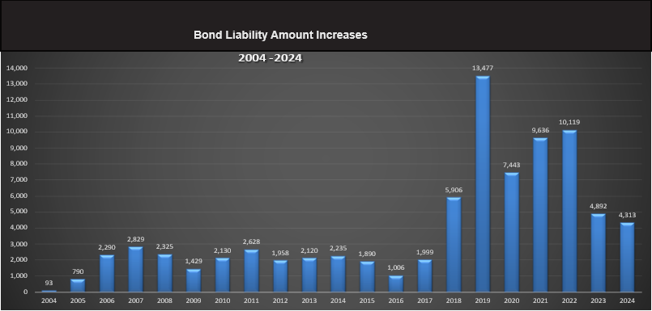
Bond Sufficiency Notifications

Slide 11

Bond Amount Formula – Activity Code 1
Continuous Bonds
All entries within a bond period
  Bond Period = Up to 12 months
Bond Amount = 10% of annual Duties, Taxes & Fees (DTF)
Minimum $50,000
  Allows up to $500K in DTF
Increase by increments of $10K up to first $100K, then by $100K thereafter
Single Transaction Bonds
One entry/shipment
Bond Amount = TEV + DTF
  Up to 3X Value for FDA
Minimum $100

Slide 12
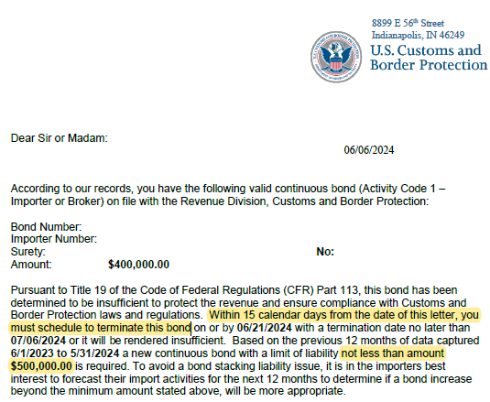


Bond Insufficiency Notice

Slide 13

Bond Saturation
Bond saturation occurs when the TRAILING 12 months of Duties, Taxes & Fees (DTF) exceed the amount allowed for the bond’s limit.
  Trailing 12 months does not align with the bond period
Example: $50K bond allows up to $500K in DTF
Once DTF paid to Customs within recent 12 months EXCEED $500K…
  Customs issues the Bond INSUFFICIENCY Notice and forces the bond to be TERMINATED within 30 days

Slide 14

What is Stacking of Liability Exposure?
Stacking of Liability is caused by a bond
having open exposure in more than one bond period.
  Bond Period = Bond Effective Date thru renewal or termination, whichever is first
    Up to 12 months, could be less
  What is Open Exposure? An unliquidated entry
Liquidation is the final assessment by Customs of an entry filing.
  Liquidation takes TIME
  Liquidation is the key!

Slide 15



Stacking of Liability
Bond Period 3
New Bond
$100K Limit
Bond Exposure REDUCED
by $50K (BP1) to $150K
$200,000
$150,000
Bond Period 2
$50K Limit
$100,000
Green scoop melted!
Bond Period 1 Entries LIQUIDATED
$50,000
Bond Period 1
$50K Limit
$50,000

Slide 16
Takeaways…
Bond Saturation > Recent 12 months of DTF
Stacking of Liability > Bond Period
Liquidation reduces stacking!

Slide 17

Underwriting
Risk factors include:
  Unliquidated entries & stacking of liability
  The commodity mix - risk level (i.e. Anti-dumping/CVD, PGA,
  quota/visa, etc. are higher risk than other commodities.)
  Claims history (tariff/HTS/value discreps, marking violations, etc.)
  The bond limit needed – the higher the amount the more risk
Review Financials
  Payment Obligation
    Financial liquidity, profitability, positive cash flow and net worth are key indicators
    How will the latest increase in tariffs impact their bottom line?
Indemnity
  Must be signed by the bond principal and any other party whose financials are securing the risk (i.e. parent co).

Slide 18
Underwriting
Collateral
  Required when risk warrants
    AD/CVD entries
    History of claims
    New/foreign importer, high risk commodity (circumvention)
  Acceptable forms of collateral:
    Letter of Credit (bank must be approved by surety and reflect required letter of credit language)
    Cash Deposit/Wire Transfer
How long does surety hold collateral?
  Generally, until all liability is extinguished
  Waiting period after all entries have been liquidated (typically 1 year + 90 days for reliquidation period)
  Liquidation can be extended for up to 4 years or suspended indefinitely in the case of Anti-Dumping/Countervailing Duty (AD/CVD) entries.

Slide 19

Best Practices
Know your customer!
  Their products, financial strength and integrity – It Matters!
Use the bond’s approaching renewal date to make any bond limit changes to avoid unnecessary stacking of liability which impairs underwriting.
  Sureties send renewal notices 60-90 days in advance.
  Keep in mind, Customs require 15 days advance notice to terminate
  Forecast, Forecast, Forecast – overestimate!
  Request a bond saturation report from your surety
Timely respond to Claims to avoid a disruption of your client’s bond.
  Customs Claims have strict due dates!
  Provide entry documents timely to the surety to mitigate loss

Slide 20

Post Impact
CBP Priority Trade Issue – Protect the Revenue
Increased CBP Request for Information -CF28s
USMCA claims (IEEPA exemption)
Country of Origin
Transshipments / Circumvention
Valuation
Encourage importers to sign up for an ACE portal account!

Slide 21

Report Management
Work with your Surety
ACE Portal reports
  CF28/29
  REV-405 Open Trade Bills
  Trade Remedy reports
Broker exception reports

Slide 22

Watch List
Semiconductors Fact Sheet 301 investigation Dec. 23, 2024
Copper Investigation 232 Feb. 25, 2025
Lumber Executive Order March 1, 2025
Venezuelan Oil Executive Order March 24, 2025
Automobiles and Auto Parts Proclamation March 26, 2025
Reciprocal Tariffs Executive Order April 2, 2025
Weather Forecast - To Be Continued………

