Slide 1

Shaken, Not Stirred: Protect Your In-Bonds Like 007
Securing Your Carrier Bonds and Navigating Customs Holds with Precision

Slide 2

Agenda
History of Key Dates for Enforcement
Electronic Reporting Requirements
Local Port Procedures
Basic In-bond Process
Important Time Limits for Action
Northern Border Considerations
Southern Border Considerations
Using the ACE Portal
Most Common Message Statuses
Questions & Comments

Slide 3

Starring
Jenette Prince – Director & Miss Moneypenny
Jose (JD) Gonzalez – Screenplay & Agent 008
Jerrod Nutt – Producer & Agent 009

Slide 4
CBP Key Dates Established for Enforcement
September 28, 2017 – Publication of Federal Register
November 27, 2017 – Implementation of Regulations
July 2, 2018 – Paper CBPF 7512 will no longer be accepted by CBP for input into ACE. Electronic filing of new in-bond transactions will be the responsibility of the trade.
August 6, 2018 - Electronic reporting of all transactions will be mandatory; CBP will no longer accept paper copies of the CBPF 7512 to perform arrival and export functionality. These functions will be the requirement of the carrier. • At this time, no date is set for implementation of the provision requiring the 6 -digit Harmonized Tariff Schedule number requirement for Immediate Transportation movements.
July 29, 2019 - members of the Trade community will be required to report all in-bond exports, arrivals and diversions electronically through the Automated Commercial Environment (ACE).

Slide 5
Electronic Reporting of Exports, Arrivals, and Diversions CSMS #38731726
On July 29, 2019, all members of the Trade community were required to report all in-bond exports, arrivals and diversions electronically through the Automated Commercial Environment (ACE). Air shipments will continue to be exempt from these requirements and trade members can still request manual posting by Customs and Border Protection (CBP) for these shipments. CBP will no longer accept paper copies of the CBP 7512 to perform arrival and export functionality. At this time, no date is set for implementation of the provision requiring the 6-digit Harmonized Tariff Schedule number requirement for Immediate Transportation movements. The Automated In-Bond Processing Business Process Document is the official publication which provides both CBP and the trade community with guidance, requirements and responsibilities when processing in-bond cargo.
On August 19, 2019 - Version 2.1 of the Automated In-Bond Processing Business Process Document was made available. The link is listed below:
Automated In-Bond Processing Business Process Document V2.0

Slide 6
Local Port Policy Regarding In-bond Procedures
The trade should continue to abide by the regulations found at 19 CFR 18.
Local port policy should be discussed with the port director. CBP ports use a variety of audit procedures to verify bonded movement, including the presentation of paper in-bond documents at ports of arrival and export.
If ports require paper copies of the CBPF 7512 to be presented at arrival and/or exportation, carriers should continue to provide them.
This does not change the requirement for electronic reporting however arrivals and exports must still be reported via ACE except where exempted by regulation.

Slide 7
In-bond Process
Merchandise transported Inbond, their carriers or their agents(Brokers or Carriers)will be required to electronically file the in-bond application.
A standard 30-day maximum transit time to transport in-bond merchandise between U.S. ports will be in effect for all modes of transportation except barge. Movement by barge is 60 days
In order to provide consistency and uniformity in the application of the CFR regulations (18.24), merchandise may be permitted to remain on the dock or in carriers' custody for 15 calendar days after arrival of the shipment at the port of exportation provided that the delivering carrier has properly reported its arrival and remains under a carrier's custodial bond (HQ Ruling 115880 dated February 10, 2003.

Slide 8
In-bond Process (Cont.)
15 days after report of arrival, unclaimed shipments shall be subject to General Order, Broker/Carrier has 5 days to have merchandise entering into GO warehouse.
CBP does not need to be notified when in-bond merchandise is transferred from one conveyance to another.
Carriers or their agent will be required to report the arrival and location of the in-bond merchandise at location with a valid FIRMS code within the port.
FIRMS code must be true and accurate.
CBP procedures will not change for prohibited or restricted merchandise where trans-loads must have an appointment and supervised by CBP AQI inspectors .

Slide 9
In-bond Process (Cont.)
Description of Merchandise
CBP will require that in-bond merchandise be described with sufficient accuracy to enable the agency concerned to determine contents of the shipment, “the quantity of the smallest external packing unit.”
Amendments- Prior to departure from the origination port, all data elements related to the in-bond may be updated or amended. During transit the in-bond data may not be updated or amended, except for the trailer, destination, and seal number. Updating the quantity does not relieve the initial bonded carrier from liability for any shortages based on the quantity originally reported in the in-bond application.

Slide 10
In-bond Process (Cont.)
Liability and When Does it Transfer
Per 19 CFR 18.8(a), the party whose bond is obligated on the transportation entry will be liable for breach of any of the requirements found in 19 CFR 18.8(a), any other regulations governing the movement of merchandise in bond, and any of the other conditions specified in the bond. This includes, but is not limited to, shortages, irregular delivery, or non-delivery, at the port of destination or port of exportation of the merchandise transported in-bond; Any loss found to exist at the port of destination or port of exportation will be presumed to have occurred while the merchandise was in the possession of the party whose bond was obligated under the transportation entry, unless conclusive evidence to the contrary is produced.

Slide 11
Critical Time Restrictions
Action Required | Timeframe
Movement to final destination Port | 30 Calendar Days
Electronic Notification to CBP of arrival at Port | 2 Business Days
Time allowed at port after arrival | 15 Calendar Days
Report to General Order (G.O) applies after arrival at port (see above) | 5 Calendar Days
Electronic Notification to CBP of Export at port | 2 Business Days

Slide 12
In-bond Process (Cont.)
Timeframe for updates and amending the in-bond record will be within 2 business days of the event that requires amendment.
In-Bond Amendment - Updates or corrections required to an in-bond application must be done electronically; however, a specific amendment function does not exist. In order to correct or amend information provided on an in-bond application, the in-bond must be deleted and re-added providing the corrected information using the same in-bond number.

Slide 13
In-bond Exams and Audits
Ports will continue to conduct examinations of in-bond shipments to ensure the accurate reporting of information is as filed on the in-bond entry. In-bond compliance examinations are primarily concerned with the quantity, merchandise description, and proper entry/export resolution.
Enforcement, Trade Compliance, or other examinations may be conducted simultaneously with these examinations. There are documents (or the electronic equivalent) that need to be made available by the carrier for review upon the request of the Port Director. These documents are related to manifests or bills that are being audited.
These include but are not limited to those on the following slide.

Slide 14
Documents (or the electronic equivalent) for proof of export
Bills of lading (master, house, etc.)
Delivery authorized documents
Delivery and pick-up orders
Manifest discrepancy reports
Vessel out-turns or tally sheets
General Order documents
Permits to transfer
Surveyor’s reports
Carrier’s automated reports
Foreign country entry documents or the electronic equivalent
Foreign country transportation documentation
A date-stamped CBPF 7512 provided at a CBP supervised export (upon Request at Some ports)
Ports will continue to conduct in-bond audits to ensure that the Inbond merchandise is properly accounted for.

Slide 16
Best Practices & Northern Border Considerations
Transportation Entry Filing by Authorized Agents (Brokers, Forwarders, etc.)
  Power of Attorney or Letter of Authorization – 19 CFR 18.1(c)(3)
Initiating Electronic Arrival and Export
  Set expectations in advance. Will the bonded carrier manage in ACE or have the agent send the electronic arrival/export upon notification from the carrier?

Slide 17
Best Practices & Northern Border Considerations
IT preferred in most cases for shipments going to the southern border for export to Mexico.
Immediate Exportation Bonds – Refused Shipments
  Is the importing carrier bonded?
  Electronic Export – Port specific procedures
  Obtain a stamped copy of the 7512 as proof of export

Slide 18
Tariff Impacts on In Bonds
Increase in IT and T & E Bonds.
  Shipments previously cleared as consumption entries.
  Export declaration required for goods exported from Canada and moved in bond through the US.
Timing of Duty Calculation
  Subject to duty rates in effect when the IT was accepted at the port of original importation – 19 CFR 141.69(b)

Slide 19
Mexican Customs SOIA System “Sistema de Operación Integral Aduanera
SOIA is a Mexican government web page that cannot be manipulated by a broker or importer.
Only Mexican Customs System can populate the information that is loaded into the system.
This information is uploaded in the MX Custom system when the shipment arrives in the primary booth at Mexican Customs with the DODA, Mexican Customs scan the bar code of the DODA and at that time the information is uploaded into the SOIA
DODA, is an acronym for Documento de Operacion para Despacho Aduanero (Customs Clearance Operation Document)

Slide 20
Link to Access SOIA Page https://aplicacionesc.mat.sat.gob.mx/SOIANET/oia_consultarap_cep.aspx

Slide 21
Export Southbound Inbond Arrival
Current Procedures
7512 Inbond has a delivery address at the southern border port where the merchandise is delivered. Usually, a Forwarding Agency warehouse or carrier terminal
Carrier notifies Consignee’s agent usually Forwarding Agency of arrival of merchandise
Forwarding Agent notifies US Broker acting as bonded carrier of arrival of merchandise
Exporting Carrier/Broker prepares 7512 (I.E.) which activates Type 2 Custodian of bonded merchandise by transferring liability of importing carrier and gives copy of 7512 to local carrier so Merchandise can be delivered to forwarding agent.
If importing carrier has no terminal, bonded merchandise is delivered to forwarding agent and 7512 prepared unless 7512 is T&E and some forwarders use same 7512 T&E for export
Merchandise is physically reviewed for accuracy as per guidelines provided in the Laredo trade bulletin TRD10-006 (Only in Laredo)
Areas of Concern
Review of merchandise is an issue, as merchandise has to be verified for accuracy prior to export into Mexico. CBP enforcement on the permitted review/manipulation needs to be defined in order to expedite the flow of legitimate trade. Penalties incurred for opening more than 1 box unless authorized by CBP.
Current procedures (Trade notice) allows review of outermost package and open one box, more than one box requires CBP approval, many times CBP declines request. (See next Slide)
Arrival of 7512 delays as some broker arrive 7512 to transfer liability as courtesy to carrier and some wait for carrier to arrive as requirements under 19 CFR § 18.25(f)

Slide 22
Export Southbound Inbond Export
Current Procedures
Once merchandise has been reviewed and MX Import document are prepared (Pedimento), Drayage company picks-up merchandise at Forwarder’s warehouse either LTL or complete truckload.
Bonded Carrier or Broker must query BOL on the 7512 to see if there is an Inbond message HOLD or 1J Inbond Movement Authorized.
If there is a HOLD you must stop and have merchandise inspected by CBP prior to export at the CBP Export lot.
Driver proceeds to Mexico and completes import process with US & Mexican customs, and once released delivers freight to Mexican carrier terminal
Carrier/Broker closes out 7512 IE within 2 business days based on date query of MX pedimento: Consultas rápidas de SOIA (sat.gob.mx) as per 19 CFR § 113.55
Carrier/Broker should request copy of Pedimento & DODA for audit requirements
Areas of Concern
CBP is presenting liquidated damages to the carriers that are not updating the date of export/ arrival with 2 business days as described in 19 CFR § 18.25(f)
Carriers with no terminal that allow Forwarder to export under carrier T&E must rely on Forwarder/ or partner person (Preferably a Broker) who can timely arrive or export T&E 7512 within required time frame or be subject to liquidated damages.

Slide 23
ACE Portal Functionality
Restrict access of your Carrier Bond - Bonded carriers can block other parties from using their bonded carrier number on their ACE portal
Manage filings via various reports – Carrier and Broker Reports
  INBND-001 – In-Bond Details
    When running as Broker you will see ALL in-bonds filed using your FILER code.
    When running as a Carrier you will see ALL in-bonds filed under your SCAC code.
  INBND-003 – Carrier IRS Details
  INBND-007 – Late In-Transit Waring

Slide 24

Importance of Adding Authorized Partners
Importance of Adding Authorized Partners
  Prevents unauthorized use of your bond
  Ensures bond is used exclusively by your company
Steps to Add Yourself as an Authorized Partner
  Include your company as an authorized partner
  Exclude all other parties from bond usage
Notes:
To restrict bond usage to your company, add yourself as an authorized partner. This prevents unauthorized use and ensures exclusive bond usage by your company.
Original Content:
IMPORTANT: If you do not add an authorized partner, ACE will not restrict the use of your bond by other parties. Add yourself as an authorized partner to limit bond usage to only your company. This will exclude all other parties from utilizing your bond.

Slide 25

Process of Adding Authorized Partners
Removing Authorized Partners
  Must remove yourself before adding others
Identifying Authorized Carriers and Brokers
  Carriers identified by SCAC
  Brokers identified by filer code
Notification of Authorized Partners
  Authorized partners not notified of their entry
Adding Authorized Partners
  Automatic entry creation for all ports
  Begin date set when partner is added
  No end date specified
Notes:
To manage authorized partners for in-bond authorization, you must first remove yourself before adding others. Identify carriers by SCAC and brokers by filer code. Note that authorized partners are not notified of their entry. Adding a partner creates an entry for all ports with a start date and no end date.
Original Content:
You must remove yourself as an authorized partner before adding other authorized partners. Identify authorized carriers by SCAC and organizational brokers by filer code. Authorized partners will not be notified that they are entered in your in-bond authorization list.
Adding an authorized partner automatically creates an entry for All ports of origin and destination ports with a begin date of when the authorized partner was added and no end date.

Slide 26
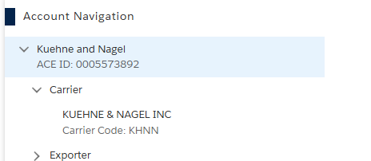
Locating Carrier Account
Locate Carrier Account
  Necessary for adding authorized partners
  Ensures proper management of Type 2 custodial bond
Notes:
To add authorized partners for the Type 2 custodial bond, first locate the carrier account. This step is crucial for proper bond management.
Original Content:
1. Locate the carrier account to add authorized partners for the Type 2 custodial bond.

Slide 27
Adding New Partner Authorization
Select the Add Authorized Partner button
  Initiates the process of adding a new partner
Add New Partner Authorization dialog box
  Displays upon selecting the button
Steps in the dialog box
  Follow instructions to complete authorization
Notes:
To add a new authorized partner, select the Add Authorized Partner button. This will display the Add New Partner Authorization dialog box. Follow the steps in the dialog box to complete the authorization process.
Original Content:
3. Select the Add Authorized Partner button.
The Add New Partner Authorization dialog box displays.
4. In the Add New Partner Authorization dialog box:

Slide 28

Search for Partner
Selecting Partner Type
  Select the SCAC radio button to add an authorized carrier
  Select the Filer Code radio button to add an authorized broker
Entering Partner Information
  Type the SCAC or filer code of the partner to authorize in the respective field
Locating the Partner
  Select the Search button to locate the partner to authorize
Notes:
To search for a partner, first select the SCAC or Filer Code radio button. Then, enter the SCAC or filer code of the partner and click the Search button to locate them.
Original Content:
a. For *Search for Partner:
i. Select the SCAC radio button to add an authorized carrier.
OR
ii. Select the Filer Code radio button to add an authorized broker.
b. In the *SCAC or *Filer Code field, type the SCAC or filer code of the partner to authorize.
c. Select the Search button to locate the partner to authorize.

Slide 29
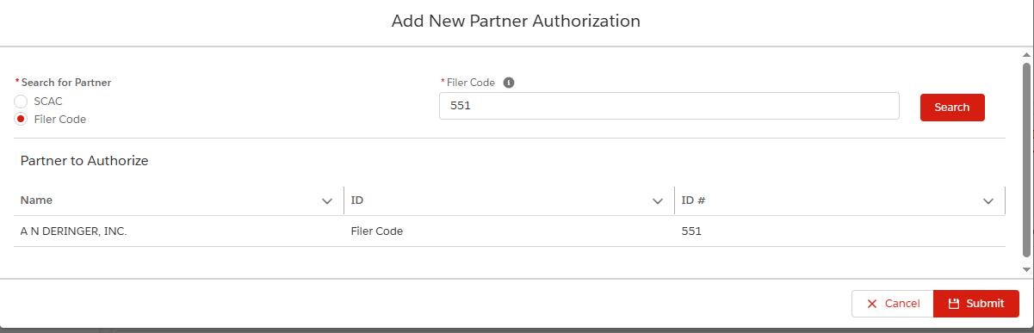
Submitting New Partner
Partner to Authorize Section
  Displays the Name, ID, and ID # of the partner
Submit Button
  Select to add the new authorized partner
Authorization Successful Message
  Displays upon successful authorization
Notes:
The Partner to Authorize section shows the partner's Name, ID, and ID #. Click the Submit button to add the new authorized partner. A message will confirm successful authorization.
Original Content:
The Partner to Authorize section displays the Name, ID, and ID # of the partner.
d. Select the Submit button to add the new authorized partner.
The Authorization Successful message displays.

Slide 30

Introduction to Removing Partners
Removing Authorized Partner
  Carriers can terminate the relationship anytime
  Authorized partner is removed from the In-Bond Authorization list
Important Consideration
  Another partner must be added before removing the solo authorized partner
Notes:
Carriers can terminate an In-Bond Authorization relationship by removing the authorized partner from the list. However, if there is only one authorized partner, another must be added before removal.
Original Content:
Carriers may terminate an In-Bond Authorization relationship at any time by removing the authorized partner. The carrier or broker is removed from the In-Bond Authorization list in the In-Bond Authorization tab.
IMPORTANT: If there is only one authorized partner, another authorized partner must be added before the solo authorized partner can be removed.

Slide 31
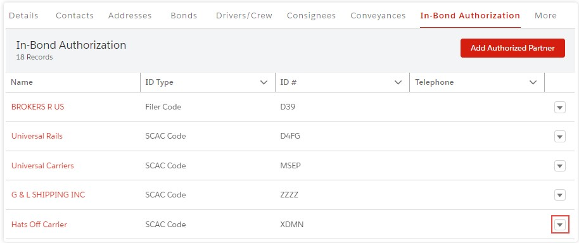
Steps to Remove Partner
In-Bond Authorization Tab
  Access the In-Bond Authorization list
  Select the down arrow actions icon
Removing an Authorized Partner
  Select 'Remove' from the drop-down menu
  Confirm dialog box will display
  If only one partner exists, an 'Invalid Operation' message will display
Adding an Authorized Partner
  Use the 'Add Authorized Partner' button
  Add another partner before removing the only existing one
Notes:
To manage authorized partners, access the In-Bond Authorization tab. To remove a partner, select 'Remove' from the drop-down menu and confirm. If only one partner exists, add another before removing.
Original Content:
1. In the In-Bond Authorization tab, in the In-Bond Authorization list, to the right of the row . 2 . In the drop-down menu, select the Remove option. The Confirm dialog box displays. NOTE : If only one authorized partner exists, an Invalid Operation message displays. for the authorized partner to remove, select the down arrow actions icon
Use the Add Authorized Partner button to add another authorized partner prior to removing the only existing authorized partner.
TABLE
OF CONTENTS
Topic 1: Add an
Authorized Partner............................................................................................................ 2
Topic 2: Remove
an Authorized Partner...................................................................................................... 5
Topic 3: Add a
Port Authorization and Date Range..................................................................................... 7
Topic 4: Edit
Date Range and Remove a Port Authorization...................................................................... 10

Slide 32

Success Message
Success Message Displayed
  Indicates successful removal
Authorized Partner Removed
  Partner no longer on In-Bond Authorization list
Notes:
The success message confirms the authorized partner has been successfully removed from the In-Bond Authorization list.
Original Content:
The Success message displays.
The authorized partner is removed from the In-Bond Authorization list.

Slide 33
Introduction to Port Authorization
Restriction Fields for Bond Usage
  Origin Port: Departure port for goods
  Destination Port: Arrival port for goods
  Effective Begin Date: Start date of bond usage
  Effective End Date: End date of bond usage, optional
Default Settings for New Authorized Partners
  Origin Port and Destination Port default to All
  Effective Begin Date defaults to partner addition date
  No Effective End Date entered by default
Important Steps for Adding Specific Port Authorizations
  Set Effective End Date of default All port authorization to current date
  Use Remove feature or edit Effective End Date field
Notes:
Authorized partners can have their bond usage restricted to specific ports and date ranges. The restriction fields include Origin Port, Destination Port, Effective Begin Date, and Effective End Date. Default settings apply when a new partner is added, but specific port authorizations require setting the Effective End Date of the default All port authorization to the current date.
Original Content:
The carrier can restrict an authorized partner’s use of their bond to specific ports and date ranges.
The restriction fields are:
• Origin Port - The port from which the goods are being requested to depart.
• Destination Port - The port to which the goods are being requested to be transported.
• Effective Begin Date - The start date of the authorized bond usage.
• Effective End Date - The end date of the authorized bond usage. If no end date is entered there will be no date restrictions on the use of the bond.
A new port authorization is automatically added when a new authorized partner is added. The Origin Port and Destination Port fields default to All. The Effective Begin Date field defaults to the date the authorized partner was added. The Effective End Date field is not entered, indicating no end date restriction.
IMPORTANT: Before specific port authorizations can be added, the Effective End Date of the default All port authorization must be set to the current date. Use the Remove feature or edit the Effective End Date field.

Slide 34
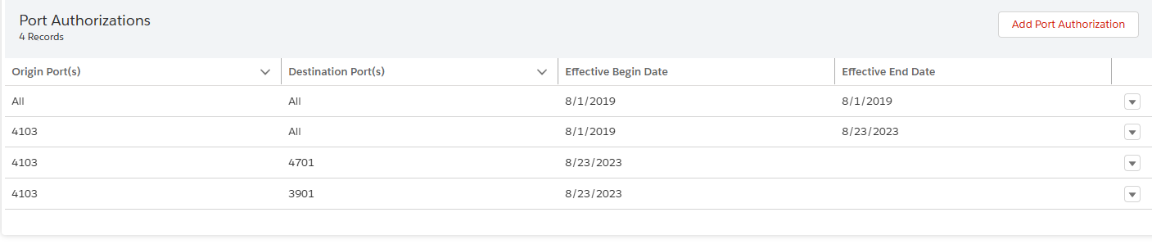
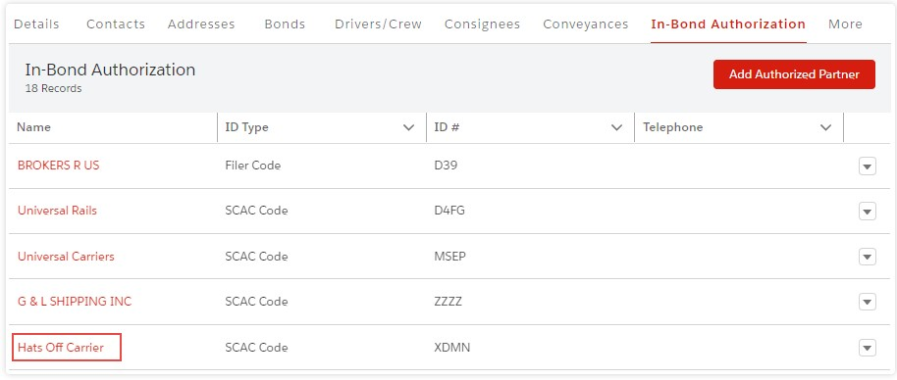
Setting End Date for All Ports
Accessing In-Bond Authorization
  Select the authorized partner hyperlink in the Name column
  The In-Bond Authorization Information pane displays
Setting End Date for Default All Port Authorization
  In the Port Authorizations section, locate the All port row
  Select the down arrow actions icon
  Choose the Remove option from the drop-down menu
  Confirm the action in the dialog box by selecting OK
  The Success message displays, and the Effective End Date is updated to the current date
Notes:
To set the end date for the default All port authorization, select the authorized partner hyperlink. In the Port Authorizations section, remove the All port authorization and confirm the action. The end date will be updated to the current date.
Original Content:
1. In the In-Bond Authorization tab, in the Name column, select the authorized partner hyperlink.
The In-Bond Authorization Information pane displays.
NOTE: The generated port authorization defaults to All when a new authorized partner is added. To add specific ports, the Effective End Date of the All port must be set to the current date.
2. To set the end date of the default All port authorization, in the Port Authorizations section:
a. In the All port row, to the far right, select the down arrow actions icon . b. In the drop-down menu, select the Remove option. The Confirm dialog box displays. c. Select the OK button.
The Success message displays.
The Effective End Date of the authorized port is automatically updated to the current date.

Slide 35
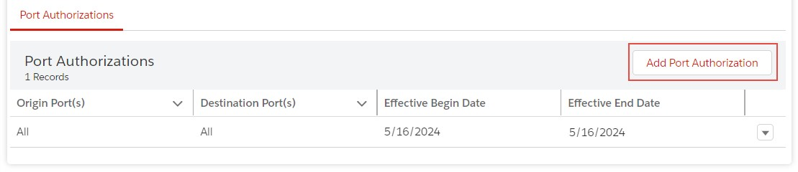
Adding Specific Port Authorization
Selecting Effective End Date
  Use the Edit drop-down menu
  Type the current date in the Effective End Date field
  Select the Submit button
Adding a Specific Port Authorization
  Go to the Port Authorizations section
  Select the Add Port Authorization button
  Uncheck the default All Ports checkbox
  Select a specific port
  Effective Begin Date defaults to the current date
Notes:
To add a specific port authorization, first select the Edit drop-down menu and enter the current date in the Effective End Date field. Then, go to the Port Authorizations section, click the Add Port Authorization button, uncheck the All Ports checkbox, and select a specific port. The Effective Begin Date will default to the current date.
Original Content:
TIP : You can also select the Edit drop-down menu option, type the current date in the Effective End Date field, and select the Submit button. 3 . To add a specific port authorization, in the Port Authorizations section:
a. Select the Add Port Authorization button.
The Add New Port Authorization dialog box displays.
NOTE : Uncheck the default All Ports checkbox to enable selecting a specific port. The Effective Begin Date defaults to the current date. b. To add a port of origin authorization:
i. Uncheck the All Origin Ports checkbox.
ii. In the Port of Origin field, type a complete or partial port code or name and select it from the drop-down menu.
c. To add a destination port authorization:
i. Uncheck the All Destination Ports checkbox.
ii. In the Destination Port field, type a complete or partial port code or name and select it from the drop-down menu.
d. If applicable, to edit the default date in the *Effective Begin Date field, type a begin date or select it using the Calendar icon.
e. If applicable, in the Effective End Date field, type an end date or select it using the Calendar icon.
f. Select the Submit button.
The Save Successful message displays.

Slide 36
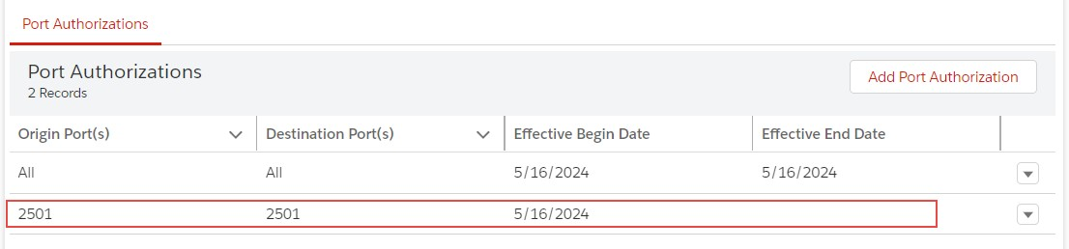
Viewing Port Authorization
Functionality for Carriers
  Allows control over Type 2 custodial bonds
  Manage authorized partners
ACE Modernized Portal
  Platform for carriers
  Enhances bond management
Notes:
Carriers can use the ACE Modernized Portal to create in-bond authorized partners. This feature helps carriers manage who can obligate their Type 2 custodial bonds, providing better control and management.
Original Content:
Carriers can create in-bond authorized partners in their ACE Modernized Portal account. This functionality allows the carrier to control who obligates their Type 2 custodial bonds.

Slide 37

Introduction to Editing Date Range
Begin and End Dates Editable
  Only the begin and end dates of an authorized port can be changed
Changing Authorized Port
  Remove existing port authorization entry
  Add new port authorization
Automatic Update on Removal
  Effective End Date updates to current date
  Authorized port is not deleted
Notes:
To edit an authorized port, you can only change the begin and end dates. To change the port itself, remove the existing authorization and add a new one. When you remove a port, the Effective End Date updates automatically to the current date, but the port is not deleted.
Original Content:
Only the begin and end dates of an authorized port are editable. To change the authorized port, remove the existing port authorization entry and add a new port authorization.
Removing an authorized port automatically updates the Effective End Date to the current date. It does not delete the authorized port.

Slide 38
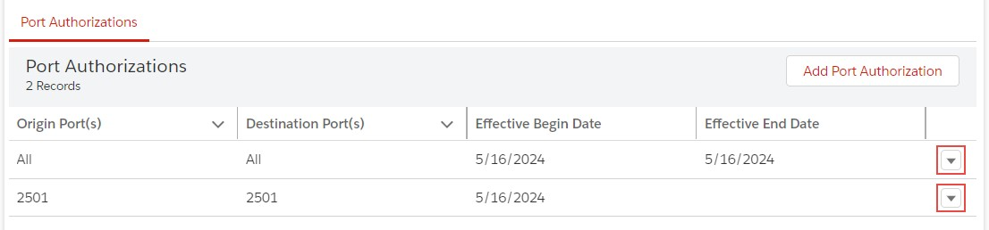
Steps to Edit Date Range
Accessing Port Authorizations
  Select the down arrow actions icon in the port row
  Choose the Edit option from the drop-down menu
Editing Port Authorization
  Open the Edit Port Authorization dialog box
  Note: Only the Effective Begin Date can be edited
Notes:
To edit port authorizations, select the down arrow actions icon in the port row and choose the Edit option. In the Edit Port Authorization dialog box, only the Effective Begin Date can be edited.
Original Content:
. 1 In the Port Authorizations section: a. In the port row, to the far right, select the down arrow actions icon . b. In the drop-down menu, select the Edit option. 2 . In the Edit Port Authorization dialog box: NOTE : Only the Effective Begin Date and Effective End Date fields are editable.
a. If applicable, in the *Effective Begin Date field, type a begin date or select it using the Calendar icon.
b. If applicable, in the Effective End Date field, type an end date or select it using the Calendar icon.
c. Select the Submit button.

Slide 39
Steps to Remove Port Authorization
Access Port Authorizations section
  Select the down arrow actions icon
Choose the Remove option from the drop-down menu
  Confirm dialog box will appear
Click OK to remove the authorized port
Notes:
To remove an authorized port, go to the Port Authorizations section and select the down arrow actions icon. From the drop-down menu, choose the Remove option. A confirmation dialog box will appear. Click OK to finalize the removal.
Original Content:
1. In the Port Authorizations section, in a port authorization row, to the far right, select the
down arrow actions icon . 2 . In the drop-down menu, select the Remove option. The Confirm dialog box displays.
3. Select the OK button to remove the authorized port.

Slide 40
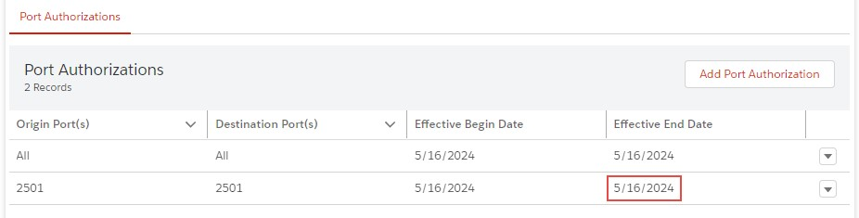
Success Message
Success Message
  Displays upon successful addition of partner
Automatic Entry Creation
  All ports of origin and destination ports
  Begin date set to partner addition date
  No end date specified
Notes:
When an authorized partner is added, a success message is displayed. An entry is automatically created for all ports of origin and destination ports, with the begin date set to the date of partner addition and no end date.
Original Content:
The Success message displays.
The Success message displays.
Adding an authorized partner automatically creates an entry for All ports of origin and destination ports with a begin date of when the authorized partner was added and no end date.

Slide 41
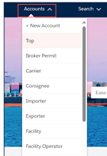
ACE Reports for In-Bonds
Access “Top” Account from Accounts drop-down menu
Select “Organizational Broker” – For Broker Reports
Select “Carrier” – For Carrier Reports
Select Public Folder
  Select Trade
  Select In-Bond

Slide 42
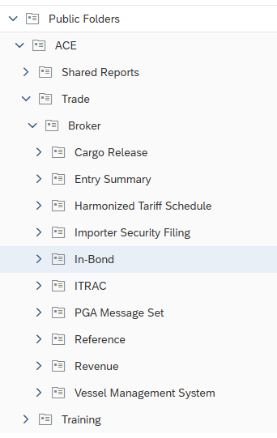
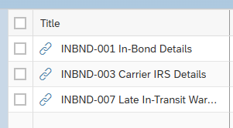
ACE Reports for In-Bonds
Most Common Report to manage in-bonds filed as a broker is INBND-001

Slide 43
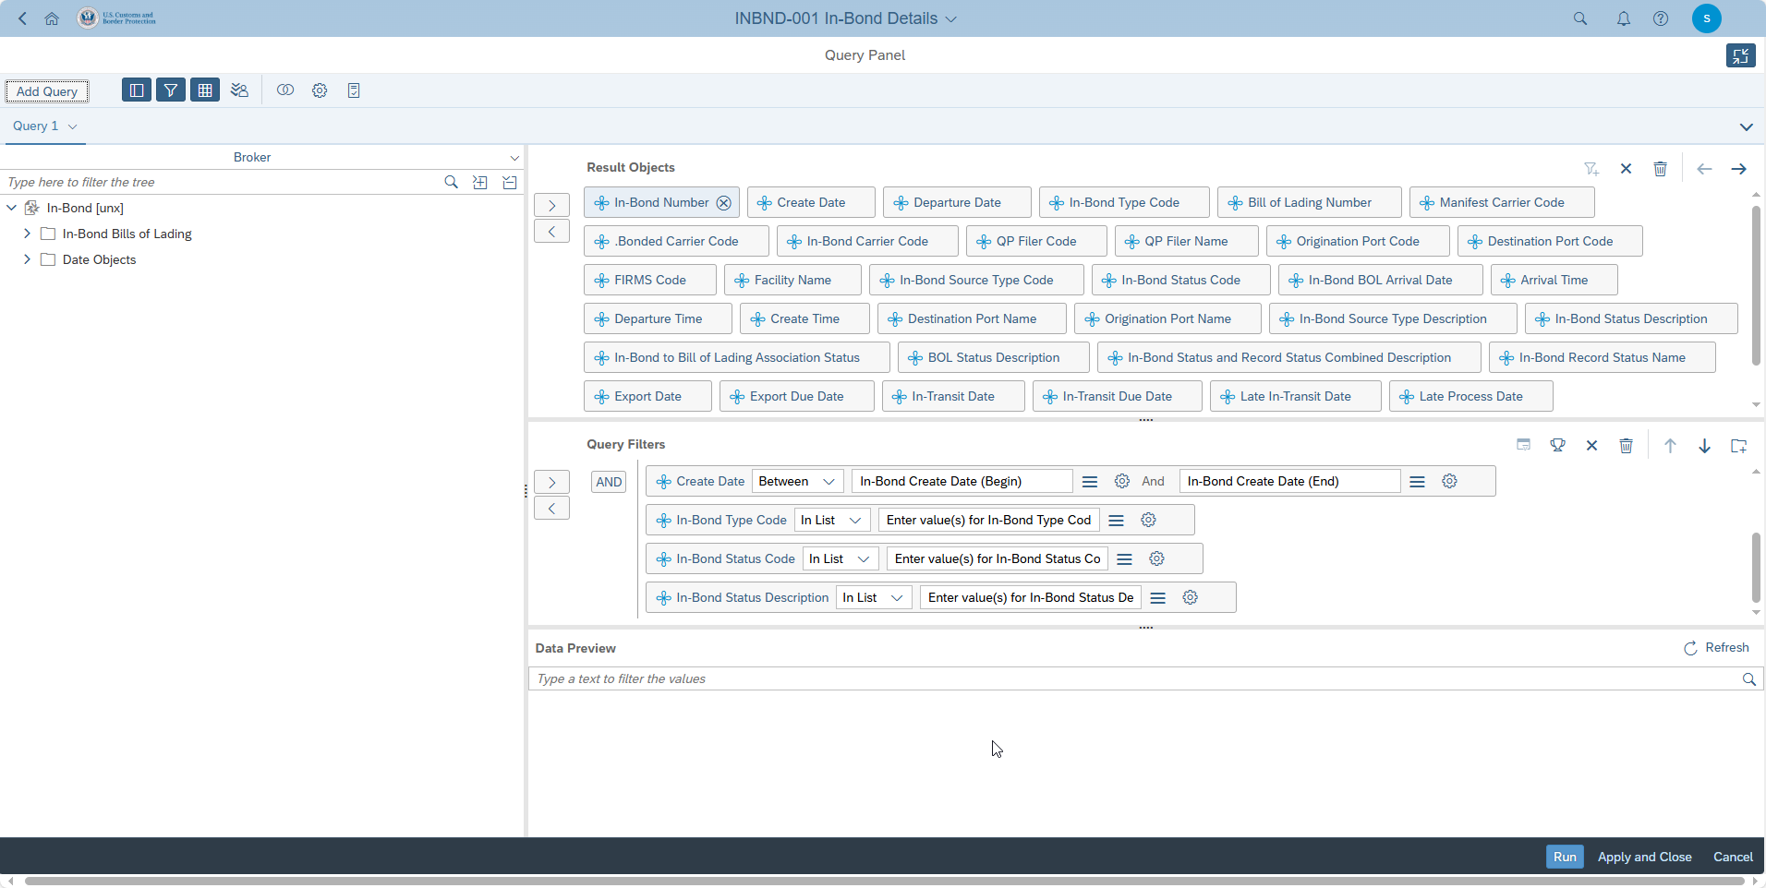
ACE Reports for In-Bonds
The standard report will give basic information – it is best to “DESIGN” a report to add key dates and status

Slide 44
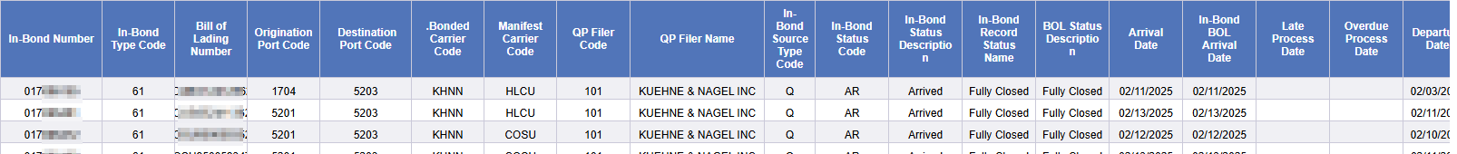
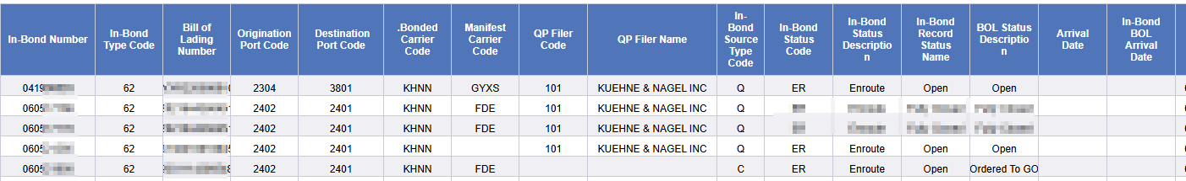
ACE Reports for In-Bonds
Below is an excerpt showing data with a “Designed” report. As you see you can see the status of the In-Bond as well as the BOL Status.
Here you will see exceptions that require research and action.

Slide 45
Five (5) Most Common Status Codes
On File: The in-bond will have this designation immediately after it is created but before the consignment enters the States.
Enroute: An enroute designation is given to s shipment upon initial entry into the United States. It can also be given immediately after the creation of the in-bond if it is for a foreign trade zone withdrawal or a bonded warehouse. The designation usually means that the in-bond movement from the port of origination to the destination port has kicked off. According to regulations, these in-bond shipments need to be at their destination in no more than 30 days or else they will be declared overdue.
Arrived: An in-bond will be designated as arrived once it reached the destination port in the United States and its arrival reported to the Customs & Border Protection (CBP) Agency electronically. Such a designation will typically complete the in-bond process for Immediate Transportation (type 61) type in-bonds as after this they will typically be deemed “closed.”

Slide 46
Five (5) Most Common Status Codes
Exported: Goods that have left the US are designated as exported once they have been reported as such to the CBP through electronic means. They could also be deemed exported when the shipment is in a location in which export is reasonably certain. For instance, goods at an airport, seaport or rail location and under a carrier charged with exporting them. This designation signifies the end of the in-bond process for type 62 (Transportation & Exportation) and type 63 (Immediate Export) which will then be deemed “closed.”
Concluded: In some situations, the in-bond will be concluded by the filing of a succeeding bond. In such an instance, the in-bond will show as “arrived.” Once a succeeding in-bond is filed, the previous one will be designated as “Concluded” given that the liability will transfer from the old to the new in-bond and in doing so complete the in-bond process. The initial in-bond will then be deemed “closed.”

Slide 47

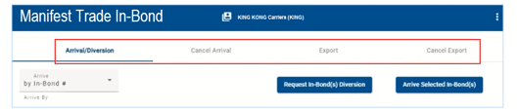
Using ACE to Arrive or Export In-Bond
Access “Carrier” Account
Select “Manifest Trade In-Bond”

Slide 48
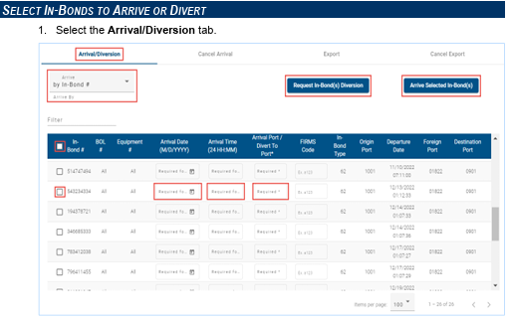
Using ACE to Arrive/Divert or Export In-Bond
Choose the action you would like to take. Check the in-bond and populate the information.
You may also choose to cancel the arrival or exportation.
This functionality is only available for in-bonds moving on your carrier bond. If you filed the in-bond as a broker, the carrier has this same functionality in their ACE Portal.

Slide 49
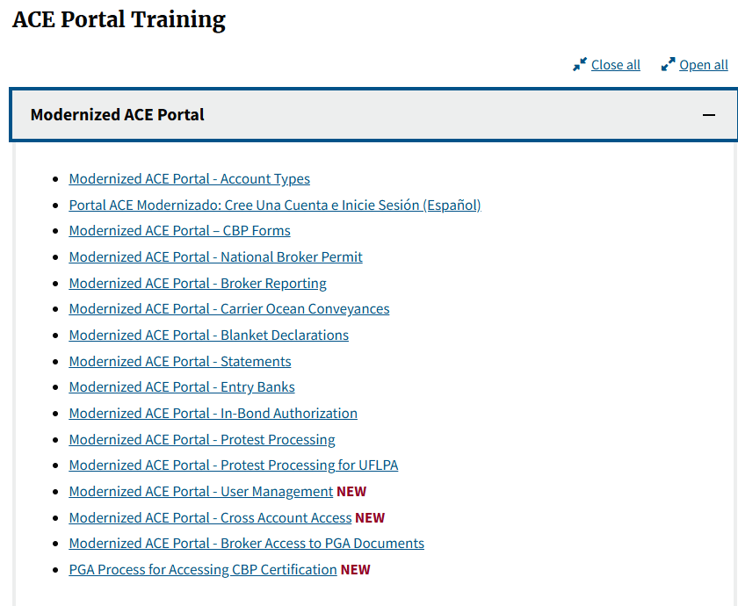
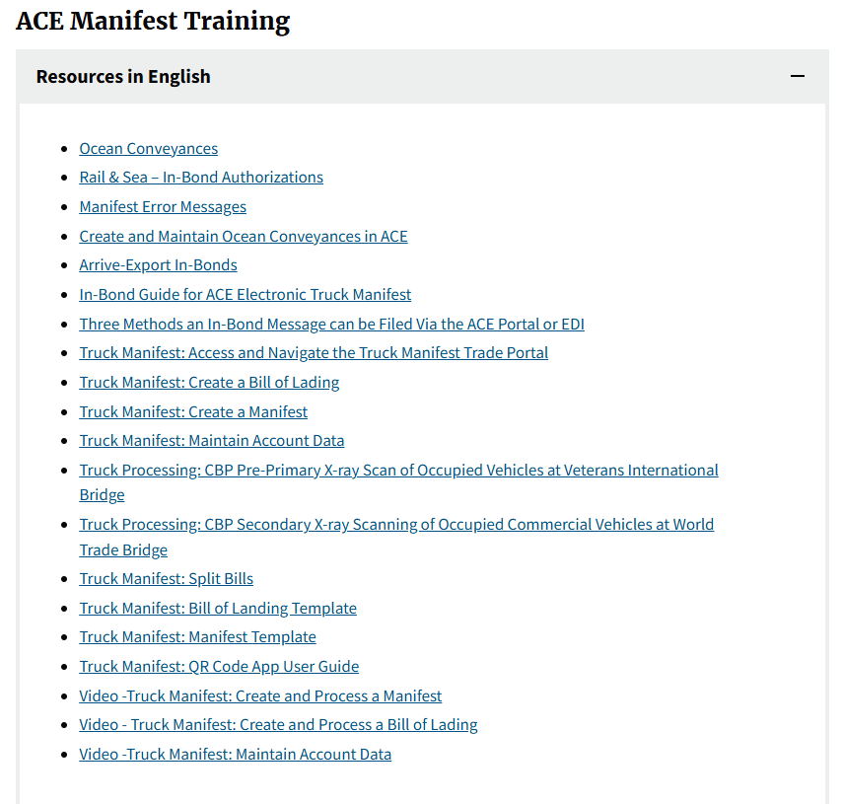
Resources
ACE Training and Reference Guides
  Access Training for the Portal
  Use ACE Manifest Training for Carrier specific resources
ACE Portal

Slide 50

Questions & Comments

Slide 51

In-Bonds, Shaken Not Stirred – Simply Perfect

