Slide 1




Manifest Destiny: Conquering ICS2-ENS & Understanding EEM Compliance
Panelists:
Moderator:
Tom Lloyd
Vice President - Customer Relations & Data Services, Trade Tech, Inc
Merit Tremper
NCBFAA Logistics Subcommittee Chair; President, Merit Trade Consulting Services LLC
Fany Flores-Pastor
Sr. Director, Product Management, Descartes Systems (USA) LLC.
Kim Calicott
NCBFAA Transportation Committee Chair; National Export Compliance Manager & ISO Coordinator, Mallory Alexander International Logistics, LLC

Slide 2

Manifest Destiny: Conquering ICS2-ENS & Understanding EEM Compliance
Moderator:
Merit Tremper, Merit Trade Consulting Services LLC and NCBFAA Logistics Subcommittee Chair
Speakers:
Fany Flores-Pastor, Descartes Systems (USA) LLC
Tom Llyod, Trade Tech Inc.
Kim Calicott, Mallory Alexander International Logistics, LLC and NCBFAA Transportation Committee Chair
Notes:
Merit Intro

Slide 3

Manifest - Security Around the World
2002: USA AMS
2005: Canada ACI
2006: Mexico AMS
2009: USA 10+2 / ISF
2008: USA AES
2011: EU ENS (ICS – MBL)
2014: Japan AFR
2016: Canada e-Manifest
2018: South Africa SARS
2022: Egypt
2024: EU ENS (ICS Release 3)
2025: EU ENS (Road & Rail)
2025: GB ENS
2025: UAE MPCI
TBD: Electronic Export Manifest
Notes:
Merit open then turn over to Tom

Slide 4
European Union ICS2 and ENS for Non-Vessel Operating Common Carriers (NVOCCs)
Notes:
Tom

Slide 5
What are ICS2 and ENS?
ICS2 is the EU Customs Advance Cargo Information System
ENS is the name of the filing
When to file? - FCL, LCL, BBK
Who needs to file? – Imports, In-transit and transshipment, FROB
Consequences for non-compliance - penalties, “Do Not Load” / “Holds”, Demurrage and Delays
    ICS2- ENS Ocean Go Live - April 1, 2025 – HBL (House level filers)
Notes:
Tom

Slide 6
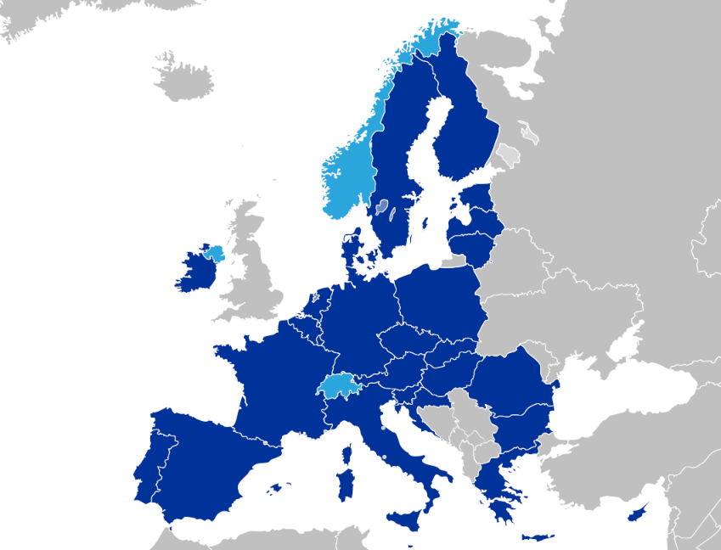
EU ENS Participants
27 EU Member States
• Austria
• Belgium
• Bulgaria
• Croatia
• Cyprus
• Czech Rep.
• Denmark
• Estonia
• Finland
• France
• Germany
• Greece
• Hungary
• Ireland
• Italy
• Latvia
• Lithuania
• Luxembourg
• Malta
• Netherlands
• Poland
• Portugal
• Romania
• Slovakia
• Slovenia
• Spain
• Sweden
+ Switzerland, Norway
& Northern Ireland
Notes:
Tom

Slide 7
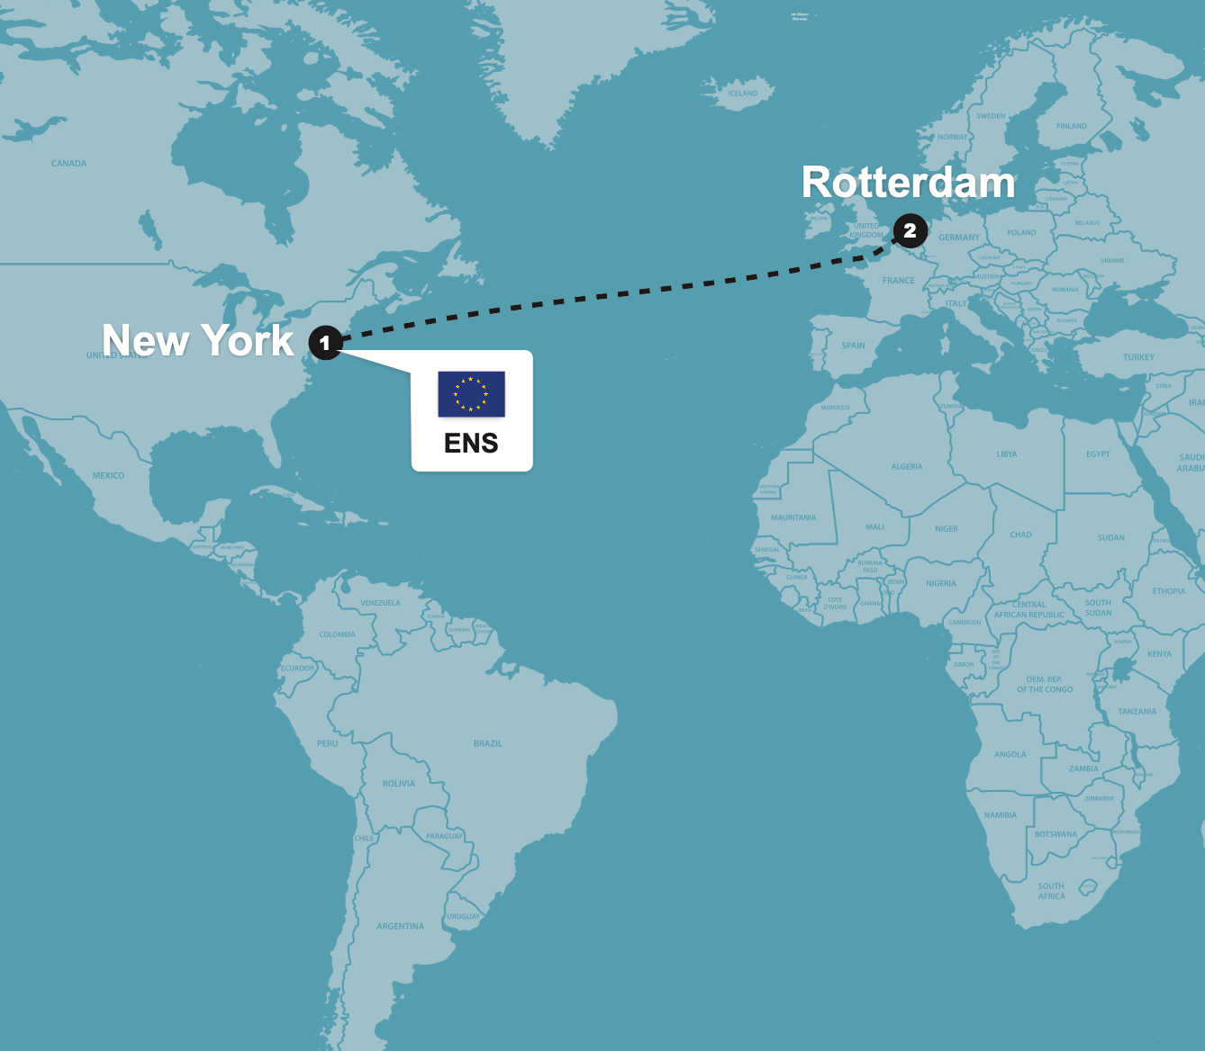
ICS2 ENS Filing – Scenario 1
The majority of ENS filings will be port to port shipments.
Example:
Vessel – New York to Rotterdam
This also applies to any shipment to the EU: Shanghai to Rotterdam for example.
Notes:
Tom

Slide 8
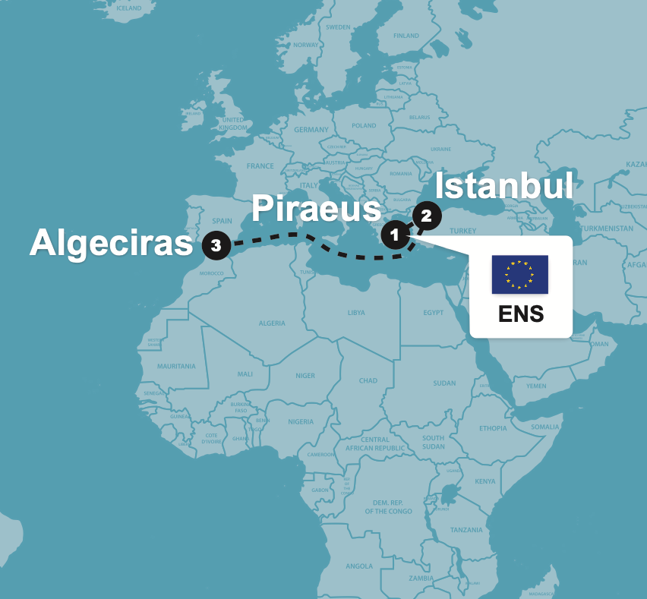
ICS2 – EU Exit Routing – Scenario 2
Export shipments from the EU where the vessel makes a port call outside of the EU and then returns to the EU, require ENS filing.
Shipment from Piraeus to Algeciras:
Vessel sails from Piraeus to Istanbul (Turkey) and then to final POD Algeciras (SP).
Notes:
Tom

Slide 9
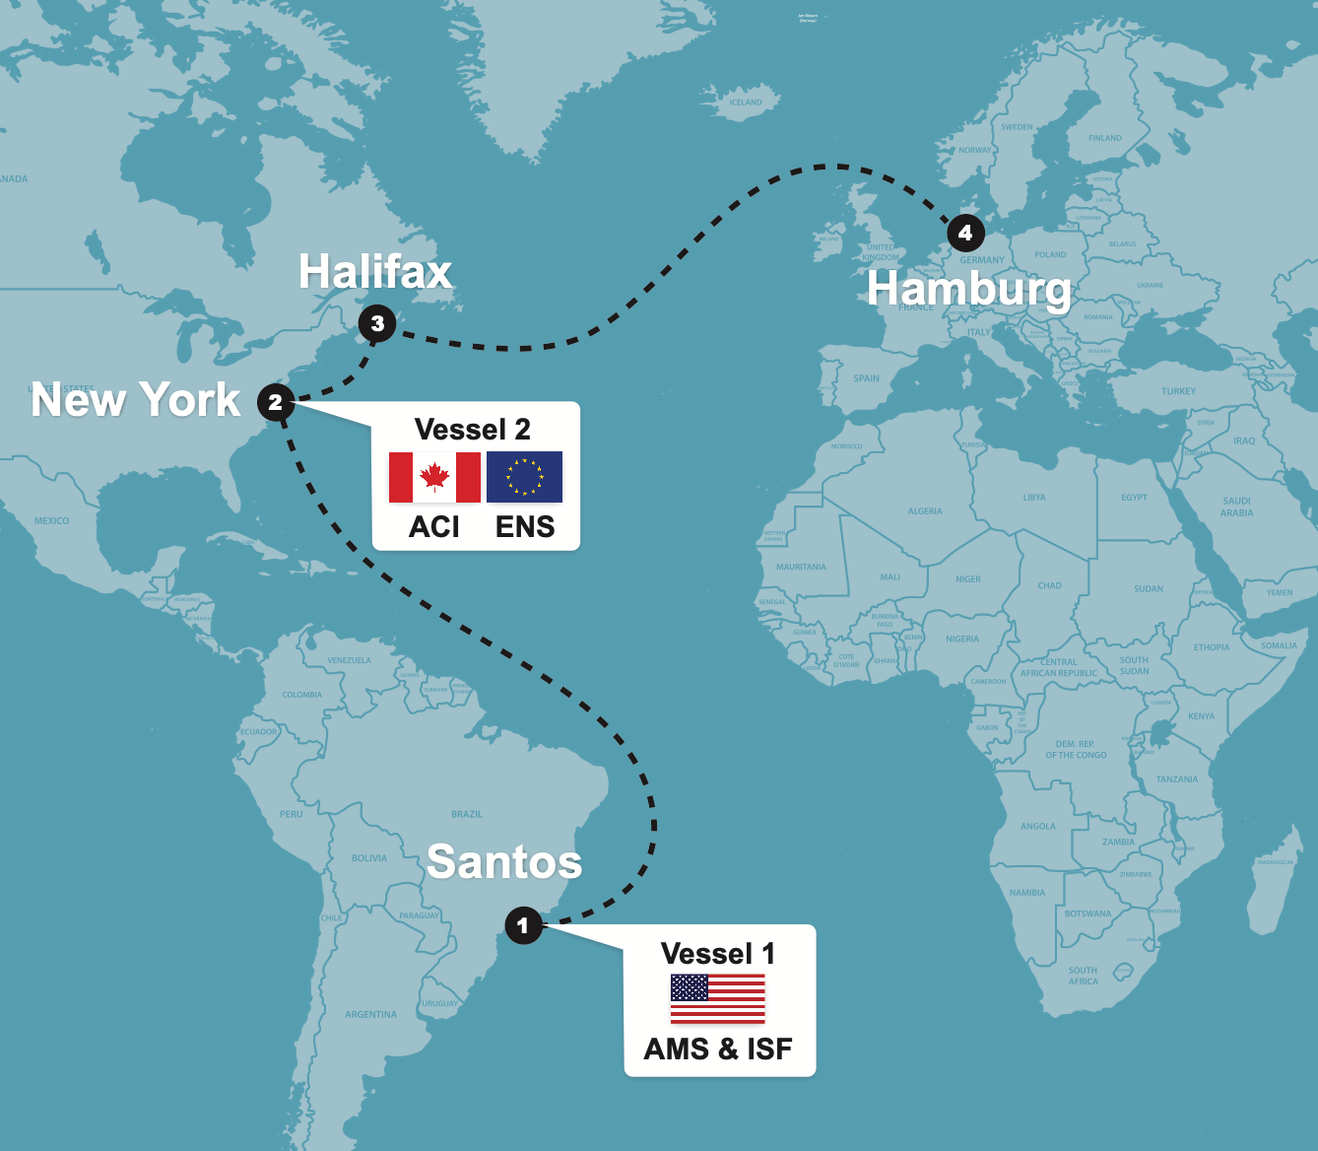
ICS2 - Multiple Security Filings
A single shipment may require multiple manifest/security filings.
For example, here is a scenario for a shipment departing from Santos, Brazil destined to Hamburg, Germany:
Vessel 1 – Santos to NYC needs AMS and ISF filing
Vessel 2 – NYC to Hamburg needs ACI (master level only) for Canada and EU ENS
Notes:
Tom

Slide 10
Who Can File an ENS into ICS2
The European Commission defined “person filing” as “Person filing means any person that submits to the customs authority ENS filing in its complete or partial content and other notifications in the prescribed form and manner. This person can be any person that issues bill of lading or air waybill and can be either carrier, NVOCC (i.e. freight forwarder), or any person identified by the legal provisions obliged to submit required particulars of ENS to the customs and can include postal operator, consignee stipulated in the lowest bill of lading. Person filing also includes representative of any of the persons mentioned above that submits the ENS filing in its complete or partial content to the customs authority on behalf of the person that it is representing.”
ENS can be filed by:
NVOCC self filer
  Proprietary programing
  Software vendor
    For example: Trade Tech, Inc. provides users the capability to enter shipment data once and execute multiple filings simultaneously.
      Vessel 1 – Santos to NYC
      Vessel 2 – NYC to Hamburg
  NVOCC’s EU office
NVOCC’s partner agent at destination
VOCC/master-loader
  NVOCC provides HBL and commercial party data to the underlying carrier who will file house details
Notes:
Kim

Slide 11
Who Needs an EU EORI
An Economic Operators Registration and Identification (EORI) must be obtained by:
An economic operator with an establishment in the EU customs territory
An economic operator outside of the EU who will be conducting “customs activities” within the EU.
This includes entities filing ENS into ICS2.
Notes:
Kim

Slide 12
Which Filing Type for House Filers
F14 – House-level data only (no buyer/seller info)
Used when the underlying carrier files an F12.
Must include the EORI of the supplementary declarant who will submit the F16.
F15 – Complete house-level + goods data
Used when the carrier files an F12 and the house-level filer has full data, including buyer and seller details.
F16 – Goods shipment data only
Filed when F12 and F14 have been submitted.
Often submitted by importers or their representatives (per EU documents).
F17 – House filer for straight B/L (not a consolidation)
Used when the underlying carrier files with code F13.
Valid filing type combinations:
(F12 and F13 are filings done by the vessel owner carrier)
F12+F14+F16
F12+F15
F13+F17
Notes:
Kim

Slide 13
Core ENS House Level Data
Shipment
  HBL and MBL numbers
Party data
Declarant/filer
Underlying carrier details and EORI
Consignee’s details and EORI
Shipper’s details
Buyer’s and seller’s details (for shipments destined to covered locations)
Notify party details and EORI
Goods data
Description
  DG data required when applicable
HS code (6-digit)
Gross mass
Quantity and type of package(s)
Shipping marks
Container details
Routing and date data
Locations: place of receipt, loading, unloading, and delivery
ETD
Payment data
  Payment method of house level services
Notes:
Kim
-each party will need type reported- (person (natural person), group designated as person (legal person) or company)

Slide 14



ENS Status Codes
IE3R01 |  | Filing Accepted
IE3N10 |  | Amendment Accepted
IE3R07 |  | Cancellation Accepted
IE3N99 or IE3N01 |  | ENS (Filing, Amendment, Cancellation) Rejected
IE3Q02 |  | Additional Information Request
IE3R08 |  | IE3R08 (Received in response to Trade Tech querying the status of an ENS filing)
IE3Q03 |  | Cargo Screening Request
IE3Q01 |  | Do Not Load
IE3N04 |  | Additional Information Request Notification
IE3Q02) |  | gets Additional Information Request / IE3Q02)
IE3N05 |  | Cargo Screening Request Notification - (Sent to carrier when party filing HBL gets
IE3Q03) |  | Cargo Screening Request
IE3N03 |  | Risk Assessment Complete
IE3N09 |  | AEO Control Notification - (Notification about the controls that will be performed on the goods)
IE3N02 |  | ENS Not Complete Notification - (Sent to Party that filed MBL / Master HBL letting them know party responsible for filing underlying HBL hasn't filed yet)
IE3N11 |  | ENS Pending Notification - (Sent to Party that was supposed to file HBL under MBL or Master HBL but has not done so yet)
Notes:
Kim – mention that these are availible for reference

Slide 15
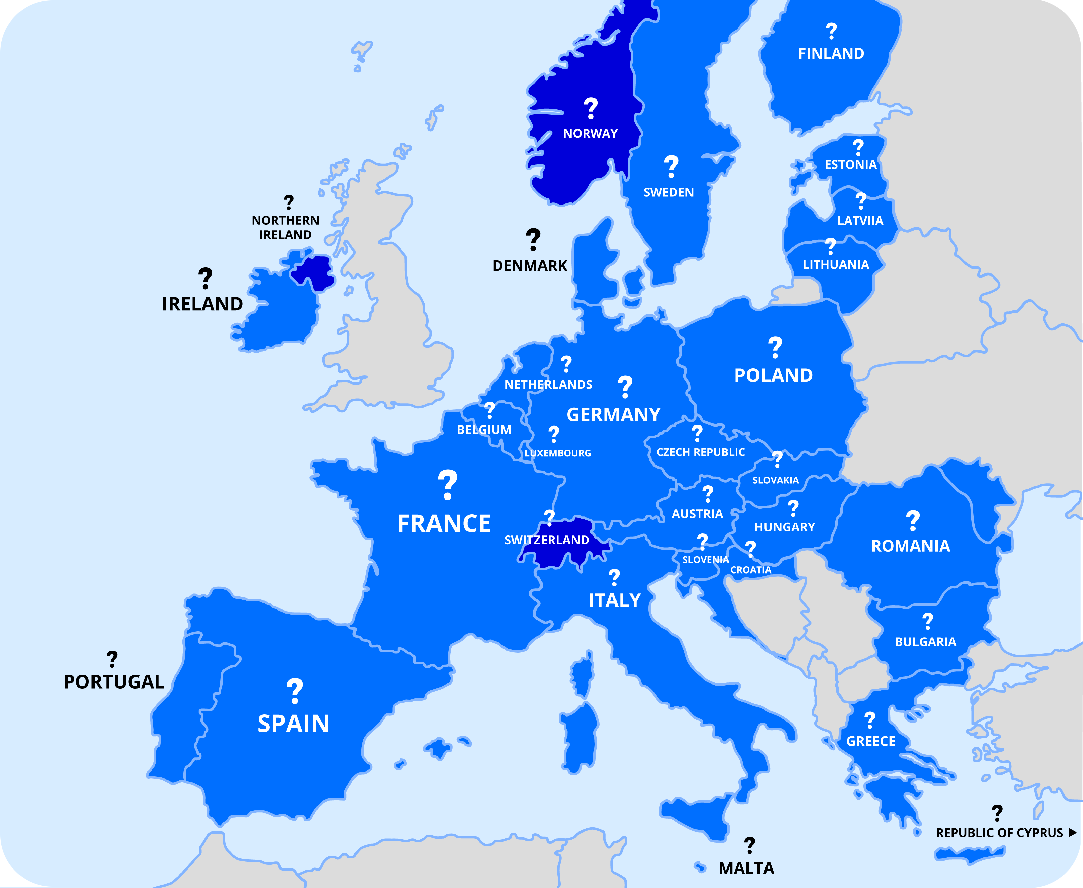
ICS2 – ENS No Central Point of Contact
  • Each EU Member State will deal with filing resolution related to that State
  • Who resolves issues?
Your Origin Office?
Your Destination Office?
Notes:
Tom

Slide 16
Resolving error messages
CIRCABC resources such as the operational guide: https://circabc.europa.eu/ui/group/18fb5859-3970-4ac5-b30b-6604977a15a7/library/16e29912-d290-417e-a45c-b286407e1770
Following are some of the topics covered:
  Filing time frames: For ocean originating outside of the EU, the filing must be completed at the latest 24 hours prior to loading the items onto the vessel that will call the EU port
  Linking of ENS: NVOCCs will need to include the underlying carrier’s EORI in their ENS filing and underlying carrier will need to include the NVOCC’s EORI in the ENS when the NVOCC is the supplementary declarant
  Assessment notifications: These notifications include an “assessment complete” notification to the carrier and declarant, as applicable.
  Amendments: An amendment cannot be made after customs flagged the goods for inspection or the goods have been presented to customs.
Notes:
Kim

Slide 17
ICS2 ENS Filing References from EU
EU’s web-based application Communication and Information Resource Centre for Administrations, Businesses and Citizens (CIRCABC):
The EU’s reference guide for error messages is the Interface Control Document, error messages start on page 90 https://circabc.europa.eu/ui/group/18fb5859-3970-4ac5-b30b-6604977a15a7/library/2d1142eb-eab4-4886-974b-c26e9b1d3c20/details
CIRCABC landing page with various ICS2 resources https://circabc.europa.eu/ui/group/18fb5859-3970-4ac5-b30b-6604977a15a7/library/16e29912-d290-417e-a45c-b286407e1770
Notes:
Kim

Slide 18
More to the Story
EU ENS for Road and Rail begins April 1, 2025 – at the “carrier” level
At the HBL level (CMR or CIM Waybill level) – projected for Q2 2026
Great Britain Safety & Security - all goods entering Great Britain require a Safety & Security declaration and a UK EORI number –
Ocean for master data is in effect
Projected implementation for house bill data requirement of Q2 2026
UAE - Maritime Pre-Load Cargo Information (MPCI) Program - July 2025
Notes:
Tom – then –
Merit it follow up with questions: e.g., what should be done if the ICS2 system is down or the filers software is down and the house level END cannot be filed within the proper time frame.
1. Absence of a N03 (risk assessment complete) People think this is required, but it is not.
2. Master loaders not providing the master BL number to the House filer in time for the filing.
3. EORI Numbers (consignee EORI numbers, people outside the EU or using a GB EORI)
4. What are the most common causes of security Issues or other filing issues that you’ve seen so far? (People not filing correctly. Incorrect data, or incorrect BL type.)
5. EU customs is using the UNLOCODE data base from 2017, any city added since 2017 will be rejected. Where would one find the list of codes that will be accepted?
6. When cargo leaves the EU touches a foreign entity then comes back to the EU, ENS is required.
7. What is the ENS Error "71 House Consignment in a wrong state, Presented"

Slide 19
Electronic Export Manifest (EEM)
Notes:
Tom

Slide 20
Electronic Export Manifest
What is EEM?
  The U.S. Customs and Border Protection (CBP) Electronic Export Manifest (EEM) is an initiative under the Automated Commercial Environment (ACE) aimed at modernizing and automating the export manifest process. This transition from a paper-based system to an electronic one seeks to enhance trade facilitation and strengthen border security by allowing CBP to receive export manifest data electronically prior to the departure of shipments.
Objectives
  Early Identification of Issues – compliance and security concerns
  Enhanced Communication – shipment examination requirements
Notes:
Fany

Slide 21
Electronic Export Manifest
EEM will allow CBP to collect the lowest level pre-departure data for all U.S. exports as required by the Trade Act of 2002.
Since 2002, CBP has utilized Census data collected through the Automated Export System (AES) to collect advanced data on many, but not all exports.
EEM will replace the current carrier manifest process using form 1302A, intended for all export transactions across all modes of transportation.
Notes:
Fany

Slide 22
EEM Pilot Programs
Current regulations do not require the complete export manifest until after vessel departure.
The Automated Commercial Environment (ACE) Export Manifest is a voluntary test in which participants agree to submit export manifest data to CBP electronically prior to loading.
Notes:
Fany

Slide 23
Pilot Programs
CBP has implemented pilot programs based on mode of transportation
MOT | Started | Message Type
Air | July 15. 2015 | Cargo Imp IATA Cargo XML
Ocean | August 20, 2015 | CAMIR X12
Rail | September 9, 2015 | X12
Truck | N/A | ACE Portal
Multi-Modal |  | XML
Notes:
Fany

Slide 24
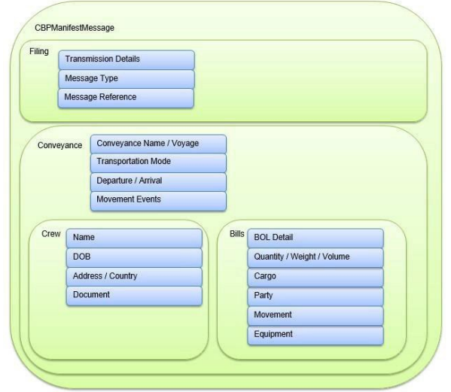
Data Elements
MMM Transaction Set
Notes:
Fany

Slide 25
Pilot Program Update
Participants
  As of February 2025, there are 21 active carrier participants*
    20 Container
    1 bulk
  These carriers are submitting 100% EEM transactions.
  Lack of participation from the NVOCC community
  * See CBP Export Manifest Appendix P for carriers submitting electronically: https://www.cbp.gov/document/guidance/appendix-p-pilot-participants-carriers-submitting-electronically
Notes:
Fany

Slide 26
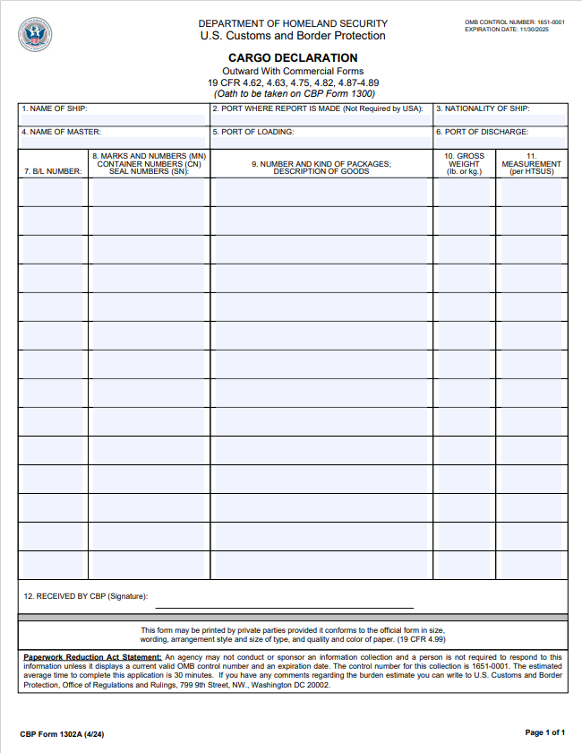
1302A Submission
Beginning on March 2012, CBP allowed CBP Form 1302A (Cargo Declaration – Outward with Commercial Forms) to be filed using Document Image System (DIS).
This is an interim step until the development of EEM was finalized.
However, extending this has allowed trade not to prioritize the use of EEM.
Currently scheduled to end on April 1, 2025. CBP may extend it…
Notes:
Fany

Slide 27
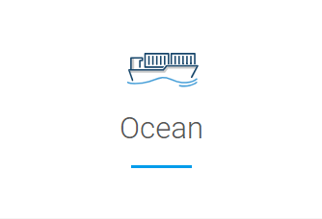
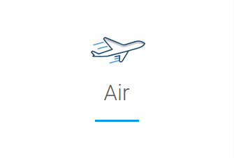
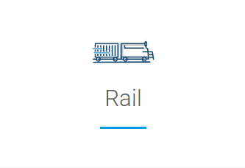
Filing Time Guidelines
24 hr. prior to vessel loading (awaiting NPRM) | 4 hr. prior to loading (awaiting NPRM) | NPRM states initial filing must be complete no later than 24 hour prior to departure with the full manifest at least 2 hr. prior to loading
Notes:
Fany

Slide 28
Enforcement Updates
CBP has the intention to enforce the use of EEM for all MOTs.
Rail Notice of Proposed Rule Making (NPRM)
  Federal Register :: Automated Commercial Environment (ACE) Electronic Export Manifest for Rail Cargo
Next NPRMs, in this order:
  Ocean (under review within Department of Homeland Security)
  Air (under review within Department of Homeland Security)
  Truck (being drafted, the ACE user interface’s target deployment is June 2025)
Notes:
Fany

Slide 29
Breakdown of EEM NPRM for Rail
  CBP issued the NPRM on January 13, 2025, and comments were due on March 14, 2025.
  NVOCCs are directly impacted by the rail rule. CBP classifies any shipment departing the U.S. via rail to a vessel in Canada or Mexico as a rail export. This includes ocean shipments routed by VOCCs through Northern or Southern border crossings.
  Rail carriers cannot file house-level data on their behalf of the NVOCC. To comply with EEM requirements, NVOCCs must develop or adopt a solution to file house-level data for these rail export transactions.
Notes:
Kim
Reviewed and submitted comments. Consensus that there are some things that should mirror imports, some things that should be an improvement over current import regs, and some things that do not have an equivalent on the import side and will be different.

Slide 30
Breakdown of EEM NPRM for Rail
  EEM filers will be required to hold a valid CBP bond.
  This ensures accountability and compliance with export manifest obligations.
    The NPRM identifies several potential filers—including outbound carriers, NVOCCs, USPPIs, FPPIs, ABI filers, and customs brokers—but places ultimate responsibility with the carrier.
  House-level data filed as part of the initial EEM filing is due no later than 24 hours before departure from the U.S.
    Early submission enables earlier CBP targeting,
    which can lead to document reviews or exams prior to cargo consolidation—reducing disruption later in the process.
Notes:
Kim
Filers will need bond…mention use of FTR language in NPRM - Clear separation between EEM and EEI; avoid FTR reference overlaps

Slide 31
Breakdown of EEM NPRM for Rail
  House level filing data elements include:
    Master bill of lading
    Precise cargo description
    Shipper’s ID or complete name and address
    Consignee’s ID or compete name and address
    ITN or exemption or exclusion statement
    Weight and quantity of goods
  Rail carrier data elements include transportation data, equipment and train specific data,
Notes:
Kim
-Master bill of lading – linking rail waybill vs. VOCC MBL
- Cargo description – asked CBP for clarification on requirements – what about licensed cargo’s desc in AES – MMM allows 100 characters vs AES 45 character

Slide 32
Breakdown of EEM NPRM for Rail
  The rule includes a requirement for data transmitters to provide a telephone number and email address that is monitored 24 hours/7 days a week.
  Updates are required upon discovery of data changes per the rule, although there is not a cutoff period.
  EEM business process document from CBP is in the works, “under review within CBP.”
Notes:
Kim
-important for modes to be harmonized as much as possible.

Slide 33
Join the Pilot
Benefits
  Cargo Processing efficiency
  Streamlined reporting and protection of proprietary shipment data
  Adapting the design and able to provide input on the process to CBP
  Elimination of redundant data elements/increased accuracy
  Better data access/proof of export
  Beneficial resolutions
  Potential cost savings
Invitation to carriers, consolidators, Indirect Air Carriers and NVOCCs.
EEM resources, including IGs and appendices, are on their website: https://www.cbp.gov/trade/ace/technical/export-manifest
NCBFAA members may access the resource, benefits, and explanation document on NCBFAA’s website: electronic-export-manifest-flyer-2024.pdf
Notes:
Fany
Merit to ask questions:
How does an NVOCC or IAC start participating in the pilot? What is needed to transmit and who helps with setup?
Are there penalties for not filing or incorrect filings? If yes, who can be penalized?
Will export PGAs use the EEM filing?
Will the EEI filer still need to include the transportation data since the manifest includes that data?

Slide 34
Summary
Engage now to avoid disruptions and ensures regulatory compliance.
  Are processes in place for filing ENS under ICS2 and addressing various responses?
  Stay informed on EEM regulatory developments.
  Have internal discussions on processes, system readiness, and resource planning begun internally?
  Consider participating in the EEM pilot program.
  Early involvement offers valuable insight, operational experience, and a voice in shaping implementation.
Notes:
Kim

