Slide 1
NCBFAA NVOCC Day 2025: NVOCC Liabilities and Common Errors (Legal)
May 22, 2025
Presented by Venable LLP
Ashley Craig, Chair, International Trade and Logistics Group
AWCraig@Venable.com
+1.202.344.4351

Slide 2
Agenda
Quick Overview of FMC’s Regulatory Domain.
    Statutes and Regulations.
    A Look at the “New” FMC.
Key Rules for NVOCCs.
What NVOs Can and Can’t Do.
Recordkeeping.
Your HBL – What Agents Should Do.
Vetting Your VOCC (and Other NVO) Partners.
Cargo Insurance and Liability.
Core Non-FMC Trade Compliance.
FMC Penalties and Enforcement Snapshot.
Questions and Answers.

Slide 3
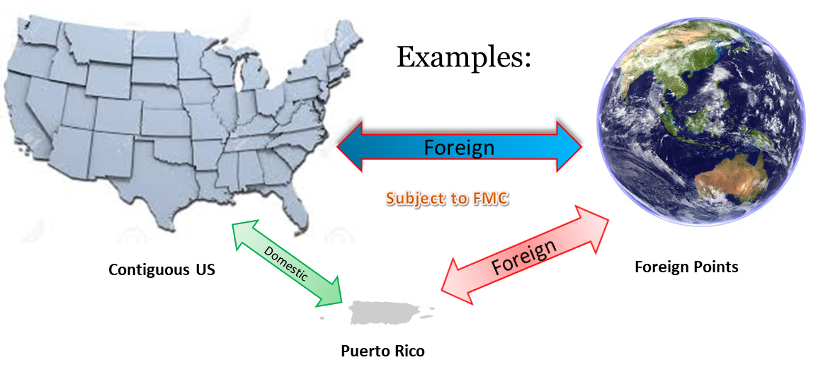
Federal Maritime Commission (“FMC”) Oversight
Practically, What Does This Mean?
  Any shipment to/from the United States and a foreign point is subject to FMC requirements.
  “United States” includes all U.S. commonwealths, territories, and possessions.

Slide 4
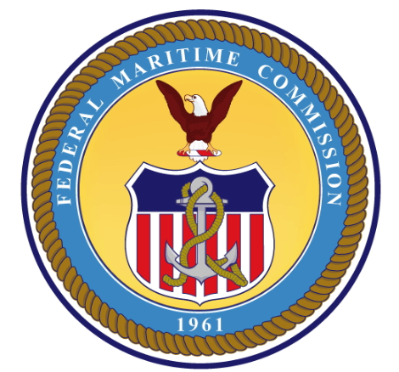
Applicable Statutes and Regulations
Shipping Act of 1984, as amended.
  Amended in 1998 (Ocean Shipping Reform Act of 1998).
      Confidential Service Contracts.
      Effectively ended the decades-long Carrier Conference System (collective rate-setting).
  Amended in 2022 (Ocean Shipping Reform Act of 2022).
      Provides for “Charge Complaints” and a host of new rulemakings.
      Prohibits certain carrier practices (e.g., vessel space accommodation, assessing charges, invoicing for detention and/or demurrage).
      Detention and/or demurrage invoicing requirements.
  Key prohibited activities:
      Providing services not in accordance with the tariff or non-tariff rate vehicle.
      Illegal access to service contract rates.
      Providing services for the account of an unlicensed/unregistered entity.
FMC is the Enforcer of the Law and Rules
© 2024 / Confidential / Slide 4

Slide 5
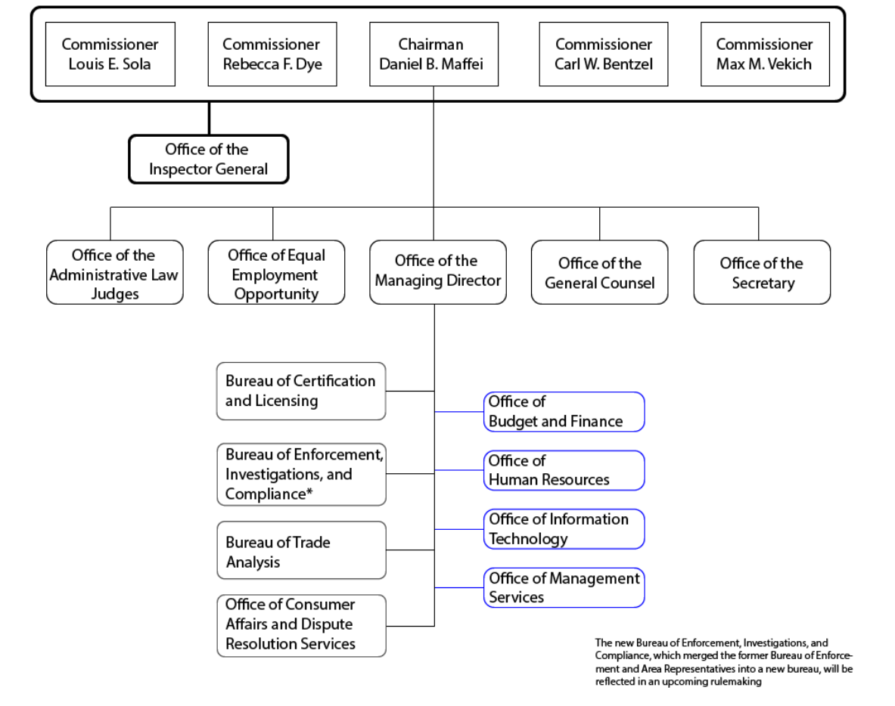
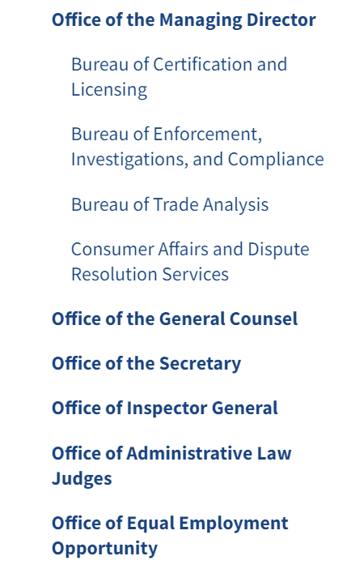
A “New” FMC

Slide 6
Key FMC Rules for NVOs
NVOCCs must:
  Be licensed (or registered) with the FMC and maintain an FMC bond.
  Publish a Rules Tariff at a minimum.
  Rate Rules:
      Ensure all rates, surcharges, accessorial, and any other fees must be published in the NVOCC’s tariff or contained in a non-tariff rate vehicle (NSA or NRA).
      Ensure the applicable rate vehicle is in place prior to receipt of cargo.
      Ensure that the customer is invoiced the exact amounts agreed to in the applicable rate vehicle.
  Include NVOCC name and license/registration number on all shipping documents.
  Maintain records for 5-years.
  Exercise care when working with agents (both affiliated and unaffiliated).

Slide 7
What NVOCCs Must NOT DO?
Allow unlicensed/unregistered third parties to use their licenses or registrations.
Provide services to or for the account of any unlicensed/unregistered NVOCCs.
Provide service not in accordance with the NOVCC’s tariff or non-tariff rate vehicle.
Assess charges inconsistent with or otherwise noncompliant with the Shipping Act and FMC regulations.
Invoice customers for demurrage and/or detention without the required data points on the invoices.
Engage in any unfair, retaliatory, or discriminatory conduct with respect to the treatment of shippers, commodity groups, or shipment types.
Allow any unauthorized party to access their service contract rates with an underlying VOCC.
Obtain or attempt to obtain transportation at less than the applicable rates.

Slide 8
Recordkeeping
All shipment records must be maintained for a period of 5 years.
Key documents include:
    Master bills of lading.
    House bills of lading.
    Records of payments to VOCCs.
    Invoices to customers.
    Records of payment received from customers.
    NRA and NSA.
    Any other documents associated with the ocean transportation services provided for a shipment to/from the United States.
Records may be subject to inspection and reproduction requests by the FMC. All records produced must be in English or have a certified translation and be promptly produced in response to an FMC request.

Slide 9
HBL Issued by an Agent vs. Your Own HBL
If an agent issues a House Bill of Lading (“HBL”) on behalf of a licensed/registered NVOCC – rather than issuing its own – unintended consequences may follow. The agent’s actions may leave the underlying NVOCC vulnerable to liability, as well as the agent that did not issue its own HBL (thus without protections afforded by its bill of lading terms).
When an NVOCC issues its HBL, it establishes a contractual relationship with the shipper and assumes carrier liability for the cargo.
This also allows the NVOCC to apply specific terms, such as liability limitations and defined claims procedures. This way, any claims by the cargo owner will be governed by the terms the NVOCC sets, rather than leaving it to a third party’s contract or general law.
If the NVOCC needs to use an agent’s HBL, ensure there is a formal, written Agency Agreement in place.
The Agreement should define each party’s roles and liability and include indemnification for claims arising from the agent’s HBL.

Slide 10
Inadequate Vetting of Carriers
NVOCCs rely on VOCCs/other common carriers (i.e., consolidators) to perform transport and handling of cargo. Inadequate vetting of carriers can expose the NVOCC to significant liability and may even breach due diligence obligations they owe to their customers. Key risks include:
    Liability for loss or damage to the cargo.
    Lack of due diligence (failing to vet a carrier may be considered negligence).
    Regulatory violations (using unlicensed or non-compliant partners can put NVOCCs at risk of regulatory trouble).
Mitigation Tips:
    Establish a formal vetting process for any third-party carrier.
    Maintain a file for each carrier, containing up-to-date confirmation of FMC qualification and relevant documents.
    Ensure third-party carriers carry adequate insurance.
    Before engaging a third-party carrier, conduct a certain degree of commercial due diligence.
    Vetting is not a one-and-done task. Set a schedule to update the third-party carrier’s documents and evaluate its performance.

Slide 11
Insufficient Cargo Insurance and Liability Coverage
Having inadequate insurance—or misinterpreting the coverage in place—can leave NVOCCs vulnerable in the event of loss, damage, or a claim. This can happen in a few ways:
    Under-coverage of cargo value.
    Cargo insurance policies do not cover every scenario.
    Other uninsured liabilities (i.e., beyond cargo damage, NVOCCs have other exposures, such as errors in documents, release of cargo without proper authorization, fines, or contractual liabilities).
Mitigation Tips:
    Carry adequate NVOCC liability insurance tailored to your operations.
    Ensure coverage limits match potential exposure.
    Understand policy exclusions.
        Common exclusions, such as war, strikes, riots, or civil commotion, may be added via endorsement for an additional premium.
    Regularly reassess the coverage.

Slide 12
International Trade Regulations
NVOCCs, as facilitators of cargo movement, can inadvertently run afoul of laws related to sanctions, customs compliance, and export controls.
Common misunderstandings or oversights in this area include considering compliance is “the shipper’s problem” or being unaware of evolving rules. Regulators increasingly hold logistics providers responsible for facilitating illegal shipments.
Key areas of concern include:
    Sanctions and restricted trade.
    Export controls.
    Customs and import regulations.
Mitigation Tips:
    Stay updated on regulations.
    Incorporate compliance clauses in contracts.
    Monitor shipments for red flags.
    Consult legal counsel when unsure.

Slide 13
FMC Penalties
FMC Investigation and Press Release
The FMC can investigate any conduct potentially in violation of the Shipping Act.
Published written report of investigation and press release of penalties.
Typically, reported on by the shipping-related media
Monetary Penalties
Monetary penalty for violations of the Shipping Act and FMC regulations.
Max is $14,988 per violation or $74,943 per knowing and willful violation.
Each bill of lading or shipment processed is considered a separate violation.
Refund Orders
FMC may impose a refund order for violations of the Shipping Act in addition to, or in lieu of, a monetary penalty.
License/ Registration Revocation
Finally, in egregious cases or cases of repetitive violations, the FMC may revoke or suspend a NVOCC license/registration.

Slide 14
FMC: Significant Increase in Enforcement
FMC’s Bureau of Enforcement, Investigations, and Compliance (“BEIC”) prioritizes investigating possible misconduct by common carriers or marine terminal operators that impacts the industry or causes market distortion.
Enforcement Statistics (as of September 30, 2024):
  602: Charge complaints Received.
  300: Perfected/assigned for investigation.
  208: Resolved by carrier.
  41: No evidence of violation
  29: Closed (e.g., no invoice, not appropriate for charge complaint, closed per complainant request, not enough information provided by the complainant).
  1: Order to show cause issued.
  Total charged refunded/waived thus far = $3,282,928.77.
Enforcement Priorities in 2025:
  Demurrage and detention billing requirements.
    $2 million (Hapag Lloyd).
    $1.7 million (Ocean Network Express).
    $950,000 (Wan Hai Lines).
  Unjust practices.
    A proposed $63+ million action against MSC, potentially the largest penalty to date.
  Use of agents/dealing with unlicensed entities.
    2 NVOCCs recently settled with FMC regarding alleged violations.
  Use of volume incentive discounts.
  Service contract rate access.
  Unreasonable refusals to deal or negotiate.

Slide 15
Questions?

