Slide 1
NCBFAA NVOCC Day 2025 Rules Tariffs – What NVOCCs Should Know
Ashley Craig, Venable LLP & NCBFAA Transportation Committee Counsel
Kim Calicott, Mallory Alexander Internationall Logistics, NCBFAA Transportation Committee Chair

Slide 2
Introduction
Welcome and Objectives
Clarify the purpose of a rules tariff
Understand regulatory requirements under 46 CFR § 520.4
Connect compliance to daily operations
Notes:
Kim

Slide 3
What is a Rules Tariff?
Definition: 46 CFR 532.3(c) “Rules tariff” means a tariff or the portion of a tariff, as defined by 46 CFR 520.2, containing the terms and conditions governing the charges, classifications, rules, regulations and practices of an NVOCC, but does not include a rate
Purpose: It outlines rules, regulations, and practices, but not the specific rates, that govern the transportation services of an NVOCC, acting as a comprehensive document that defines how it operates.
Applicability: Required for all common carriers, including NVOCCs
Rules tariff must be availible to the public free of charge prior to entering into an Negotiated Service Arrangement (NSA) or Negotiated Rate Arrangement (NRA)
Notes:
Confusion on use of “tariff” in regs

Slide 4
Contents of a Rules Tariff
Authority is in Federal Maritime Commission (FMC) regulations, including 46 CFR § 520
Organizational Information
Include FMC License information, contact information, bond information, etc.
Application Rule
Tariff number, effective date, and other header details
Specify if NRA and NSA will be issued in lieu of rate filings and how the rules apply to shipments
Scope Rule
Define geographic locations of operations, commodity scope, and services provides
Bill of Lading Terms
Incorporation of standard contract terms
Notes:
Melzie-Kim
- Scope can be listed generally: covers cargo moving from all U.S. ports to foreign ports…except those deemed as high risk by the carrier and restricted by applicable regulatory agency.
- Verify that BL terms are harmonized with rules tariff

Slide 5
Contents of a Rules Tariff
Charges and Accessorial
Rules on surcharges, accessorial fees/categories, and special charges
Freight forwarder compensation
Liability and Claims
Limits of liability and procedures for loss/damage claim
Documentation Requirements
Cargo Acceptance/Refusal
Conditions under which cargo may be refused
Time/Volume Rates (if applicable)
Special contract rates and their eligibility terms
Definitions of terms
Notes:
Melzie-Kim

Slide 6
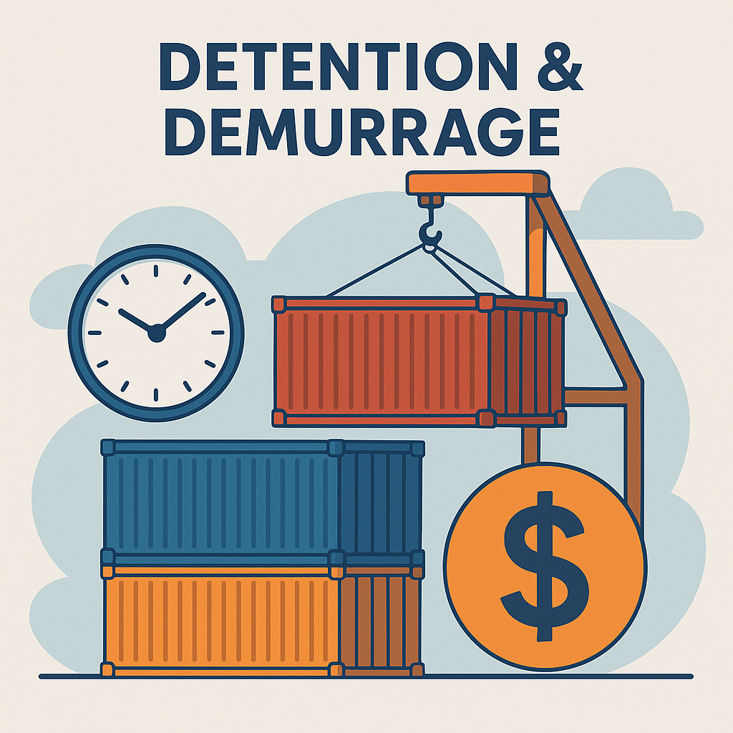
Contents of a Rules Tariff – Recent Changes
Pass through fees and surcharges
Detention & Demurrage
Advancing of fees
Notes:
Melzie-Kim
Pass throughs – how to account for them in the tariff, does the tariff need to link to all underlying carrier tariffs?
- need wording to convey that charges passed through are beyond control of carrier.

Slide 7
Rules Tariff Optional Contents
Cargo Diversion by Shipper or Consignee
Safety of Life At Sea (SOLAS)
Requirements related to the SOLAS Verified Gross Mass (VGM)
Dispute resolution process
Reference to USTR Section 301 actions on Chinese built/operated vessels
Notes:
Ashley

Slide 8
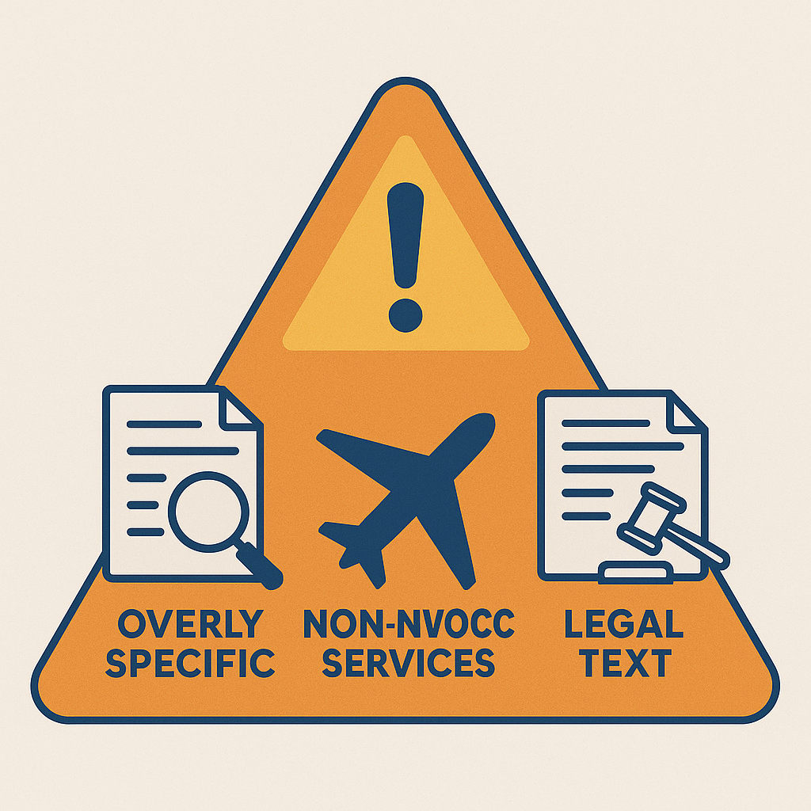
Risks in Provisions
Too specific
Including all in rates
Listing terms for non-NVOCC services (e.g., air)
Usage of complicated language
Notes:
Ashley

Slide 9
Updating Rules Tariff
Rules tariffs are living documents which are maintained
Previous versions must remain published online for two years, then electronically retained three years
Effective date of revision
When to amend, expire, completely re-do a tariff provision
Notes:
Kim - ask Ashley about amend, expire…

Slide 10
Why It Matters to Operations-Pricing
Guides how NVOs:
Accept/reject cargo
Issue documentation
Apply charges
Protects companies legally
Ensures consistent practices
Notes:
Kim/Melzie

Slide 11
Operational Examples
Rules tariffs are used when:
Booking cargo with special handling instructions
Denying cargo for improper packing
Quoting surcharges or accessorials
Notes:
Kim/Melzie

Slide 12
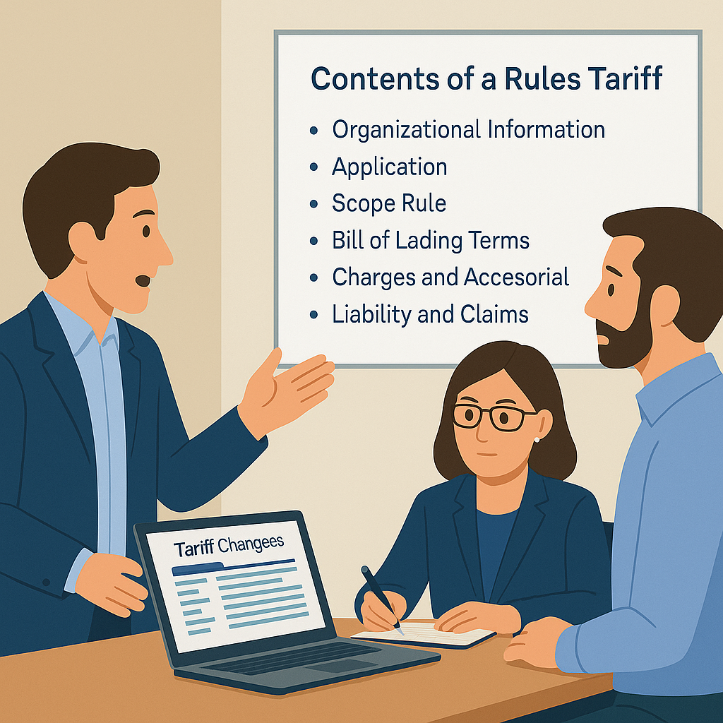
Best Practices for NVOCC Staff
Know where to find the rules tariff
Follow published provisions
Communicate clearly with customers
Flag outdated or unclear rules to Compliance
Notes:
Kim to ask Ashley for real world example of where lack of understanding the rules tariff led to legal/liability issue…

Slide 13
Compliance & FMC Enforcement
FMC audits and monitors published tariffs
Penalties and other consequences for non-compliance:
Civil fines
Suspension of NVOCC registration
Non-payment of invoices
Charge Complaints
Reputational harm – public attention to enforcement from FMC
Notes:
Ashley

Slide 14
Summary & Next Steps
Rules tariffs are essential to legal, commercial, and operational success
Living document
Training and education
Review and reference tariffs regularly
Ask questions when unsure – escalate questions and concerns internally
Notes:
Kim
- Review your rules tariff
- Ask person responsible if it is up to date

Slide 15
