Slide 1
NVOCC/Ocean Industry Advocacy
May 22, 2025
Copyright © Sandler, Travis & Rosenberg, P.A. | www.strtrade.com | All rights reserved.
Notes:
3:10 PM – 4:00 PM: NVOCC/Ocean Industry Advocacy – The Hill Initiatives
Political decisions and evolving legislation can reshape the maritime industry, directly influencing compliance, operational efficiency, and market competitiveness. This session will explore potential updates to the Ocean Shipping Reform Act (OSRA), including tighter detention and demurrage billing rules, enhanced data transparency requirements, and their implications for NVOCCs. Attendees will gain insights into how these changes can streamline operations, protect shipper interests, and reduce compliance risks. Additionally, we’ll discuss broader regulatory developments like USTR Section 301 actions, advocacy efforts in Washington, D.C., which could significantly impact, how NVOCCs operate, the fees they incur, and their overall regulatory landscape. Join us for practical guidance on staying ahead of these shifts, leveraging new requirements for competitive advantage, and preparing for the next wave of regulatory change.

Slide 2
Timeline
March 17, 2024: Ocean Shipping Reform Implementation Act of 2023 - passes House…
April 22, 2024: USTR initiates Section 301 China Shipbuilding Investigation
February 7, 2024: FMC hearing re: Merchant Shipping in the Red Sea
---
March 2025: FMC Global Maritime Chokepoints Investigation
April 17, 2025: USTR Section 301 China Shipbuilding Actions
May 21, 2025: The “Big Beautiful Bill” – passed House 215-214

Slide 3
Ocean Shipping Reform Implementation Act of 2023 (OSRA 2.0)
Introduced by: Congressmen Dusty Johnson (R-SD) and John Garamendi (D-CA)
Passed the House: 393 – 24 in 2024. Not yet reintroduced.
Purpose: To protect U.S. ports and shippers from “China’s unfair shipping practices.”
Prohibits U.S. ports from using LOGINK or any similar Chinese state-affiliated software;
Allows the FMC to investigate foreign shipping exchanges to preempt improper business practices;
Authorizes the FMC to streamline data standards for maritime freight logistics; and
Establishes an industry advisory committee to be made up of members from marine terminal operators and port authorities
Notes:
Johnson, Garamendi’s Ocean Shipping Reform 2.0 Passes U.S. House | Representative Dusty Johnson

Slide 4
Reminder: context for OSRA
OSRA (2022)
Supply chain disruptions (post-COVID)
Excessive detention and demurrage fees
Consolidated market power of ocean carriers
Empower the Federal Maritime Commission to exercise greater regulatory oversight
Rebalance shipping services for exporters
Global trade pressures

Slide 5
Context for OSRA 2.0 (2025)
OSRA Improvements:
More consistent enforcement/addressing backlog of complaints.
Billing reforms w/ greater transparency (e.g. time stamps).
Steamship line documentation requirements
Possible chassis shortage risk
Global volatility – risk of vessel bunching
Terminal fee enforcement (shorter free time, no grace periods, increased documentation burden)

Slide 6
Trump II Agenda and OSRA 2.0
Supply chain disruptions (response to tariffs)
US-China relations
Addressing “unfair trade”
Promoting U.S. exports (filling containers -> Asia)
Border protection/drug interdiction
Other policies: FMC chokepoints investigation, China Shipbuilding 301
Is OSRA 2.0 OBE…?

Slide 7
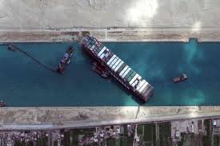
FMC Global Maritime Chokepoint Investigation
The FMC launched an investigation into transit constraints at international maritime chokepoints which have created unfavorable shipping conditions.
Notes:
The FMC notice suggests that any such measures (for the CBP measures) would primarily affect vessels registered under Panama’s flag of which there are currently more than 8,000

Slide 8
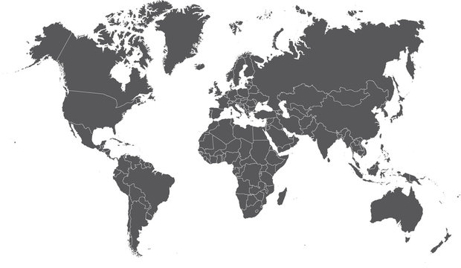
FMC Investigation: Seven Chokepoints
The English Channel,
the Malacca Strait,
the Northern Sea Passage,
the Singapore Strait,
the Panama Canal,
the Strait of Gibraltar, and
the Suez Canal

Slide 9
Actions which may come from the FMC Investigation:
Limitations on Voyages and Cargo: Restrict the number of voyages to and from U.S. ports or limit the amount and type of cargo carried.
Suspension of Tariffs and Service Contracts: Suspend tariffs and service contracts for carriage to or from U.S. ports, including the right of VOCCs to use tariffs from conferences and service contracts from agreements.
Suspension of Operational Rights: Suspend the right of VOCCs to operate under any agreement filed with the FMC, including those that authorize preferential treatment at terminals, preferential terminal leases, space chartering, or pooling of cargo or revenue with other carriers.
Imposition of Fees: Impose fees of up to $1 million per voyage.
Customs and Border Protection and Coast Guard Actions: Direct U.S. Customs and Border Protection to refuse clearance to vessels from named countries and direct the Coast Guard to deny entry of such vessels to U.S. ports for ocean borne trade, and to detain vessels about to depart for another U.S. port.
Notes:
Limitations on Voyages and Cargo: Restrict the number of voyages to and from U.S. ports or limit the amount and type of cargo carried.
Suspension of Tariffs and Service Contracts: Suspend tariffs and service contracts for carriage to or from U.S. ports, including the right of ocean common carriers to use tariffs from conferences and service contracts from agreements.
Suspension of Operational Rights: Suspend the right of ocean common carriers to operate under any agreement filed with the FMC, including those that authorize preferential treatment at terminals, preferential terminal leases, space chartering, or pooling of cargo or revenue with other carriers.
Fees: Impose fees of up to $1 million per voyage.
Customs and Border Protection and Coast Guard Actions: Direct U.S. Customs and Border Protection to refuse clearance to vessels from named countries and direct the Coast Guard to deny entry of such vessels to U.S. ports for ocean borne trade, and to detain vessels about to depart for another U.S. port.
The FMC notice suggests that any such measures (for the CBP measures) would primarily affect vessels registered under Panama’s flag of which there are currently more than 8,000

Slide 10
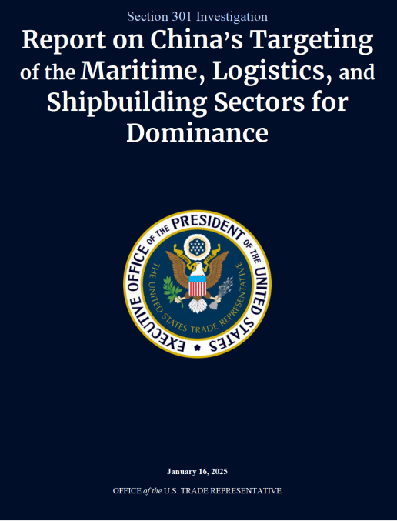
USTR Section 301 Shipbuilding Investigation
USTR began investigating market abuses in the shipbuilding and maritime sector by the Chinese government under the Biden administration and recently issued its final Section 301 Actions in the China Shipbuilding Investigation.
These actions were scaled back compared to the original proposed action
Notes:
Transportation and Infrastructure Committee Chairman Sam Graves (R-MO) and Coast Guard and Maritime Transportation Subcommittee Chairman Mike Ezell (R-MS) applauded President Trump following his April 9th executive order to strengthen the United States’ shipbuilding industry, enable the nation to be more competitive with China in maritime transportation, and bolster our national security.

Slide 11
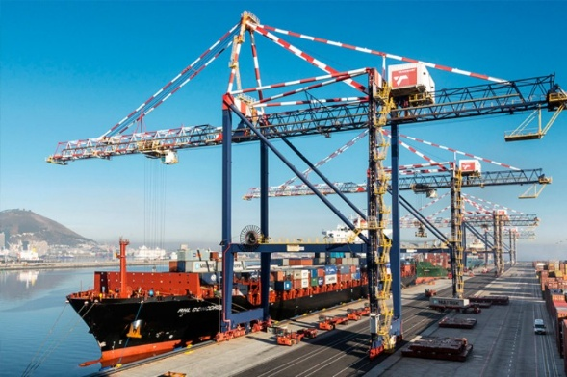
China Shipbuilding – New Proposed Tariffs
20% to 100% tariff on China-origin containers, chassis, and chassis parts
100% tariff on ship-to-shore cranes that are manufactured, assembled, or made using components of Chinese origin, or manufactured anywhere in the world by a company owned, controlled, or substantially influenced by a Chinese national.
Tariffs are in addition to other applicable duties

Slide 12
China Shipbuilding – Fees
Shipbuilding fees starting October 14, 2025 (lower than initially proposed)
Chinese operated or owned: $50 per net ton against any vessel, increasing by $30 annually over the next three years.
Chinese-built vessels: the higher of (i) $18 per net ton or (ii) $120 per container, increasing incrementally over the next three years.
Foreign vessels: $150 per Car Equivalent Unit (CEU) capacity
Fee charged on or before entry at first U.S. port
Max Fee: 5 times per year on a single vessel
Require use of U.S. vessels for the maritime transport of a certain percentage of LNG exports, starting at 1% on April 17, 2028, and increasing incrementally over the next 19 years (to 15% in 2047).
Note: fees and requirements are not cumulative. A vessel will be subject either to (a) one of the three fees; or (b) the requirement for LNG exports

Slide 13
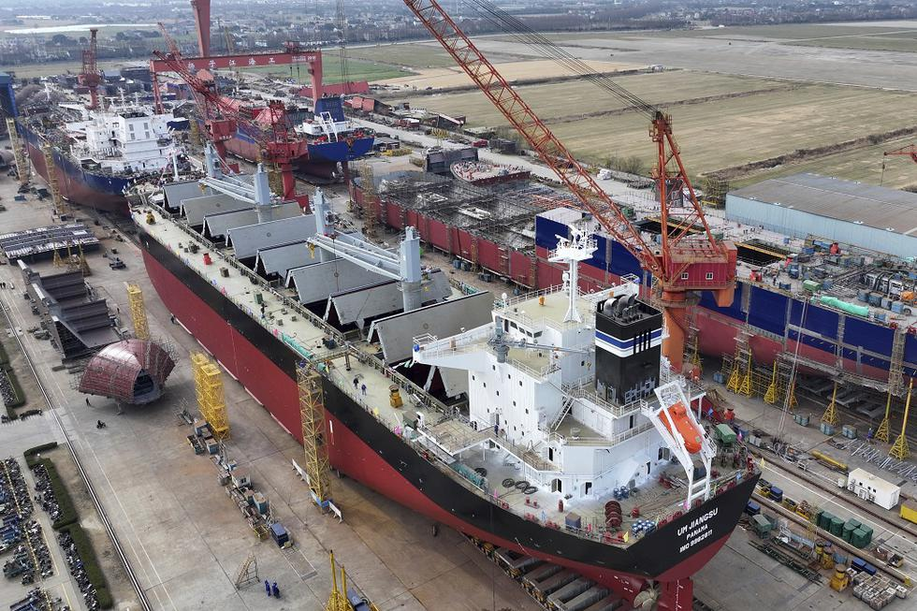
China Shipbuilding – Fees
EXEMPTION: Vessels engaged in short sea shipping (i.e. voyages of less than 2,000 nautical miles from certain U.S. ports)
Don’t know which ports are “certain U.S. ports”
All of Central America and the Caribbean is included
Colombia, Venezuela, Guyana, Suriname, possibly northern Brazil and Ecuador

Slide 14
The Big Beautiful Bill & Shipbuilding
On May 18th, the House Budget Committee voted to approve the “Big Beautiful Bill” which included nearly $32 billion for the “enhancement of Department of Defense Resources for Shipbuilding”
More than $4 billion for the shipbuilding industrial base
Nearly $16 billion for ship procurement and development
Including $100 million for the procurement of commercial logistics ships
More than $5 billion for unmanned and autonomous systems
Nearly $6 billion for specific ship classes
$742 million for training and techniques
Notes:
$4.295 Billion for the Shipbuilding Industrial Base
$250 million for US production of turbine generators for shipbuilding industrial base
$450 million for US additive manufacturing for wire production and machining capacity for shipbuilding industrial base
$85 million for US-made steel plate for shipbuilding industrial base
$50 million for machining capacity for naval propellers for shipbuilding industrial base
$110 million for rolled steel and fabrication facility for shipbuilding industrial base
$400 million for expansion of collaborative campus for naval shipbuilding
$450 million for application of autonomy and artificial intelligence to naval shipbuilding
$500 million for the adoption of advanced manufacturing techniques in the maritime industrial base
$50 million for the expansion of cold 22 spray repair technologies
$450 million for additional maritime industrial workforce development programs
$750 million for additional supplier development across the naval shipbuilding industrial base
$250 million for additional advanced manufacturing processes across the naval shipbuilding industrial base
$15,891 Billion for Ship Procurement and Development
$4.6 billion for a second Virginia-class submarine in fiscal year 2027
$5.4 billion for two additional Guided Missile Destroyer (DDG) ships
$160 million for advanced procurement for Landing Ship Medium
$1.8 billion for procurement of Landing Ship Medium
$295 million for development of a second Landing Craft Utility shipyard and production of additional Landing Craft Utility
$100 million for the procurement of commercial logistics ships
$600 million for the lease or purchase of new ships through the National Defense Sealift Fund
$2.725 billion for the procurement of AO oilers
$500 million for cost-to-complete for rescue and salvage ships
$300 million for production of ship-to-shore connectors
$695 million for the implementation of a multi-ship amphibious warship contract
$80 million for accelerated development of vertical launch system reloading at sea
$250 million for expansion of Navy corrosion control programs
$159 million for leasing of ships for Marine Corps operations
$5,246.36 Billion Unmanned and Autonomous Systems
$1.534 billion for expansion of small unmanned surface vessel production
$1.8 billion for expansion of medium unmanned surface vessel production
$1.3 billion for expansion of unmanned underwater vehicle production
$188.36 million for the development and testing of maritime robotic autonomous systems and enabling technologies
$174 million for the development of a Test Resource Management Center robotic autonomous systems proving ground
$250 million for the development, production, and integration of wave-powered unmanned underwater vehicles
$5.8 Billion for Specific Ship Classes
$2.1 billion for San Antonio-class Amphibious Transport Dock (LPD)
$3.7 billion for America-class Amphibious Assault Ship (LHA)
$742 million for Training and Techniques
$250 million for the expansion of the accelerated Training in Defense Manufacturing program
$492 million for next-generation shipbuilding techniques

Slide 15
Key Takeaways:
Reduce compliance risk by:
Carefully following all requirements for invoicing to reduce irrecuperable fees
Ensuring compatibility with non-Chinese SOE software
Maintaining compliance with key markets regulatory requirements globally to avoid being subject to investigations
Proactively engage with regulatory changes by:
Agency-level: Keep track of agency investigations and submit comments when possible
Congressional-level: Ensure that Congress hears from your industry when considering legislation

Slide 16
Thank you!
Questions?

