Slide 1
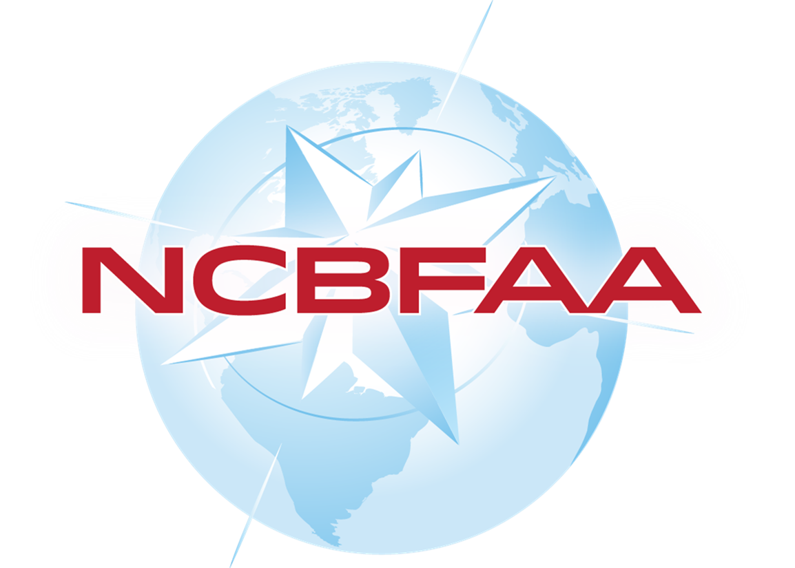

NRA & NSA Process
Rich Roche
NVOCC Sub-Committee Chair
Senior Vice President, Mohawk Global
Effective Date: August 22, 2018

Slide 2




NRA = Negotiated Rate Arrangement
NRA Features & Benefits:
  Simplified process adopted by FMC to promote trade
  Eliminates requirement to file a rate tariff
  Eliminates filing costs
  Does not need 30 days’ notice to increase rate - just a new NRA
  Easier record keeping and compliance
  New: can include non-rate economic terms like credit, MQC, demurrage, detention, per diem, free time, waiting time, penalties or incentives, service standards, EDI services, and pass-through clause to address surcharges and/or GRIs.
  Note: New FMC regulations went into effect on 8/22/2018
PART 532—NVOCC NEGOTIATED RATE ARRANGEMENTS Authority: 46 U.S.C. 40103. Source: 76 FR 11360, Eff. March 2, 2011

Slide 3

NSA = NVOCC Service Arrangement
Used when a more formal rate structure is required for / by a client.
Full-bodied contract that lays out rules of engagement, rates, MQC, penalty clause, and non-shipping logistical services like customs, warehousing, and other value-add.
Requires signature of both parties
New: Electronic filing in FMC Servcon system is no longer required for NVOCCs
New: No longer requires NVOCC to provide 30-days advance filing for rate increases
New: Essential Terms no longer need to published
PART 531—NVOCC SERVICE ARRANGEMENTS Authority: 46 U.S.C. 40103 Source: 69 FR 75853, Effective date: May 1, 2005

Slide 4

NRA USAGE ?
Total Licensed or Registered NVOCCs: About 8700
Total NRA declared users: About 3800
__________________________________________
44 %
Stats per FMC: May 2025

Slide 5

FMC Requires NRA Rate Sheet or Quote Must…
  … be in writing (clear and concise language)
  … contain contact, company name & address of NVO & Client
  … contain all applicable rate components. “All in” is acceptable.
  … be retained for 5 years
  … be readily accessible upon request

Slide 6

FMC Requires NRA Rate Sheet or Quote Must…
  … be agreed to by client (New: tendering of cargo after NRA date is now accepted as agreement – particularly if written confirmation was requested - written agreement is still preferred )
  …New: NRA can be amended prior to next cargo received, or new NRA can be written to replace old NRA for next cargo received

Slide 7
Best Practices:
  All shipments require issuance of a rate sheet or quote prior to accepting cargo
    Include both parties’ contact info on all rate documents
      Copy of individual rate quotes should be added to shipment file (or other archived record)
        Ask for agreement from the client in writing and add any response to the shipment file (or archive)
          Rate sheets kept electronically in a centralized location need not be added to shipment file
            All shipping documents to be retained in shipment file (or archive)
              Client to be invoiced at rate shown on rate sheet or quote
                Effective date of rate is based on Gate-In date of cargo (unless different in rules tariff)
  This process collectively defines and memorializes the NRA

Slide 8
Steps to begin using NRAs:
Notify FMC of your intention to use NRAs in lieu of tariffs
Post Rules Tariff on your website or other public domain so it is accessible free of charge
Have prominent statement in your rules tariff that you use NRAs
Add NRA wording to your rate quotes requesting confirmation
OK to eliminate rate tariff & tariff filer if NRAs used for all shipments
Develop a process to quickly retrieve NRAs and retain for 5 years

Slide 9
Questions?

Slide 10
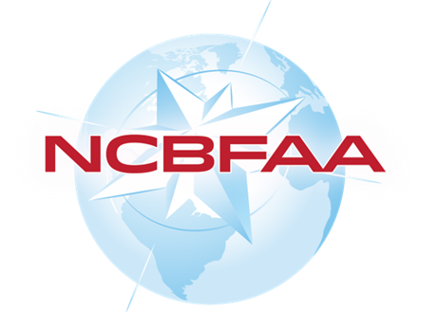

THANK YOU

